Slide 1

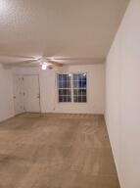
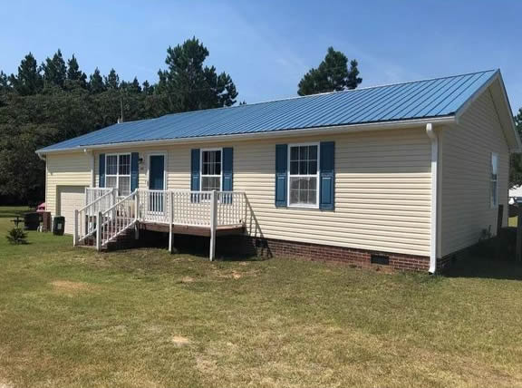
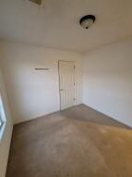
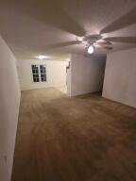
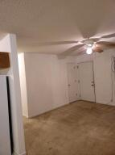
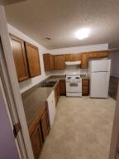
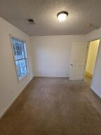
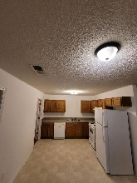
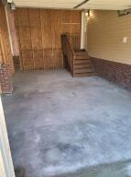
317 Walker Drive
Eutawville, SC 29048 · MLS# 20030420 · $165,000
Home Under $170,000!
Wonderful spacious 3 bed 2 bath home. Make it your home or use it for investment. Newer roof and a large yard. Huge garage could be used as a bonus room. Located not far from the town of Eutawville, Santee and Holly Hill. Near 176. Several business nearby Volvo plant Harleyville and Holcim Cement Plants,. 15 Mins to Lake Marion and the Santee. Well and Septic have been recently tested and are functioning great.
Neil Schneider · 843-200-8902 · neil@charleston.info

