Slide 1
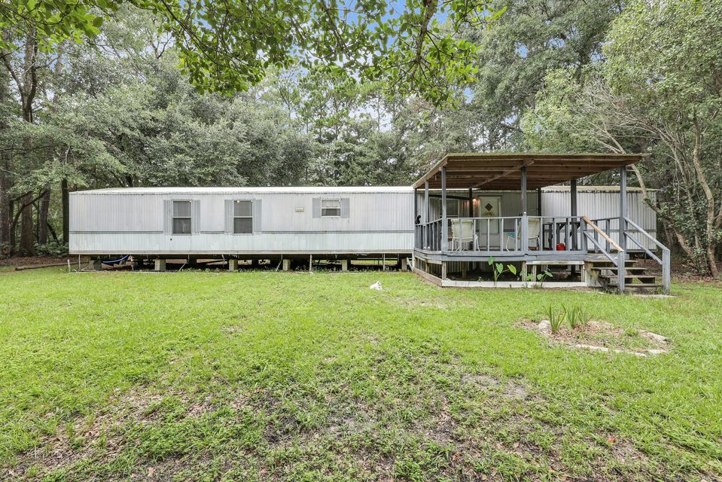
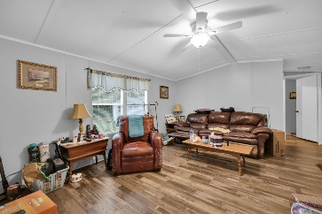
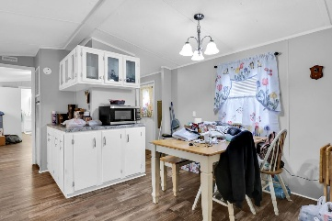
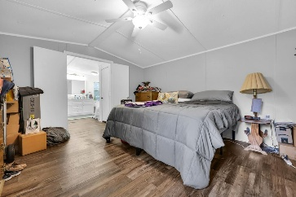
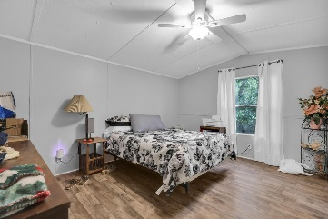
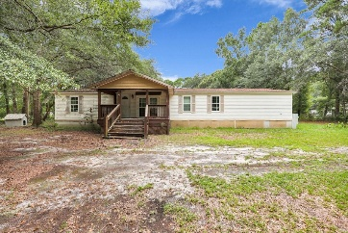
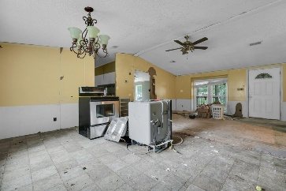
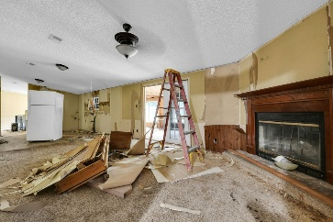
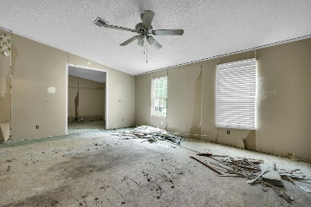



Investor Alert! Two Mobile Homes (One renovated, one gutted!)
317 Lankford Street
Lakewood
Moncks Corner, SC 29461
MLS# 25021472
$275,000
5 Beds | 4 Bath | 2,992 SF
Investor special in a rapidly growing area! Welcome to 317 Lankford Drive, a unique opportunity to own 1.30 acres just 10 minutes from Moncks Corner and 20 minutes from Summerville's expanding shopping and dining corridor. This property features two mobile homes: a livable 2-bedroom, 2-bath single wide (991 sqft) and a completely gutted 3-bedroom, 2-bath double wide with over 2,000 sqft—ready for your renovation vision. There are also three sheds on site, offering ample storage or workspace. This is a great opportunity for a buy-and-hold investor, someone looking to live in one unit while renovating the other, or those seeking cash flow potential in a location with long-term growth upside.
VIRTUAL TOUR (DOUBLE-WIDE) | VIRTUAL TOUR (SINGLE-WIDE)
Nick Mazzilli 843-640-5575
nick@themazzilliteam.com
sellmyhousecharlestonsc.com
The Mazzilli Team
3427 W Montague Ave
Suite 6
North Charleston, SC 29418

