Slide 1
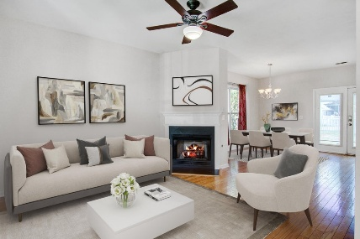
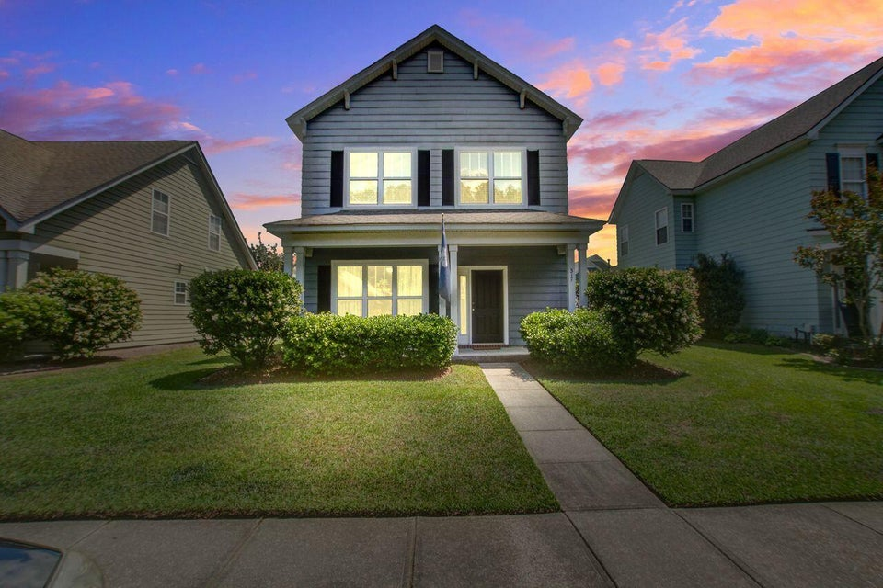
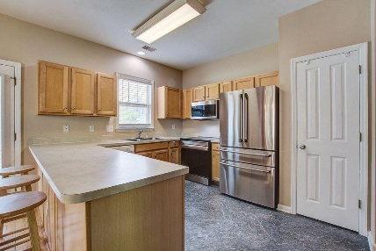
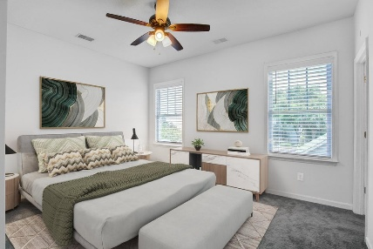
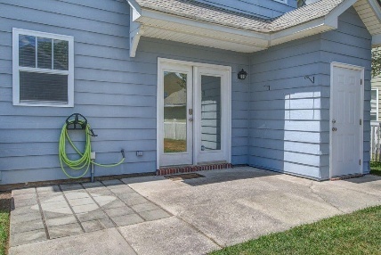
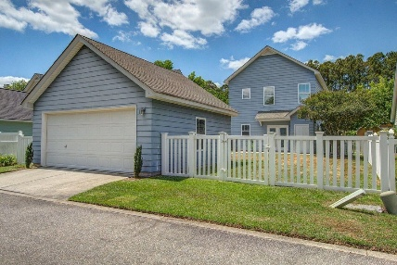
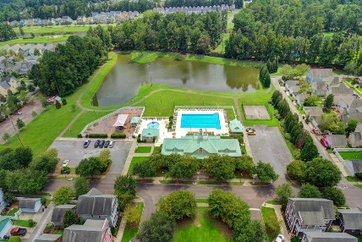
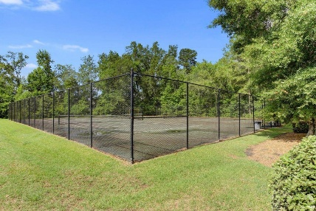


PRICE REDUCED!
Virtually Staged
Virtually Staged
317 Pimpernel Street
White Gables | Summerville, SC 29483 | MLS# 25011926 | $325,000
A Brand New Roof and Hot Water Tank installed! This home has 3-bedrooms, 2.5 baths, fenced back yard, 2 car garage and includes upgrades such as brand new carpet and vinyl flooring. The kitchen is fully outfitted with all new stainless steel appliances—including refrigerator, stove, microwave, washer, and dryer—making daily living a breeze. Whether you're a first-time buyer, relocating, or looking to upsize, this home is a standout value in the desirable Summerville area.
A conveniently located laundry area with a new washer and dryer and a stylish half-bath complete the first floor.
Upstairs, you'll find the spacious primary suite, featuring a relaxing garden tub in the en-suite bath. Two additional bedrooms and a second full bath offer plenty of space for family, guests, or a home office. Fresh carpeting upstairs and new luxury vinyl flooring in the kitchen and bathrooms add modern touches throughout. Outside, enjoy a beautifully landscaped front yard with outstanding curb appeal. The private backyard features a new vinyl fence, a cozy patio perfect for morning coffee or evening BBQs, and a detached 2-car garage for extra storage and parking.
Don't miss the opportunity to make this wonderful home yours! Schedule your showing today!
Cathy Marshall
843-609-5788
cmarshallcatherine@gmail.com
Coldwell Banker Realty
201 Sigma Dr | Ste 120
Summerville, SC 29486

