Slide 1
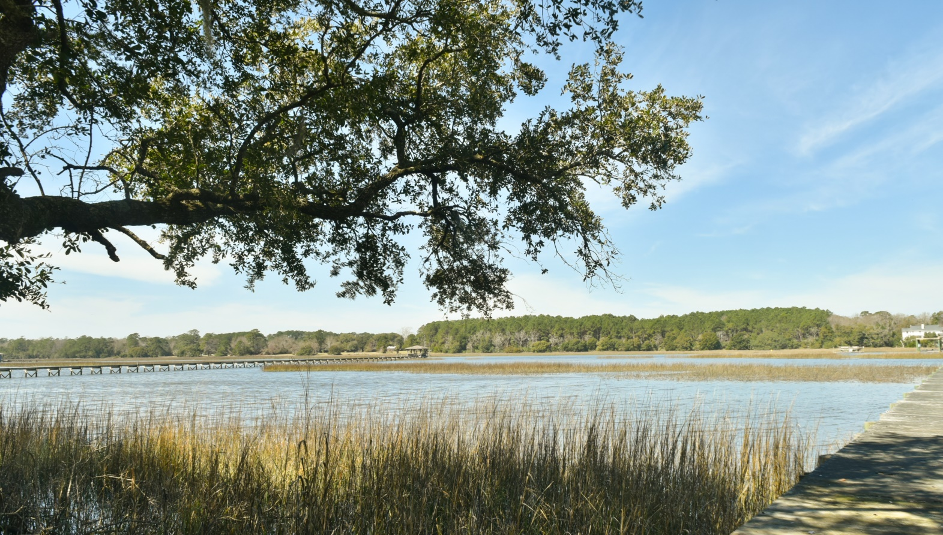
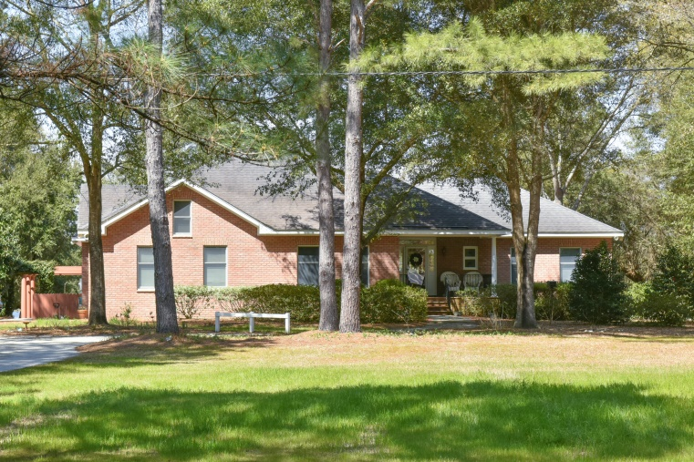
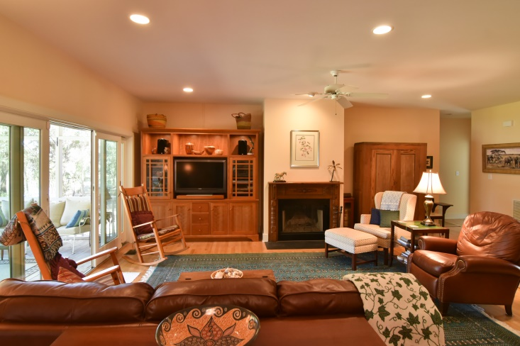



SEA ISLANDS REAL ESTATE
Just Listed!
3188 Bohicket Road ~ Johns Island Deep Water Estate
Exclusive deepwater retreat on Bohicket Creek with westerly views · Deepwater dock with pier head, floater and boat lift that can accommodate a 25’ boat or up to 16,000 pounds · Water depth is 12’8’’ on the inside of the float and 13’4’’ feet on the channel · Lot ~3.43 high acres · House ~ 2,930 square feet · 4 BD/ 3.5 BA · Open floor plan with custom kitchen cabinets and built-ins · Master bath renovation in 2014 · Bluestone patio with pergola · Garage/ workshop on site, 35 x 60
TERRI SEIGNIOUS (843) 670-1444
TERRI@SEAISLANDSGROUP.COM
HUGER SINKLER
(843) 412-3189
HUGER@HFLCHARLESTON.COM

