Slide 1
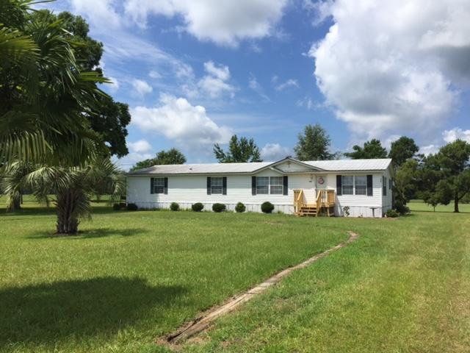
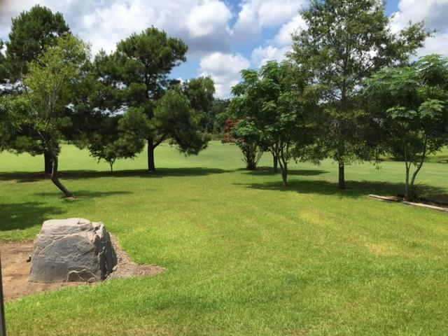
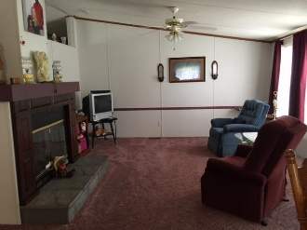
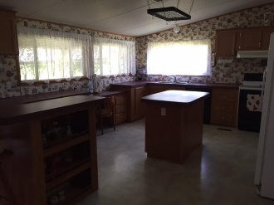
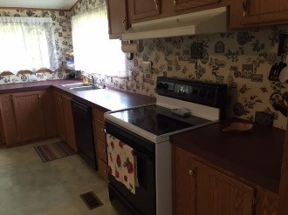
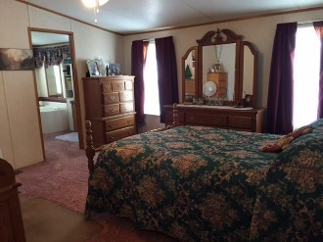
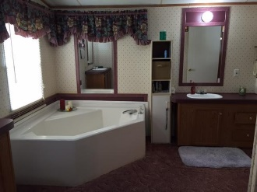
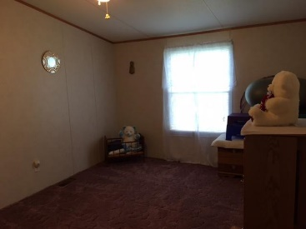
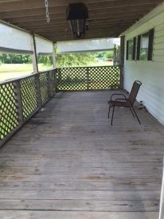
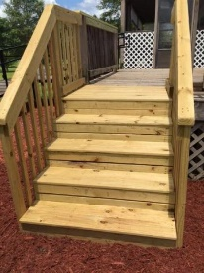
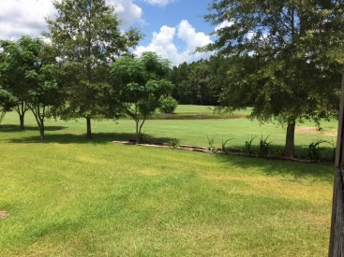
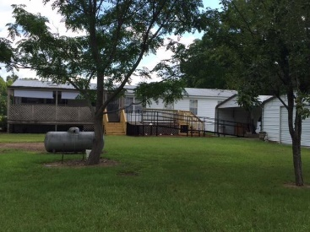

318 Mims Lake Rd
Holly Hill, SC 29059
MLS# 16019221
$95,900
HUGE double wide that has been meticulously maintained!
This property is wheel chair accessible, with a huge shed, 2 car carport, and plenty of room to grow on this 1.3 acre lot with two wells!
Also, if you would like more land there is a 1 acre lot next door (MLS 16019100) to this property that is also for sale!
Carla C Davis
Mobile - (843) 437-4873
gaweber@tds.net
AgentOwned Premiere Group
141 A N. Main Street
Summerville, SC 29483

