Slide 1
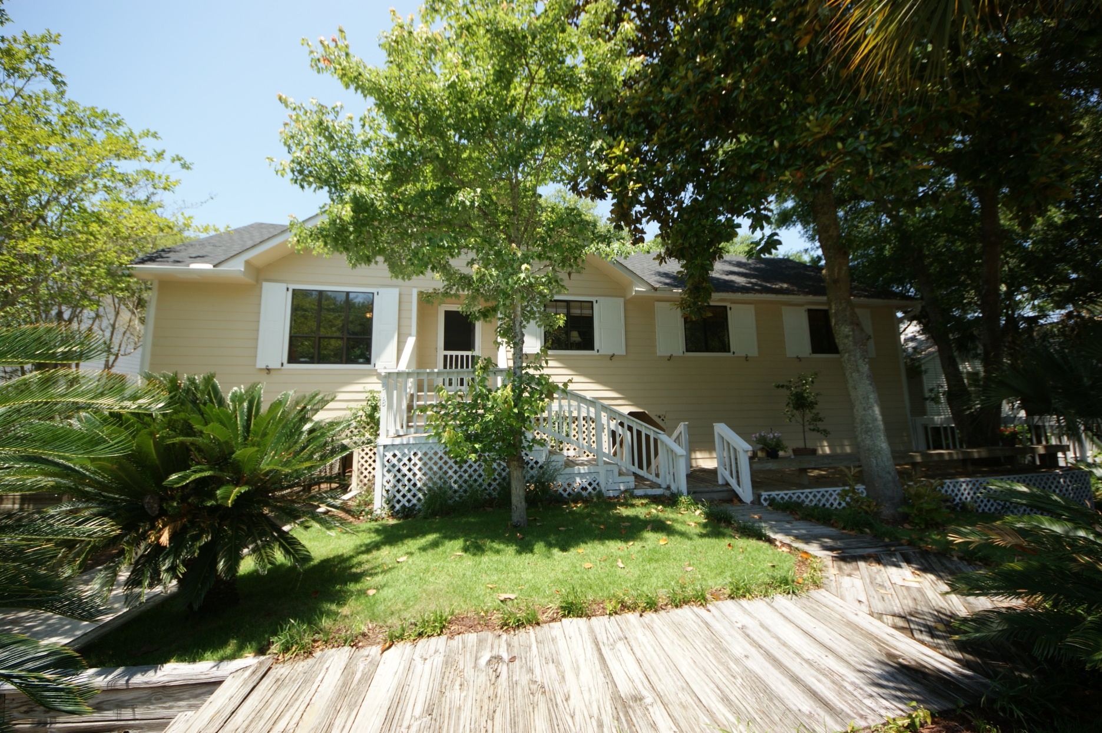
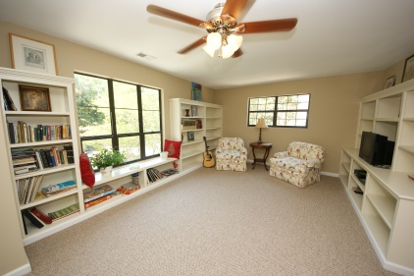
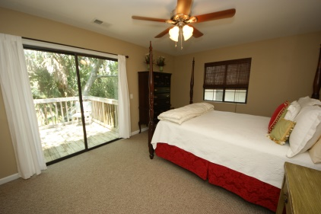
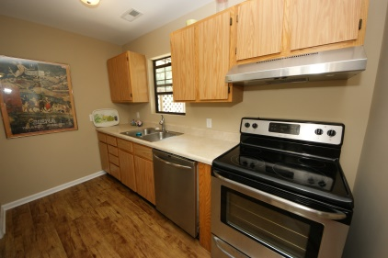
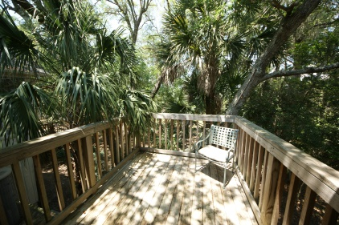
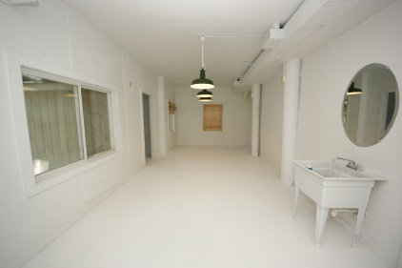
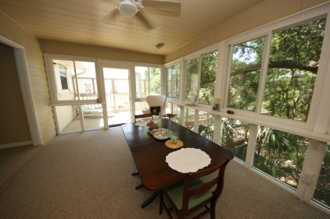


Peaceful Easy Island Living on Folly Beach
318 W Indian Avenue ~ MLS# 15014492 ~ $659,000
Nestled on the tropical Island part of Folly Beach, this Cottage-style elevated home offers a beach experience reminiscent of a Hawaiian vacation, yet you are only 9 miles from Historic Charleston! The Gorgeous Private back yard goes clear to the Marsh of the Folly River and is loaded with Majestic Live Oaks and Palmetto trees! A pool would be wonderful here! Most importantly, it's Just a 3 block stroll to the beach or to Center Street. A perfect primary home or second residence, with its 4 bedrooms and multiple decks around the home. Downstairs contains large finished rooms well-suited for a home office, workout gym, or art studio with its high ceilings! And what everyone wants: A Large workshop/storage space for storing furniture, bikes and surfboards completes this natural wonder be
Handsome Properties, Inc
53 Broad St
Charleston, SC 29401
Ellen Murray
843 813-2006
chaspremierprop@bellsouth.net

