Slide 1
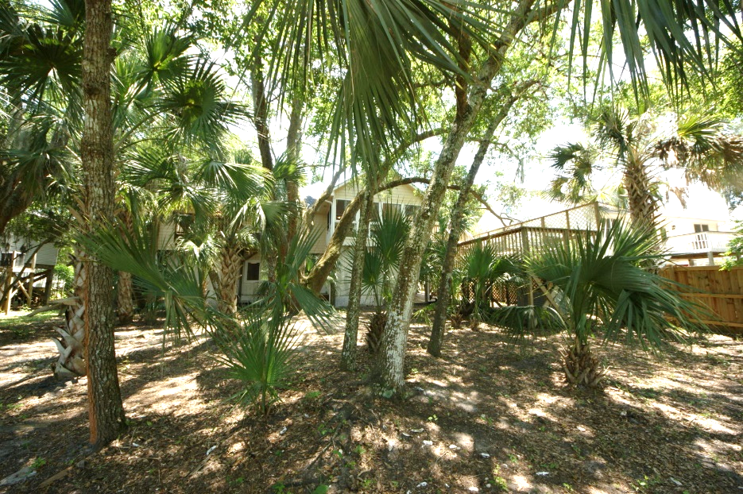
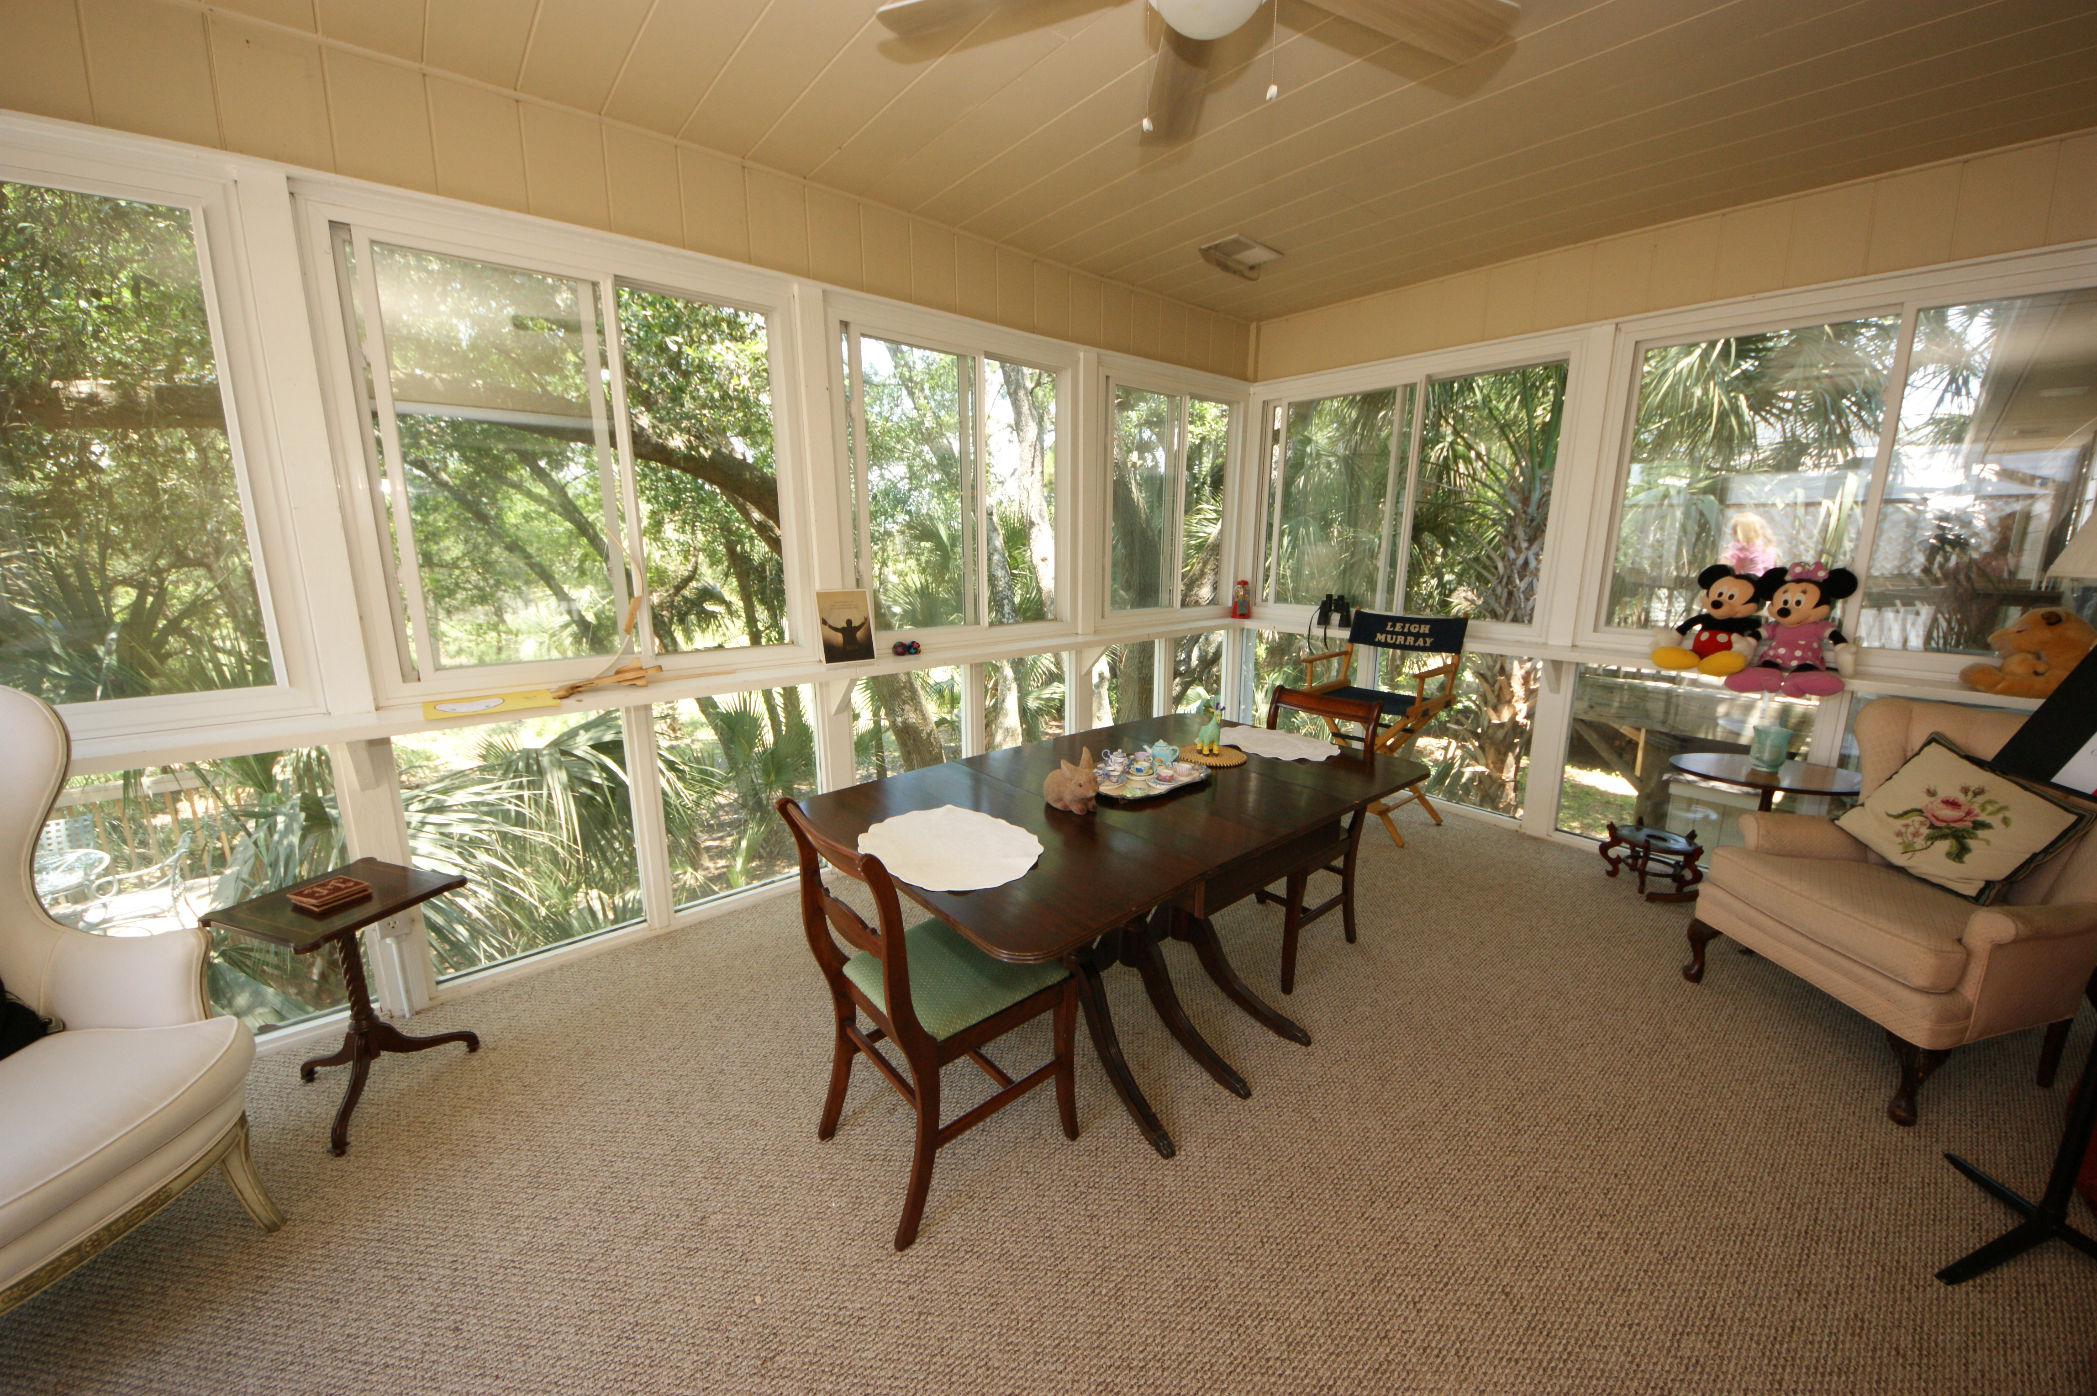
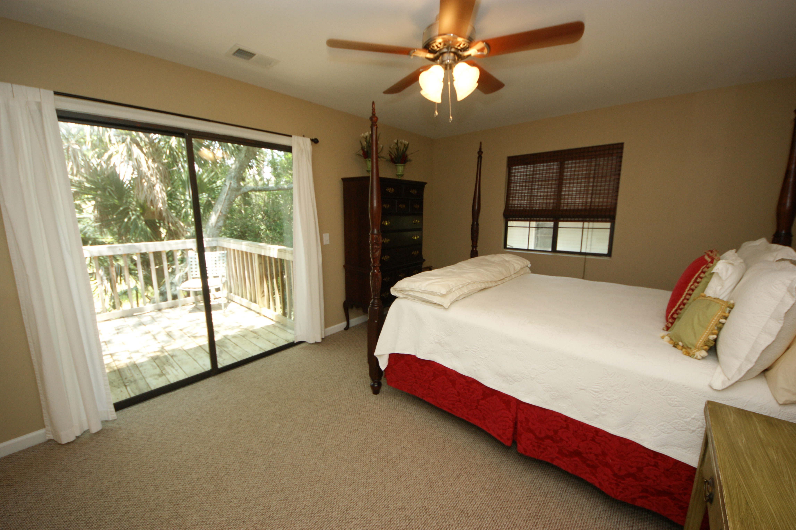
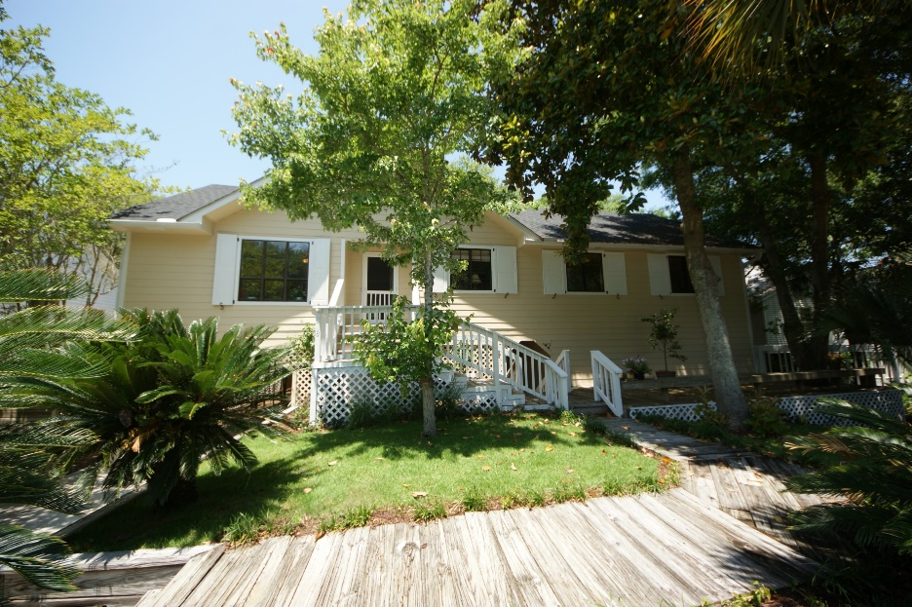


Folly Beach Residence with Great Rental Income!
318 W Indian Avenue ~ MLS# 15019659 ~ $599,000
Located on the tropical island part of folly beach, this cottage-style elevated home offers a beach experience reminiscent of a Hawaiian vacation. The gorgeous private back yard goes clear to the marsh of the Folly River. If you want privacy, this is it!
All newly renovated, the home has 4 decks for entertaining and taking in the natural wildlife. There is a perfect place for a POOL! Downstairs contains large finished rooms well-suited for a HOME OFFICE, ART STUDIO OR PLAYROOM! Also a LARGE WORKSHOP/STORAGE space for storing bikes, kayaks, surfboards and furniture!
Handsome Properties, Inc 53 Broad St Charleston, SC 29401
Ellen Murray
843 813-2006
chaspremierprop@bellsouth.net

