Slide 1
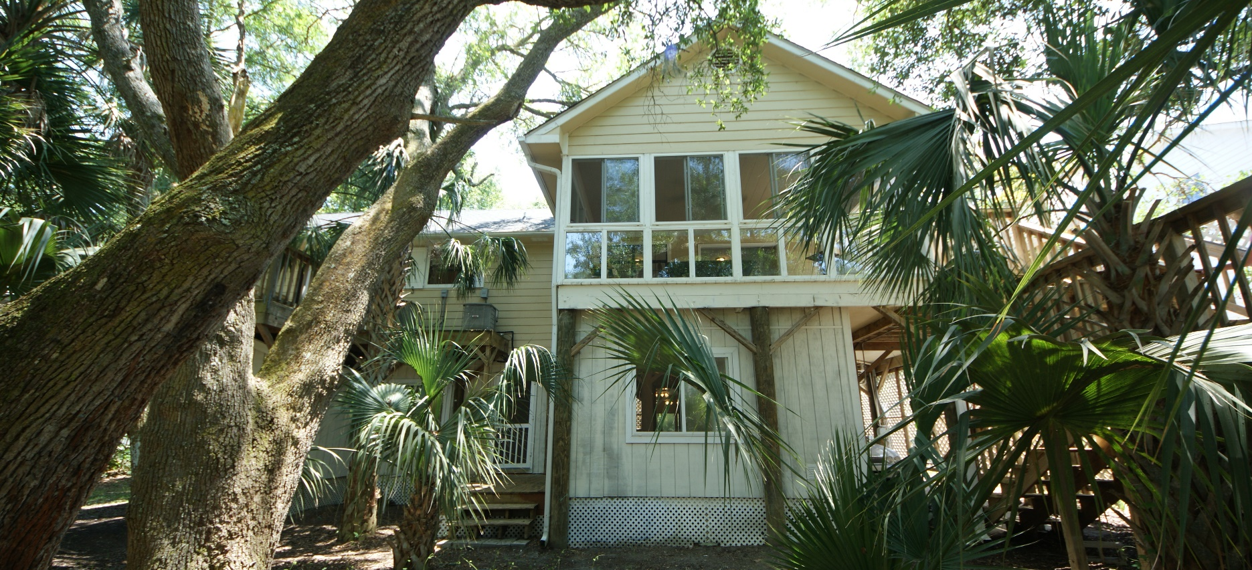
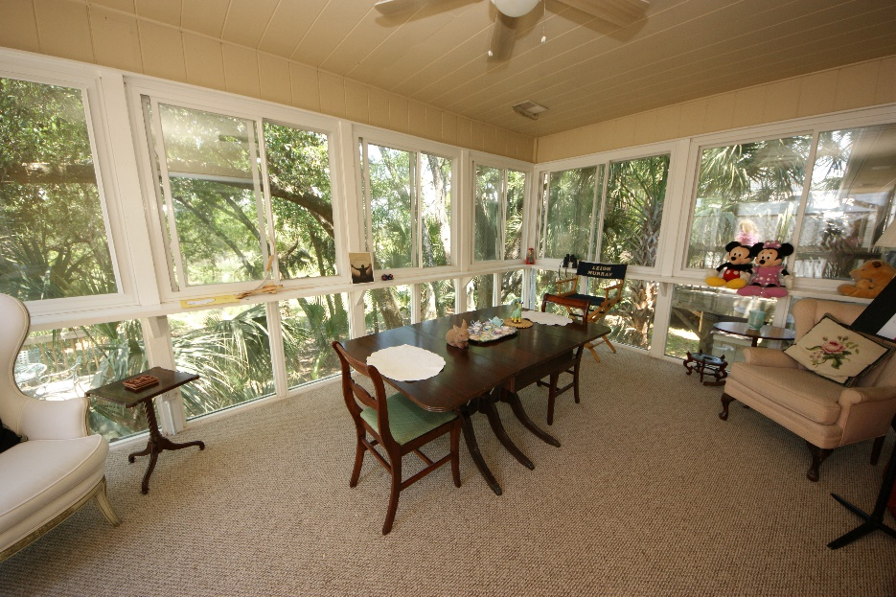
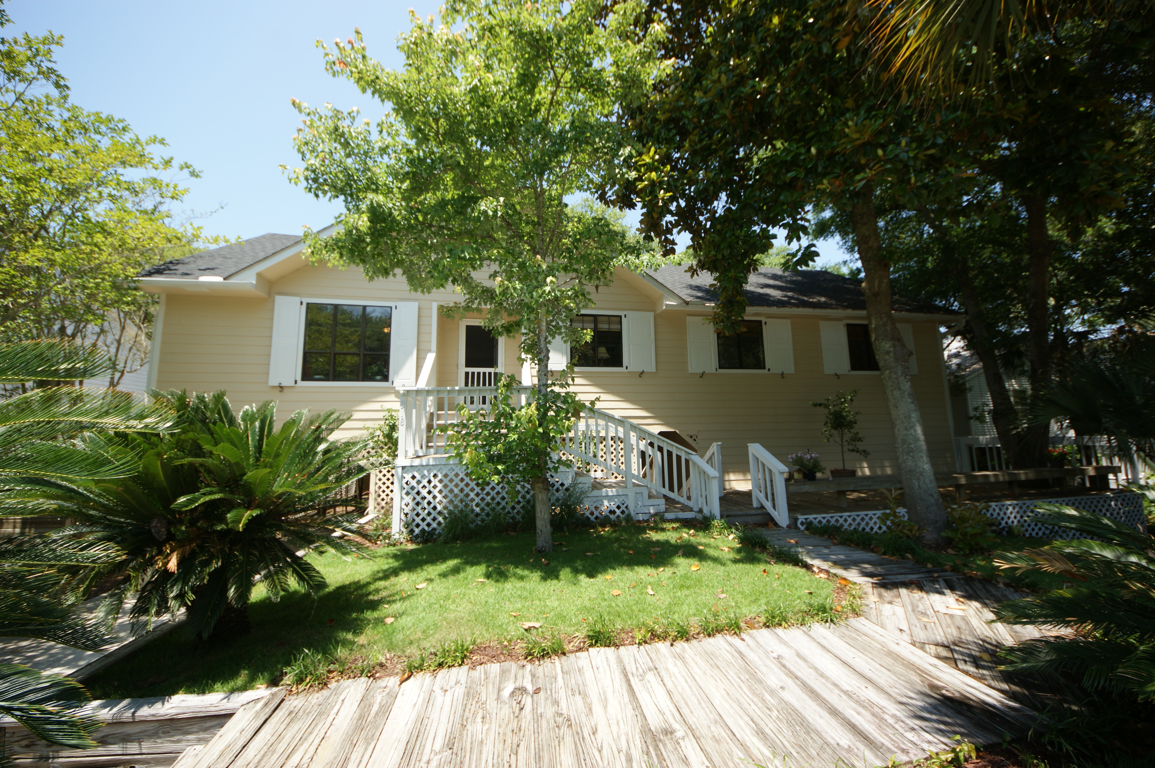


Folly Beach Residence with Great Rental Income!
318 W Indian Avenue
MLS# 15019659 ~ $599,000
If you want privacy, this is it!
All newly renovated, the home has 4 DECKS for entertaining and taking in the natural wildlife. THIS is a perfect place for a POOL! Downstairs contains large finished rooms well-suited for a HOME OFFICE, ART STUDIO OR PLAYROOM! There is also A LARGE WORKSHOP / STORAGE space for storing bikes, kayaks, surfboards and furniture!
Located on the tropical Island part of Folly beach, this Cottage-style elevated home offers a beach experience reminiscent of a Hawaiian vacation. The Gorgeous Private Back Yard, one of the biggest on the West side of Folly goes clear to the Marsh of the Folly River. FLOOD INSURANCE IS ONLY $387 ANNUALLY!
Ellen Murray
843 813-2006
chaspremierprop@bellsouth.net
Charleston Premier Properties

