Slide 1
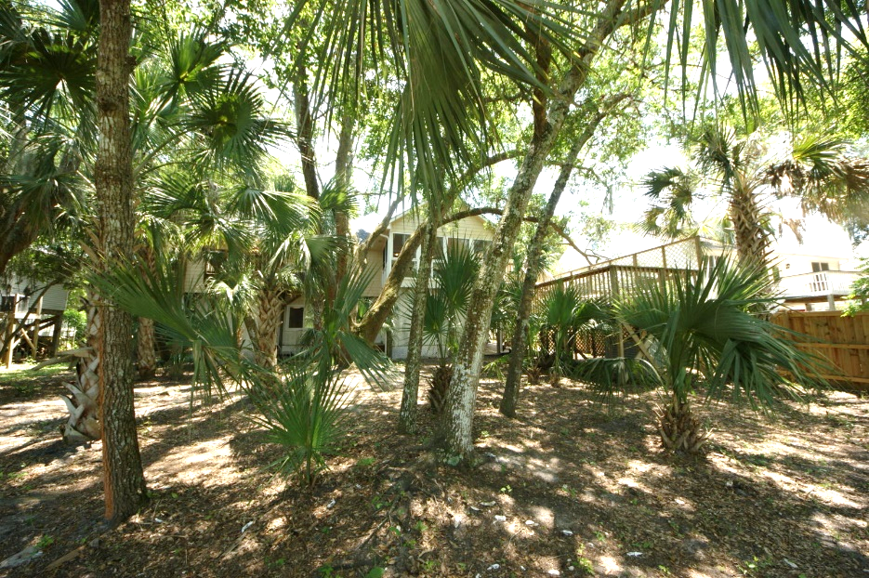
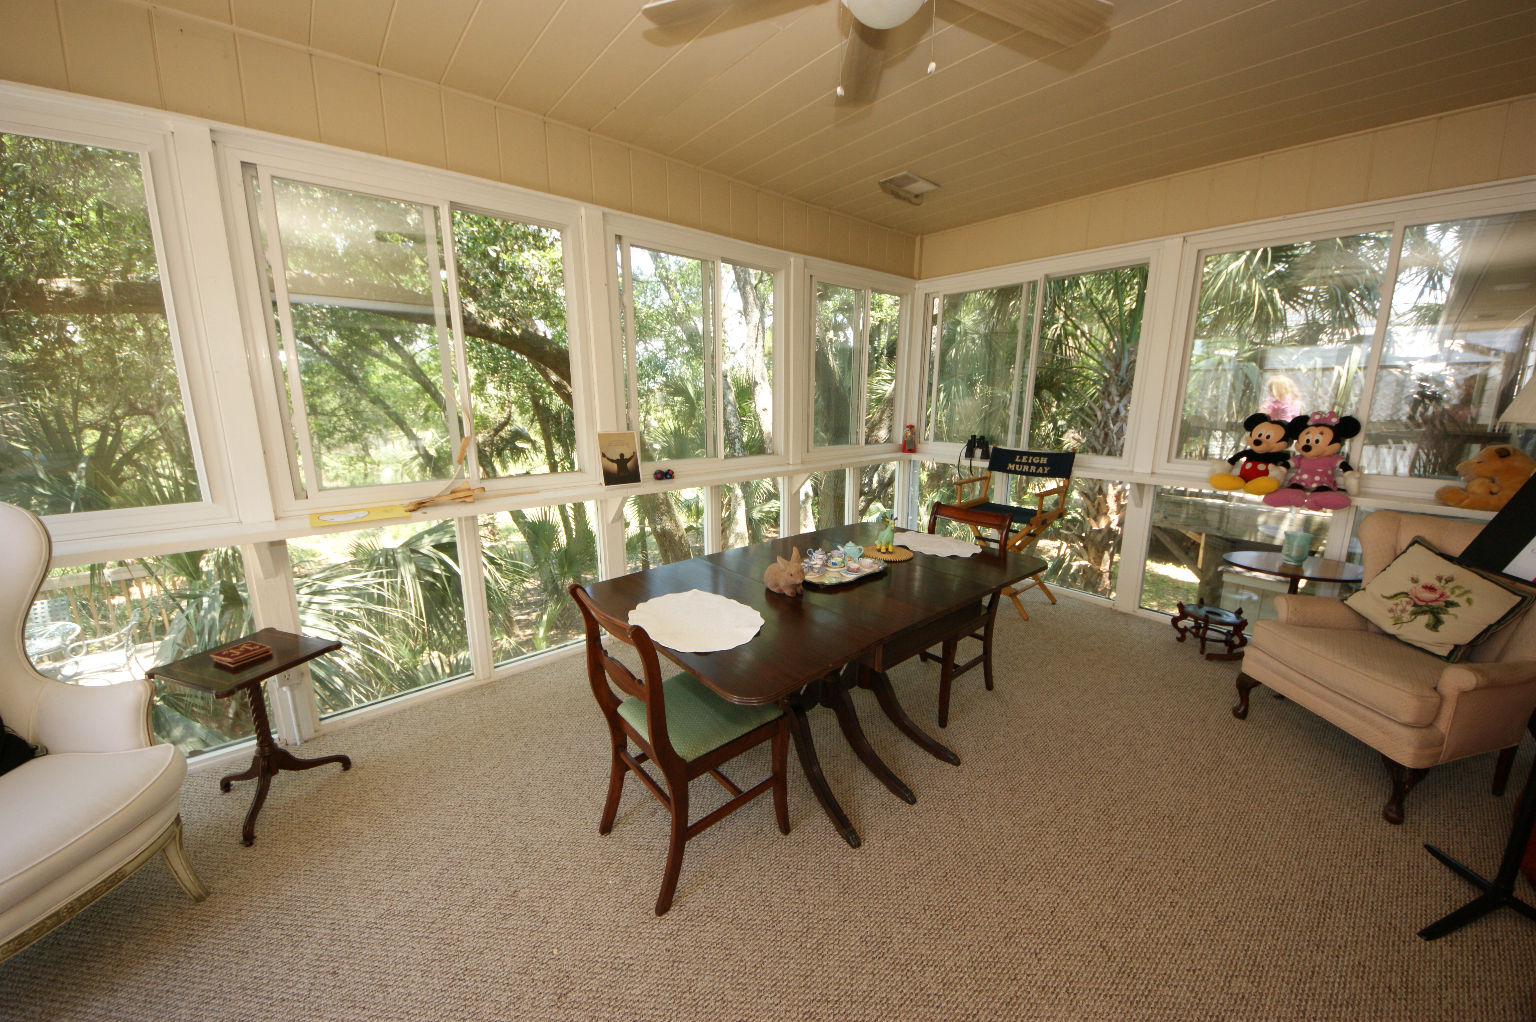
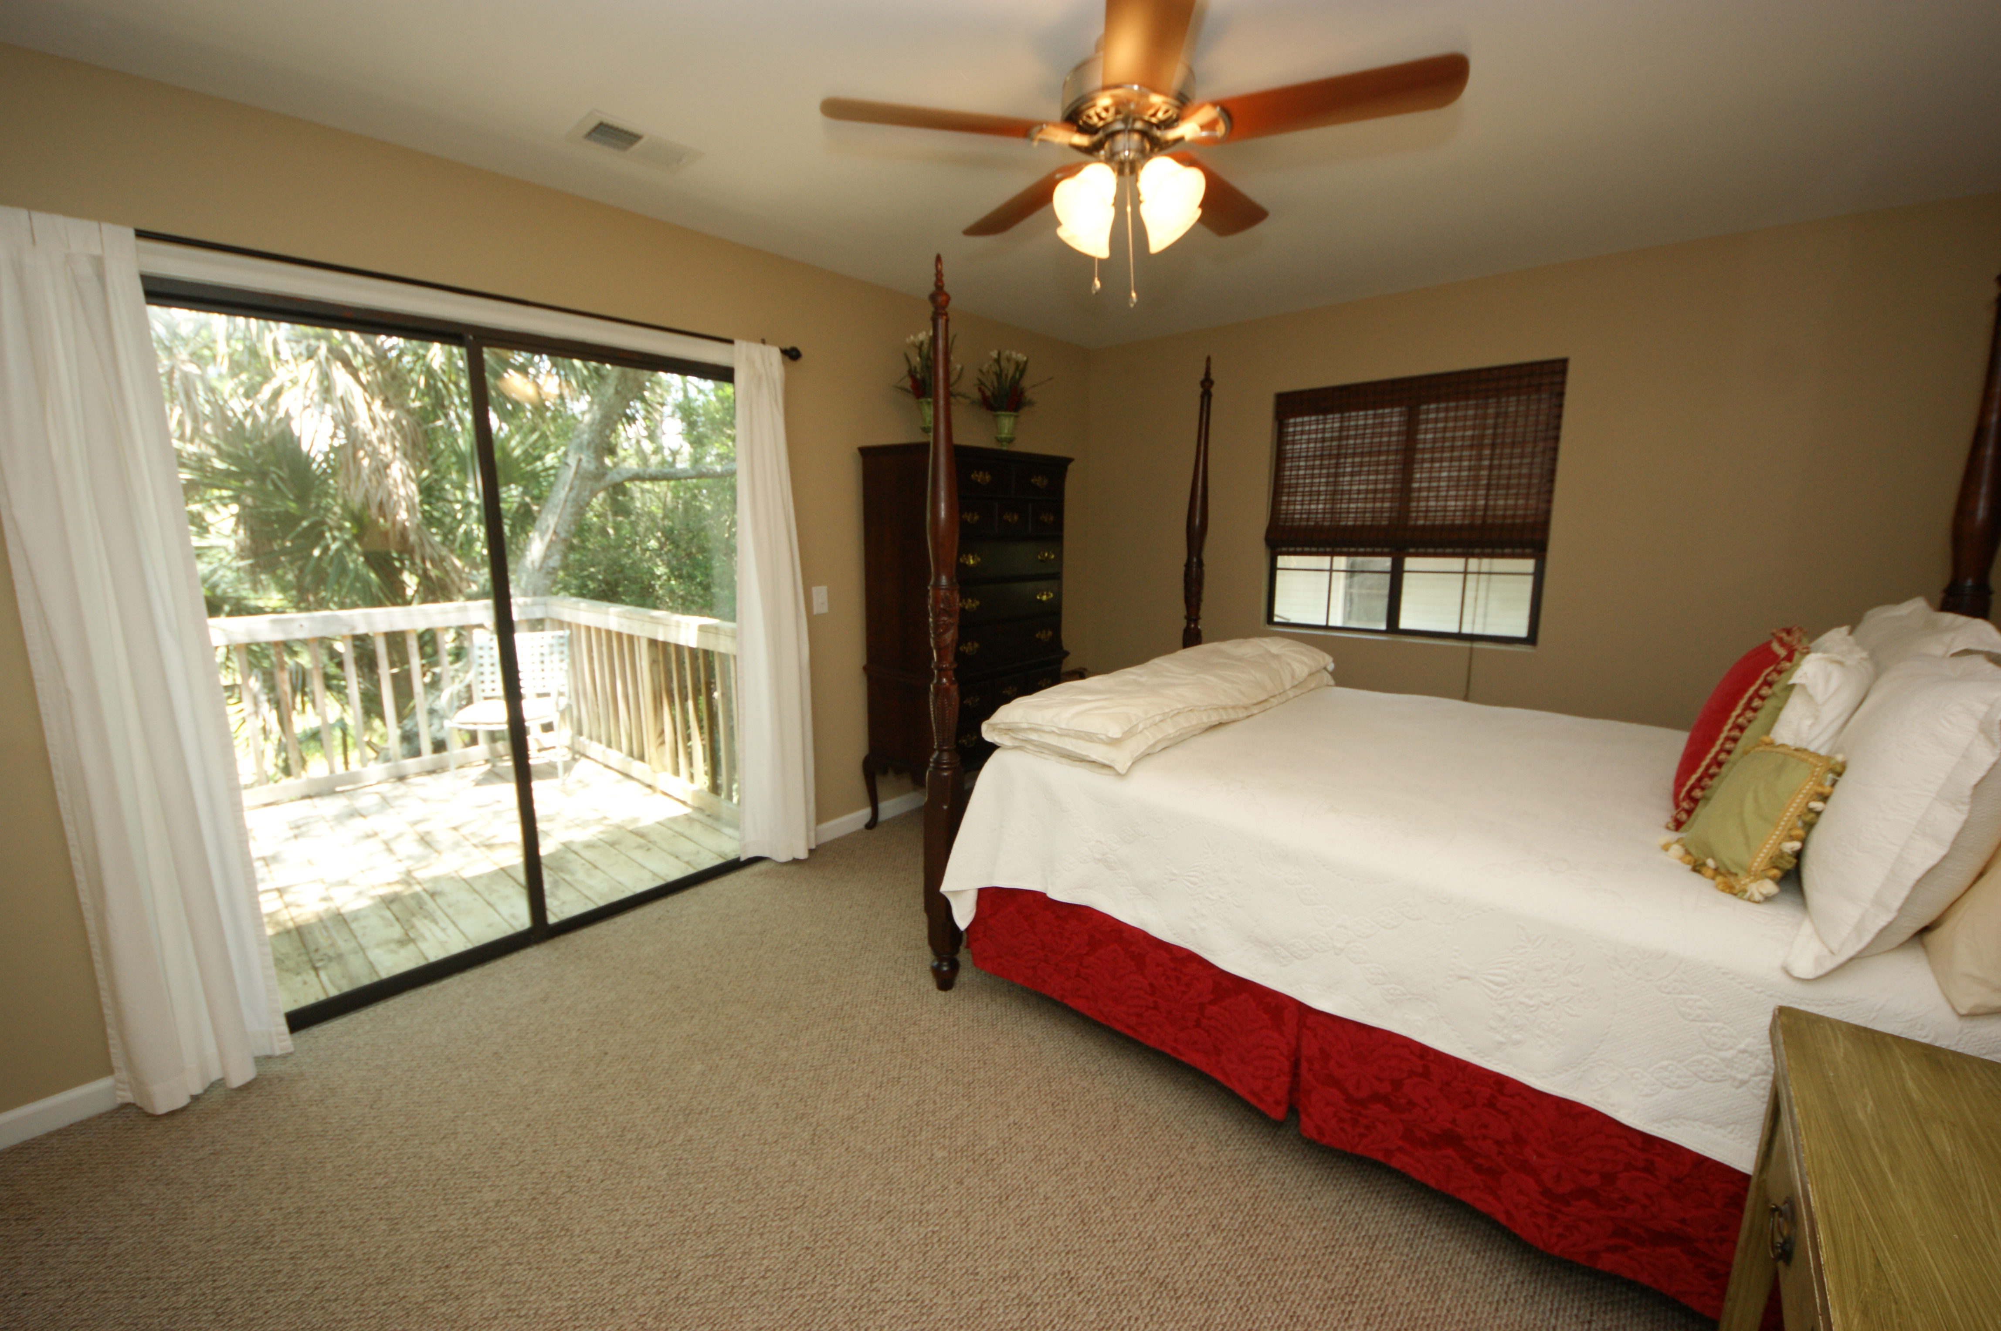
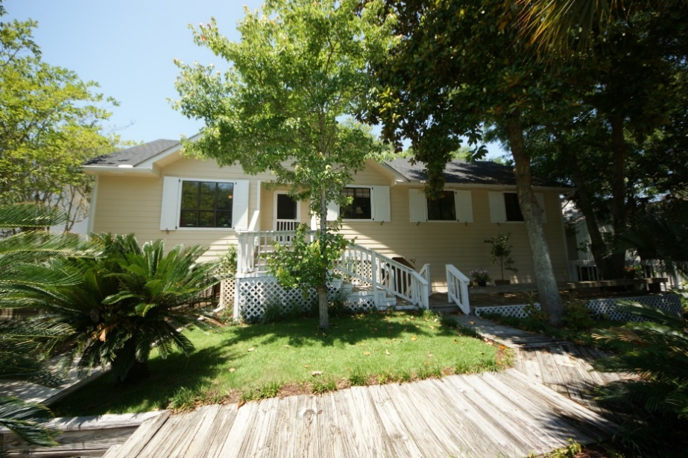


Folly Beach Residence with Great Rental Income!
318 W Indian Avenue ~ MLS# 15024890 ~ $519,000
Folly Beach Elevated Home on the desired quiet Tropical Paradise West Side of the Island. THIS IS THE LOWEST PRICED PER SQUARE FOOT SINGLE FAMILY HOME ON THE BEACH! Recently renovated, this home is on a gorgeous lot backing up to the Marsh. ONLY 3 BLOCKS TO THE OCEAN!
There is loads of privacy and multiple possibilities to creating a personal 2ND home supplemented by rentals or a full- time residence. 4 separate decks and porches make this a comfortable home for entertaining too!
All new interiors on both levels. If you want quiet peaceful Island living just 3 blocks from the bustling CENTER STEET restaurant scene, this is it. Downstairs contains large finished rooms with 10 foot ceilings and beautiful views, well-suited for a home office, gym, or art studio!
Handsome Properties, Inc 53 Broad St Charleston, SC 29401
Ellen Murray
843 813-2006
chaspremierprop@bellsouth.net

