Slide 1

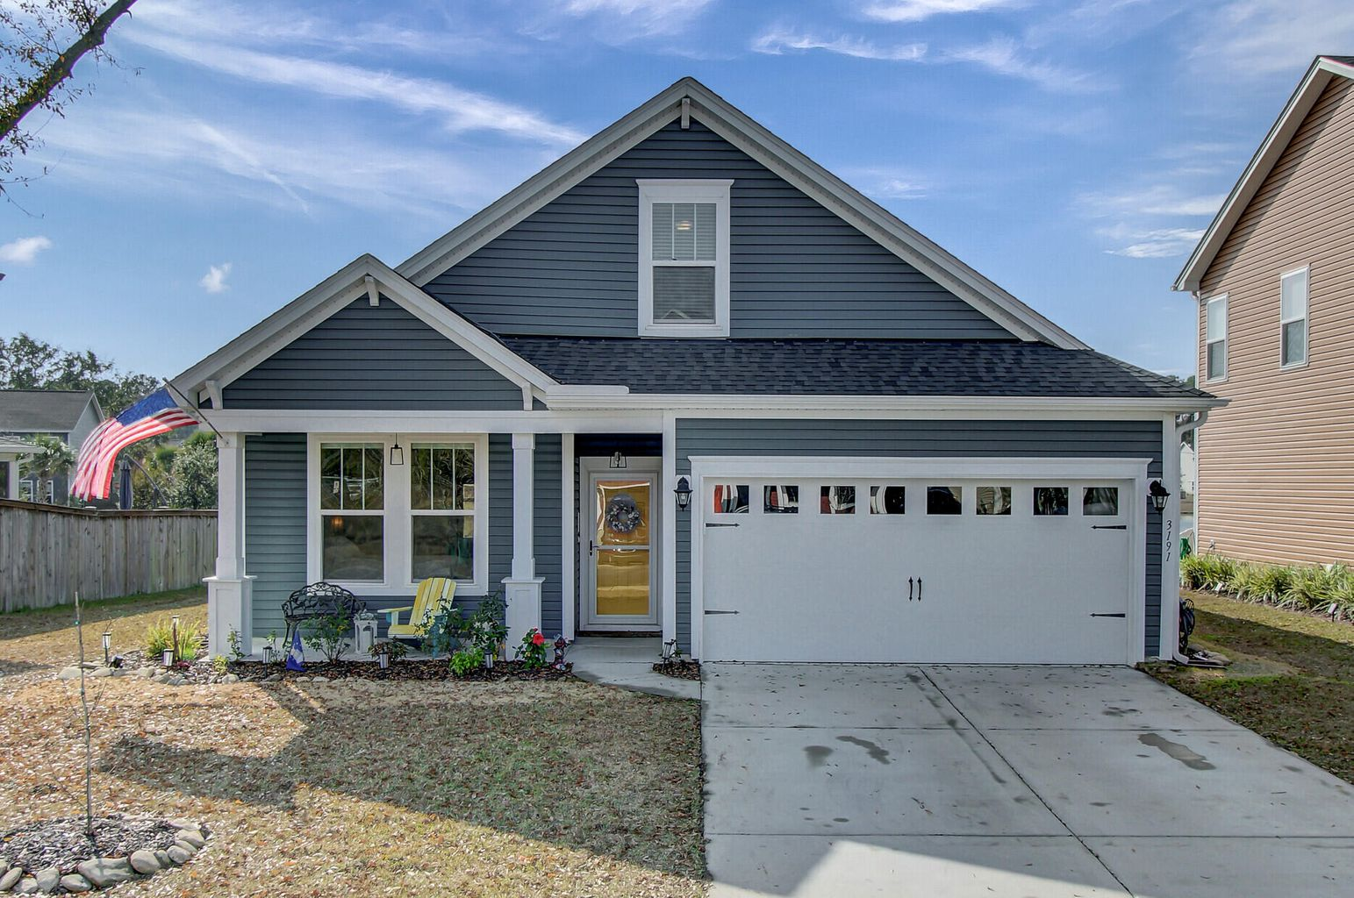


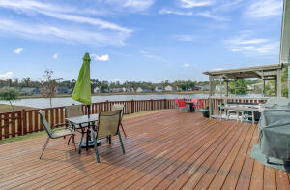

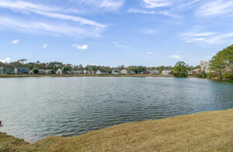


JUST LISTED
Truly Amazing House on Premium Lot
3191 Timberline Drive
Maybank Village
Johns Island, SC 29455
MLS# 21032821 | $499,000
Why compromise when you can HAVE IT ALL? One truly amazing house on a premium lot is what you have found at 3191 Timberline Drive! This gem has water views and there is HOA green space behind the home. The current owner selected the finest upgrades and has gone on to enhance the home in numerous ways. This ranch style home was upgraded to include the optional second story making it a true five bedroom home. The floor plan is so versatile and is sure to meet the lifestyle needs of a large family, an owner who works from home, a family who needs room for home schooling, or those that like plenty of room for guests who come to enjoy all that Charleston has to offer! You will notice that wood floors are found in EVERY room, downstairs and up, while bathrooms have tile flooring- no carpet in this home! The kitchen is outfitted with a gas range (sure to please the cook in your household), stainless steel appliances, and beautiful granite counters. There is an abundance of counter space, tons of storage, a new tile backsplash and a huge island with seating for four! The open concept design is ideal for families and entertaining and includes a surround sound system. The master is on the main level and owners enjoy views of the water behind the home. It is massive! The master bath has been upgraded to include an oversized spa shower and the large walk in closet has a brand new CUSTOM CLOSET SYSTEM to maximize storage and organization! Two additional guest bedrooms and a guest bath are found on the main level in addition to the laundry. What a great floor plan for an owner who never wants to deal with stairs! Venturing upstairs you will see two additional bedrooms and a third full bath with sitting area. If that is not enough, the garage has been finished into a fantastic living space for a hobbyist, car enthusiast, man cave complete with a MINI SPLIT heating and air conditioning unit! Spanning the entire width of the home is a deck complete with a covered sitting area. What a fantastic place to enjoy your morning cup of coffee or a beverage at the end of the day! There is ample room for the grill and outdoor dining furniture. This will become a favorite place to take in the views of the pond, or watch the kids or pets play in the fully enclosed back yard. Maybank Village is in a prime location on Johns Island with easy access to multiple restaurants and breweries nearby. Downtown Charleston is a mere 20 minute drive and the beaches at Folly and Kiawah are close. Other attractions such as the Angel Oak, Charleston Municipal Golf Course, Stono River County Park and Freshfields Village are also close by. This remarkable home in the ever popular Maybank Village community is sure to sell quickly, so don't delay in scheduling your tour!
Take a video tour!
Ellen O'Neil
Broker/Owner, ABR, e-PRO, CNE
Charleston Realtor of Distinction
(843) 300-8530
www.EllenONeilProperties.com

