Slide 1
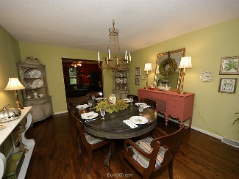
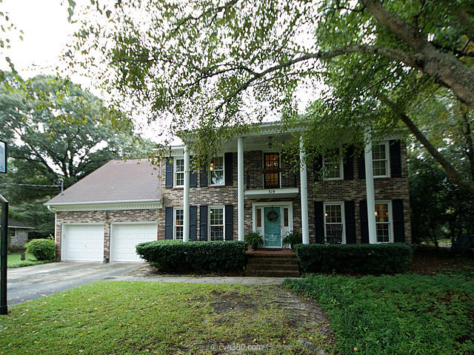
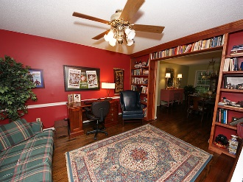
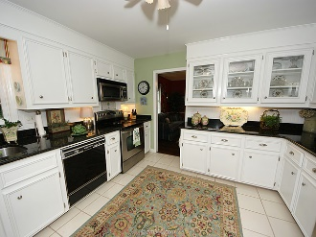
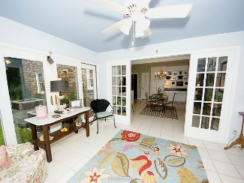
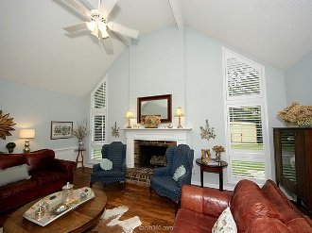
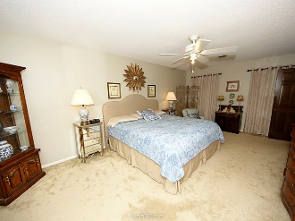
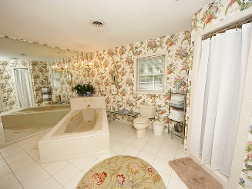
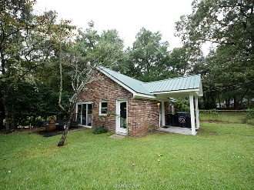


Loaded with Opportunities!
319 Ayers Cir
Salisbury Acres
Summerville
MLS# 15025047
$374,900
What a gorgeous Family home.
Terrific to live in or for entertaining. All downstairs rooms flow one to the other. Formal Living room, Dining Room, spacious Kitchen & Breakfast Rm family Rm w/soaring ceiling & wet bar . Custom Plantation shutters and sunscreen blinds just installed Terrific sunroom overlooks back yard.
One bedroom & bath downstairs and 4 bedrooms, plus 2 baths on second level one is the room over the garage currently used as an upstairs family room Large tile flooring in kitchen, breakfast room & sunroom. Some beautiful wood floors. Large entry foyer.
Cedar Hall closet Master bedroom is huge & spacious bath. Extra 25 x 25 building for hobbies, man room, etc. has 200 amp electrical service & HVAC. There is another shed for storage. Floor plan attached for room measurement. Prior appraisal shows 3407 square feet. Looking for a BIG kitchen, and fabulous space for living, this is the perfect house.
Two outbuildings: one has 617-625 sq ft and smaller building has 152 sq ft of space perfect for those gardening/yard needs.
Candace Pratt
CRS, GRI, CRB
Office - (843) 576-2710
Mobile - (843) 696-5508
candace@prattandco.com
www.prattandco.com
RE/MAX Pro Realty, 9209 University Blvd, Charleston, SC 29406

