Slide 1
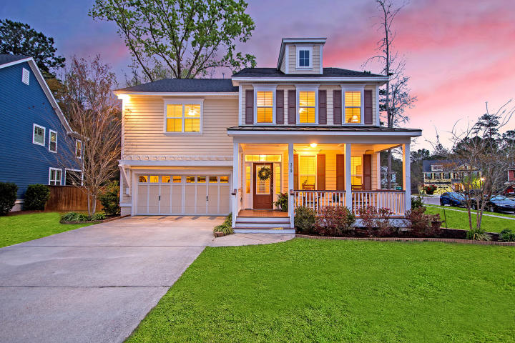



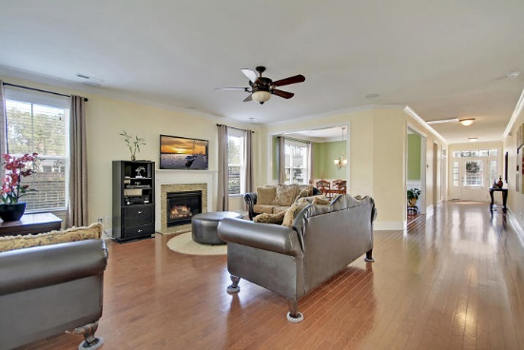
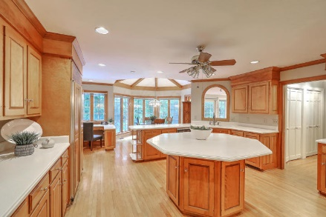
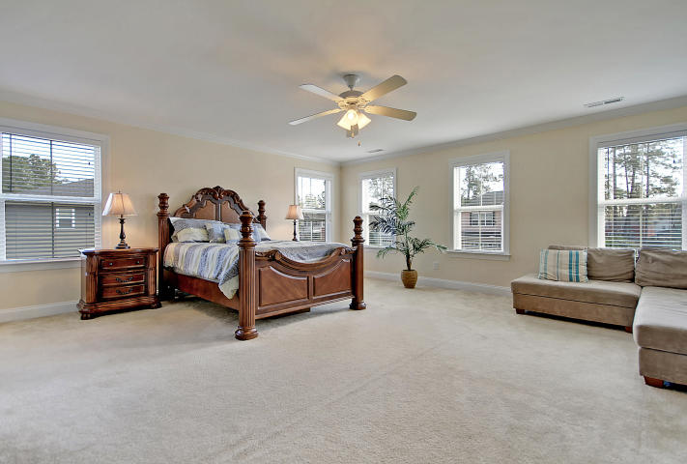



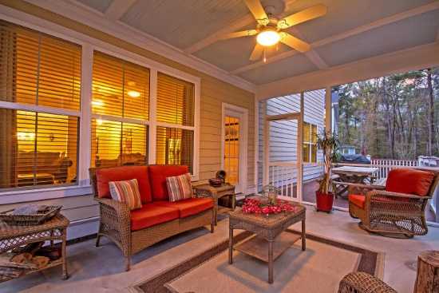

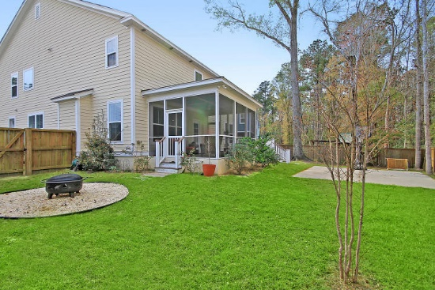
Parkshore Marshfront
$2,000 Towards Closing
If Your Buyer Uses Preferred Lender
319 Brick Kiln Drive
Branch Creek ~ Summerville, SC 29483 ~ MLS# 19008682 ~ $359,000
The community of Branch Creek offers an incredibly convenient Summerville location that's close to everything! This expansive two story home on a corner lot with a fenced-in backyard is move-in ready and waiting for you.
The open first level floorplan features a fireplace in the living room, wainscoting in the dining area, gorgeous eat-in kitchen with granite counters, a center island with breakfast bar seating, built-in desk area and an office with French doors.
The owner's retreat is beyond spacious, has two walk-in closets and an en-suite bath with dual vanities, walk-in shower and garden tub.
The backyard oasis is full of fun and relaxation with a deck, screened-in porch, basketball court and fire pit. The front porch is another outdoor living space to take in the low country beauty!
Additional features include:
Five spacious bedrooms
Large kitchen with ample cabinet and counter space
Corner lot
Book your showing today!
Christopher Smith christopher@mattoneillteam.com 843-267-0735

