Slide 1
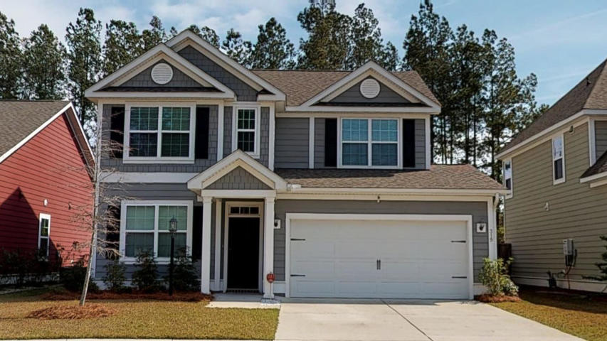
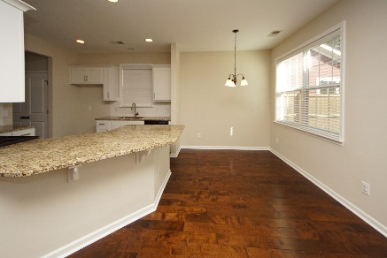
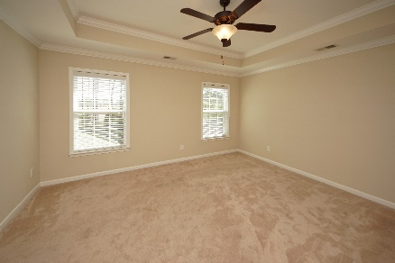
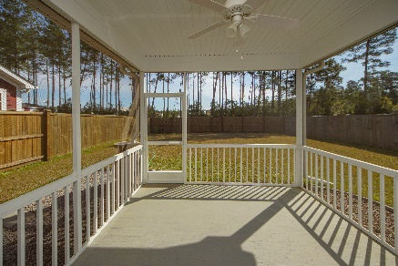


319 Whispering Breeze Lane Cane Bay Plantation :: Summerville, SC 29486 MLS# 19007626 :: $264,000 3 Bed / 2½ Bath
Why wait for new construction!
2.67 Acres!
Built in 2016, this 3 bedroom, upgraded home is turnkey with the finest features a new owner could desire!
Wood floors, granite counter tops, stainless appliances, screen porch and private fence with back yard access to the new YMCA!!!!!
Sellers are motivated and this home is ready to close quick and our home is priced less than a new build!
Connie White, Broker
843-532-3356
connie@chrepros.com · conniewhiterealestate.com
Charleston Homes · 597 Old Mt. Holly Road · Suite 301 · Goose Creek, SC 29445

