Slide 1
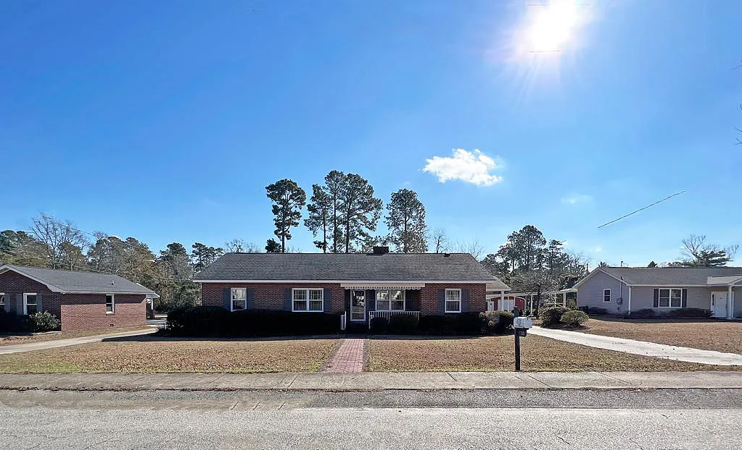
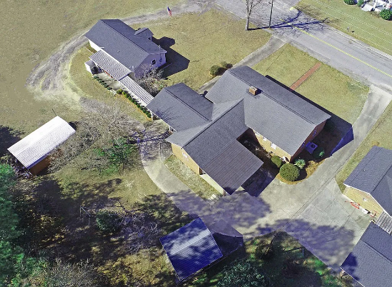
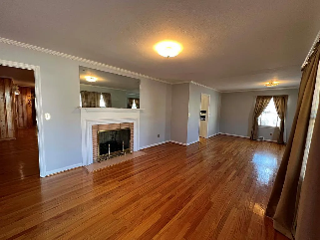
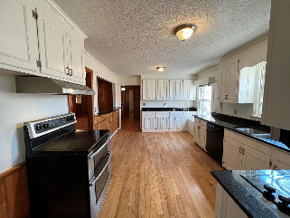
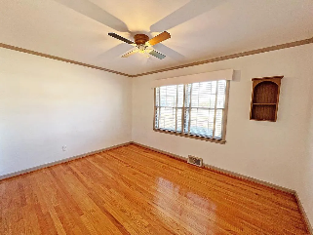
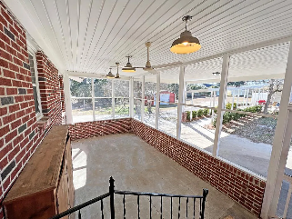
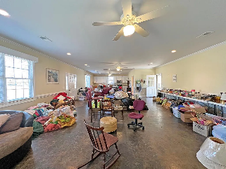

Two Houses for the Price of One
319 Hampton St
Elloree, SC 29047 ~ MLS# 155935 ~ $375,000
In Town Elloree Home with MIL Suite or Man Cave (main house 2642 sqft & MIL 1200 sqft with a total of 3842 heated sqft). The main home host 4 bedrooms with 4 full bathrooms, den, Formal living room, formal dinning and 2 bedroom suites. The hardwood floors are beautiful through out the home. This is an older home with old home charm. Built in the late 60's it has been maintained through out the years. Master suite has his and her bathrooms with each a closet. The MIL / man cave is stand alone and has a full Kitchen and full bathroom. Open floor plan to allow for lots of space for guest or the special needs of the loved one. Carport and enclosed metal garage will convey. Joined driveway with covered walk path. See this one today! Limited MIL suites on the Market!
Lake Homes Realty, LLC
Elloree, SC 29047
www.SCLakeLife.com
Kristie Anderson
(803) 387-9459
kristie@sclakelife.com

