Slide 1
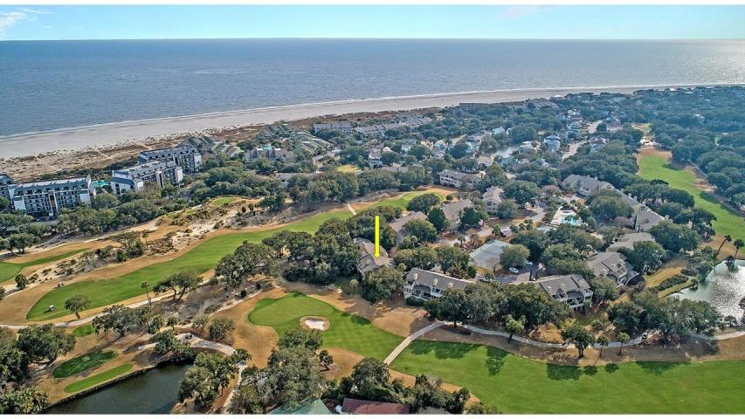



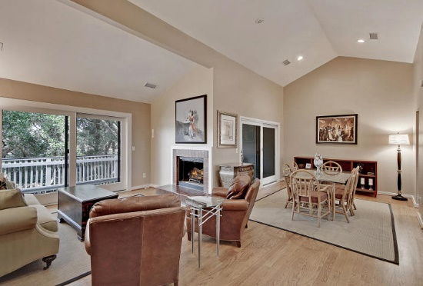
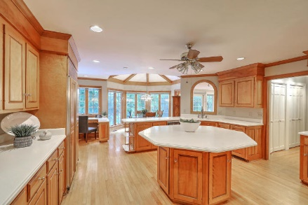
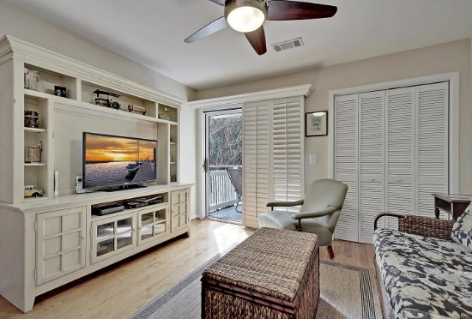



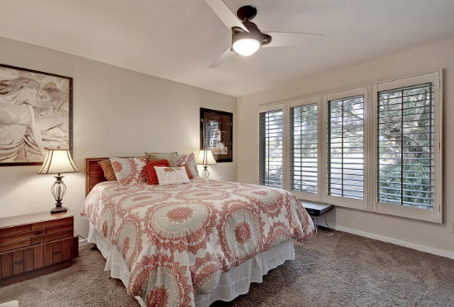

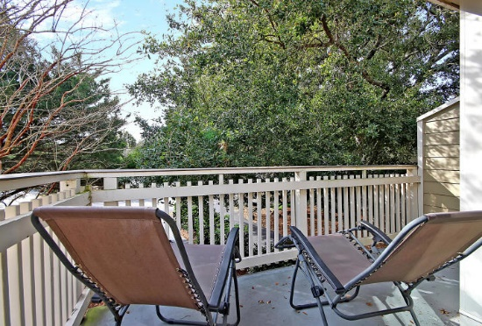
Parkshore Marshfront
Price Reduced
31 Fairway Dunes Lane
Wild Dunes ~ Isle of Palms, SC 29451 ~ MLS# 19004283 ~ $679,000
You will not want to miss this lovely town home overlooking Wild Dunes Link golf course in Isle of Palms! This spacious 3 bedroom beach villa has much to offer including tall vaulted ceilings, hardwood flooring throughout, solid wood doors, plantation shutters, and a fireplace to warm you up on chilly nights. This home has tons of outdoor space to enjoy the beautiful views. Choose between the large screened porch or the upper deck to enjoy your morning coffee or entertain friends after a day at the beach. The gated Wild Dunes community will put everything at your fingertips...not only will you be close to the beach but you will have access to tons of amenities including tennis courts, fitness facilities and swimming pools.
Additional features include:
Open floorplan
Three bedroom/Three bathroom
Lots of natural light
One Car Garage
Beautiful view of Wild Dunes Link Golf Course
Within beautiful gated Wild Dunes Community
Book your showing today!
Christopher Smith christopher@mattoneillteam.com 843-267-0735

