Slide 1
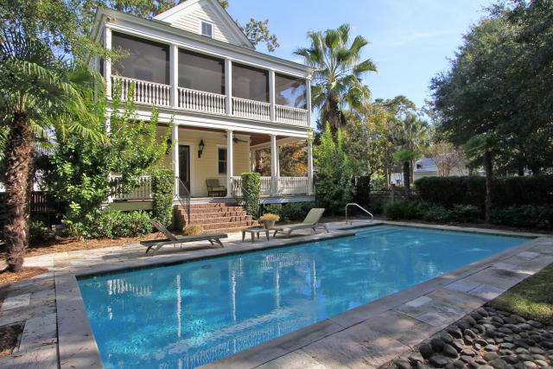
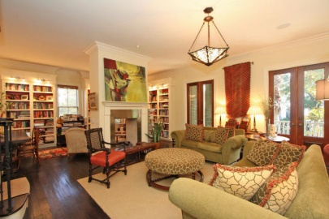
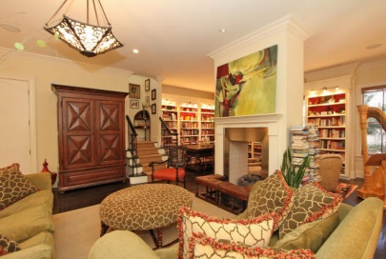
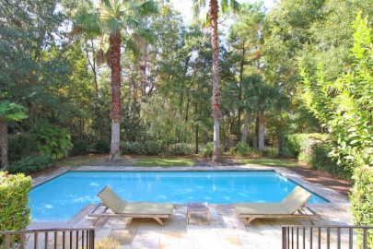
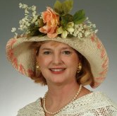

31 Frogmore Rd Mount Pleasant MLS# 14029597 $989,000
55 and Better!
New Price in I'on
A Private and Secluded Custom Masterpiece with Pool and Lush Grounds Steps from Miles of Marsh Walks, this Gracious Charleston Single was Designed by Architect Daryl Cobb and the Owner with an Open Floor Plan and Wrap Around Piazzas Affording Maximal Views. An Ancient Baptismal Font from a Cathedral in Devon, England, Sets the Tone for the Interior Design with an Elegant European Flare. The Hardwood Floors in the Mezzanine are Antique Walnut and the Steel See Through Fireplace is from Chesney's of London. The Kitchen Cabinetry, Joinery, and Wrought Iron Work in the House were Thoughtfully Chosen. A Viking 6 Burner Gas Top, Two Electric Ovens, Silestone Quartz Countertops, Island House Ice Maker and other Top of the Line Appliances Make any Cook Marvel. The House is Sited Facing South. The Home Entertains and Lives Well with Comfortable and Large Rooms and Plenty of Storage. Enter Through Custom French Front Doors into an Enormous Open Foyer and Huge, Gracious Room Where Living, Dining, Reading and Music Take Place. It Feels Like an Oasis From the Hustle and Bustle of Life. Open the Three Sets of French Doors to the Covered Piazza and Let the Sea Breezes In. The Stairway to the Second Floor is Situated off the Great Rooms. The Master Bedroom Suite Opens with Two Sets of Custom French Doors to the Upper Screened Piazza Overlooking the Pool. The Walk In Closet has Been Custom Fitted with Dressing Table with Velvet Lined Drawers Perfect for Jewelry. The Elegant Master Bath has a Freestanding Glass Shower and Large Separate Garden Tub. All Fixtures in All Baths are Kohler. An Office Adjacent to the Master is Large Enough for a Sitting Area. The Two Guest Rooms with Adjoining Full Bath Complete the Second Floor. *** An Almost Competed 3rd Floor with 750 Sq Ft of Heated and Air Conditioned Space has been Counted in the Total Home Measurements. Come Quickly to See this Private Paradise in I'on. More Custom Upgrades and Information about this Special Home are Attached in the Document Section.
Sissa Green
(843) 532-9953 – C sissagreen@carolinaone.com www.sissasite.com
Carolina One Real Estate
Mt Pleasant
195 W Coleman Blvd Mt Pleasant, SC 29464

