Slide 1
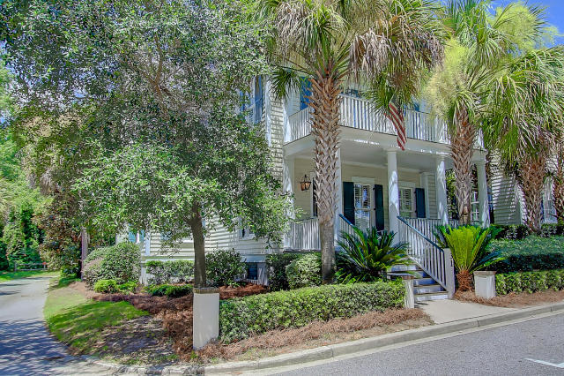
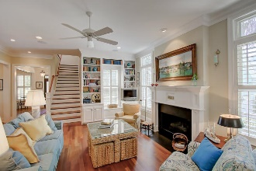
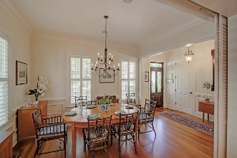
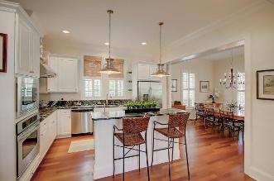
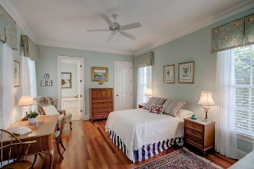
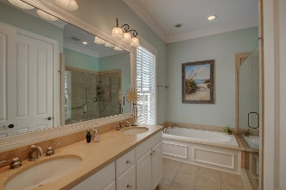
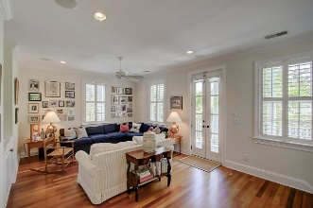
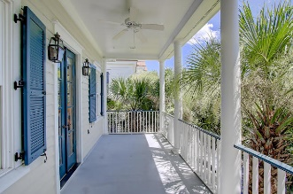
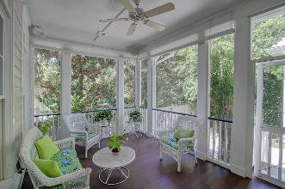
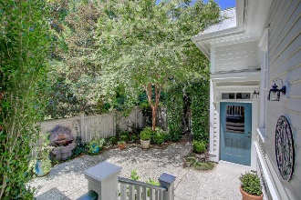
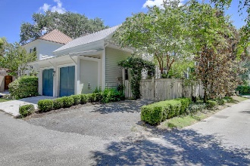

31 Mcdaniel Lane
Mount Pleasant, SC 29464 :: MLS# 16020277 :: $945,000
Great Location In I‘On!
Just steps to the I'On square. Enjoy the spacious park of Maybank Green from the lovely front porch. This home has a much sought after Downstairs Master Suite! The open floorplan is the perfect downsize for anyone in the larger homes in I'On with room for grandchildren and yet can easily house a growing family. The screened porch just off the living room overlooks a charming courtyard and 2 car garage. The kitchen is well appointed with butler's area and pantry. A laundry/mud room opens to the side yard. Upstairs a large family room has built-in bookshelves and French doors open to a porch with the view of the park. Two bedrooms one with a private bath, a hall bath and an office complete the second story. There is a walk up third floor to unconditioned space.
Catha Remington
843-697-1667 - M
843-202-8722 – F
cremington@carolinaone.com
www.catharemington.com
Carolina One Real Estate
628 Long Point Rd.
Mt Pleasant, SC 29464-3032
www.IOnHomesForSale.com

