Slide 1
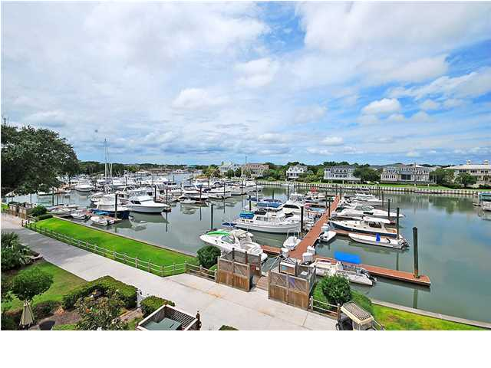
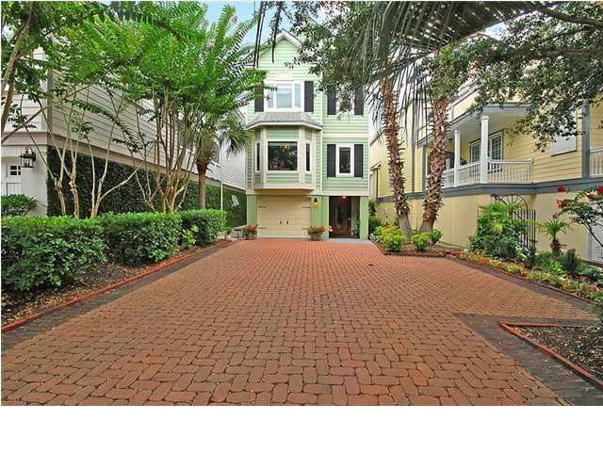
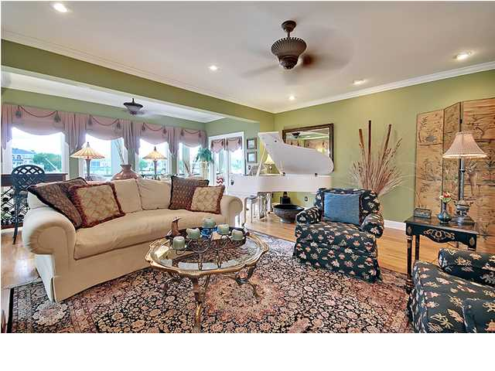
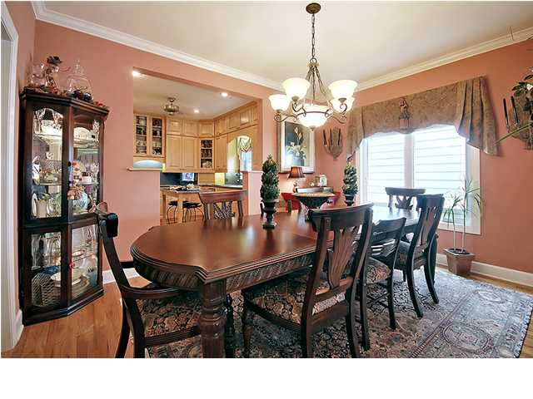
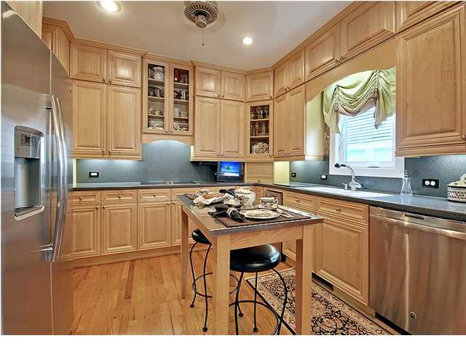
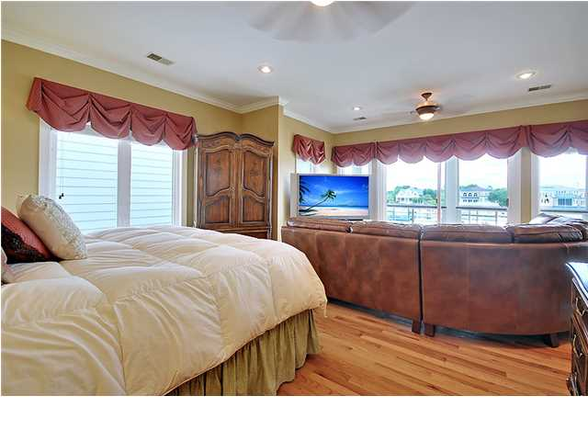
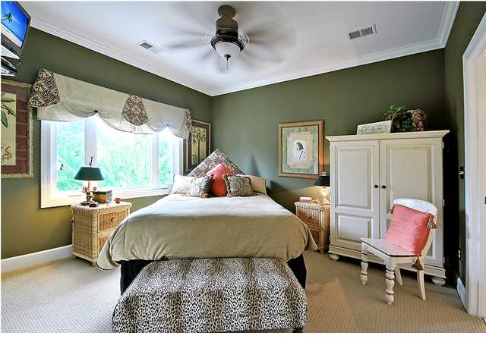
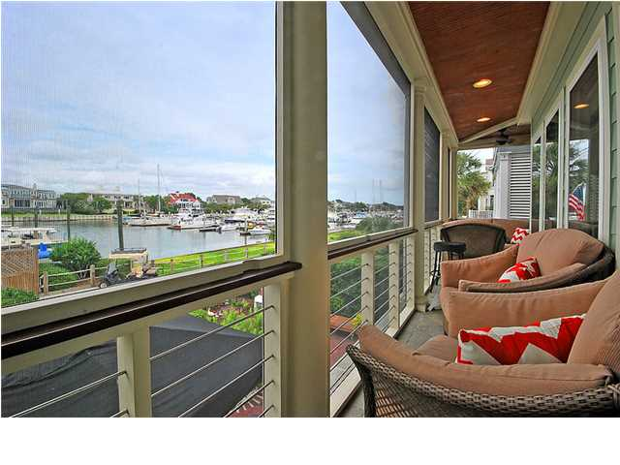
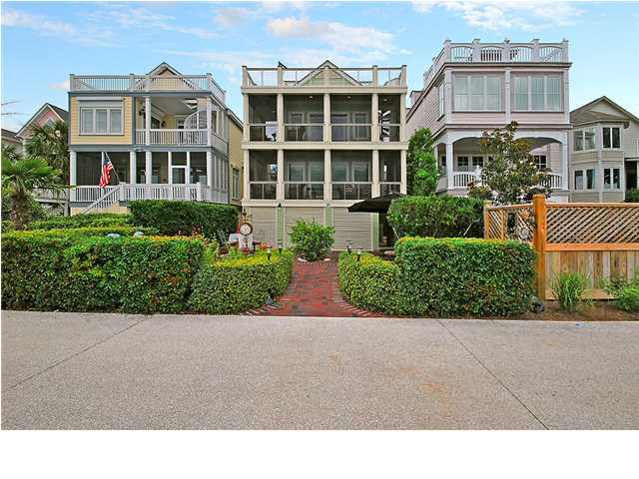
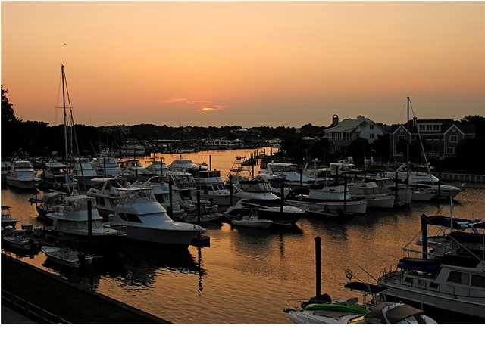

Price Reduced!
Wild Dunes Luxury
31 Yacht Harbor Ct ~ Isle of Palms ~ MLS# 1419951 ~ $1,295,000
Dynamite Wild Dunes four bedroom, three bath home on the marina offers 2,400 square feet of living area and spectacular, upgraded features throughout. The brick paver driveway large enough to fit eight vehicles is lined with beautiful landscaping and trees. Come through the custom mahogany door and pillars to find volume ceilings, beautiful hardwood floors and crown molding inside. The home's open concept has the gourmet kitchen leading to the dining area and living room where a three sided vent-less gas fireplace warms the space. Huge windows run to the rear of the home allowing in lots of light and offering priceless views of the marina. The kitchen features Corian counters and backsplash, new stainless steel appliances, under cabinet lighting, recessed lighting and floor to ceiling cabinets for extra storage. From the living room you can access the wrap around screened-in porch. This is where the breeze from the calming water will send you into relaxation mode. An office or bedroom with built-ins is located on the first level. Upstairs the owner's retreat is one that's not to be missed with fantastic views, a huge, custom walk-in closet and an en-suite bath that has a dual vanity, jacuzzi tub and seamless glass walk-in shower. Just some of the many highlights in the home include an elevator servicing all floors, two new HVAC systems, a programmable irrigation system, an instant hot water system, a UV air filtration system, hurricane rated windows with UV tint, epoxy floor paint and built-ins in the garage and Ipe wood and stainless steel railings on the upper three levels to maximize your views. As a part of the gated Wild Dunes community, you'll have access to the incredible amenities such as the pools, marina, clay tennis courts, two golf facilities, owners private club house on the ocean, playground, exercise area, bicycle/walk paths and restaurants. In order to appreciate the quality of construction and views that this home has to offer, you are going to have to come see for yourself.
Call or email for details: (843) 654-7777 or Matt@MattOneillTeam.com

