Slide 1
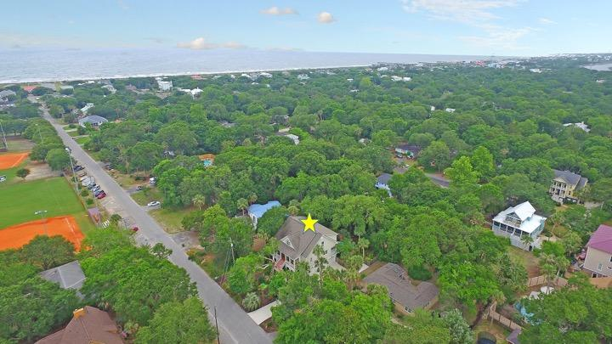
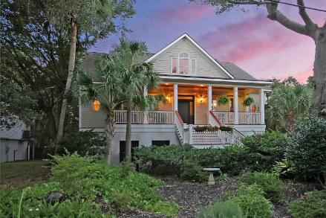
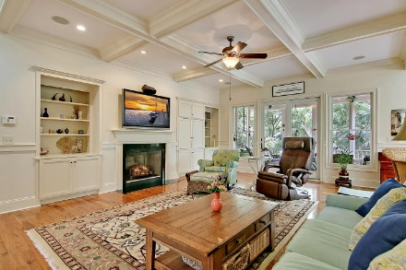
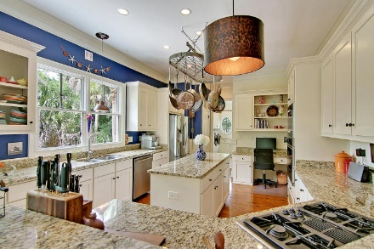
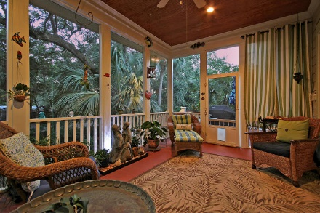
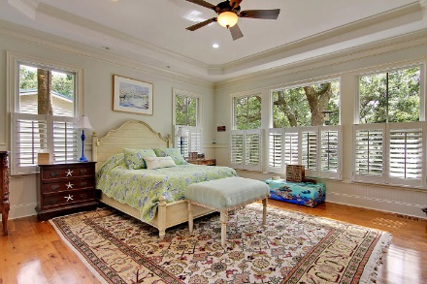
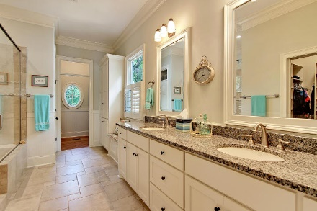
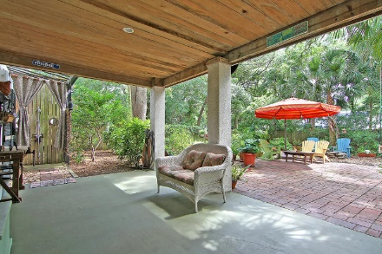
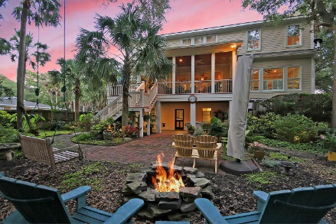
Beautiful Home on IOP
Price Reduced!
31 27th Avenue Isle of Palms, SC 29451 ~ MLS# 18005001 ~ $1,395,000
Seller is willing to sell house furnished with some exclusions. Ask for details... This Isle of Palms beauty is beautifully built and perfectly positioned. Low maintenance, tropical landscaping includes a a fire pit off of the patio in the backyard and mature palm trees. After a day at the beach, rinse off in the outdoor shower off of the covered patio and continue enjoying the outdoors from the screened-in porch, deck or full front porch. If you're a swimmer, simply add a pool. An elevator goes from the garage all the way up to the bedrooms on the third level. The home features a two story foyer, hardwood floors, office with tray ceiling, board and batten wainscoting, a fireplace with built-ins in the living room, stunning, granite, eat-in kitchen and a true getaway in the master suite.
Book your showing today!
Additional features include:
Amazing location on Isle of Palms
Beautiful wood floors
Gorgeous wrought iron staircase railing
Great kitchen features lots of cabinet space, granite countertops, stainless steel appliances, a gas cooktop, and a built-in desk
Great room includes built-in shelving, coffered ceilings, and outdoor access
Incredible outdoor space including a patio and firepit
Outdoor shower
2 Rinnai tankless water heaters
Pool can be added to the backyard
Tyler Hawkins tyler@mattoneillteam.com (843) 908-2734

