Slide 1
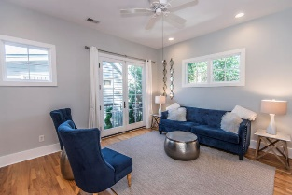
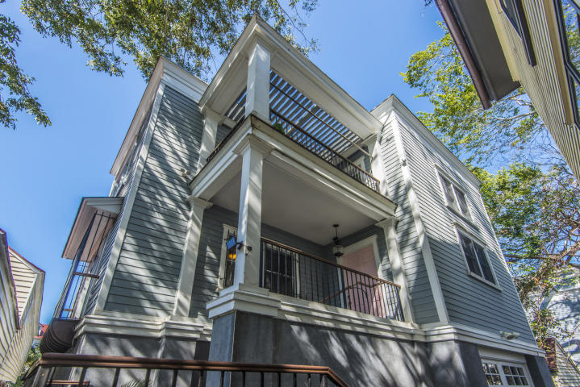
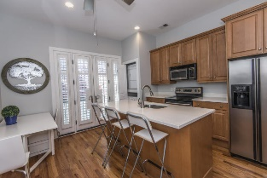
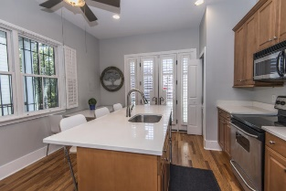
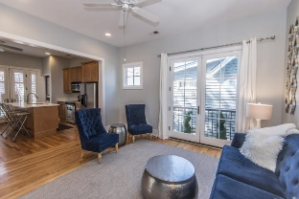
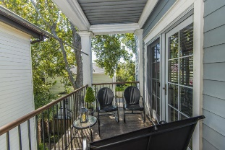
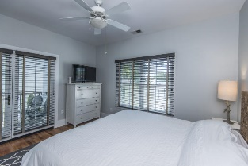
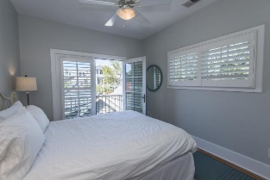

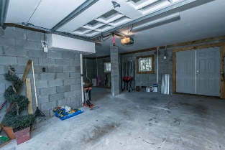


31 Hillary Court
Radcliffeborough | Charleston, SC 29403
MLS# 19026723 | $535,000
Light, Bright and Furnished
Lovely home tucked away and quiet in the sought after Morris Square section of Radcliffeborough. Light and bright with lots of windows and French doors that open to many balconies. Move in ready and conveys beautifully furnished. A great rental investment or a convenient downtown place to live. The floor plan on the first floor, includes an eat-in kitchen with center island, quartz counter tops stainless appliances, and is open to the living room. Hardwood floors throughout, with ceramic tile in the upstairs bath. A laundry closet completes the first floor. On the second floor there are two good sized bedrooms and full bath. The master bedroom has a walk-in closet, access to the full bath and opens to the upstairs porch a perfect place for your morning coffee or a good book. The guest room has french doors that open to a Juliet balcony with wonderful views of nearby historic rooftops The upstairs porch is also accessible from the hallway allowing your guests to easily join you for afternoon libations before heading out to dinner. An oversized garage under completes the property with room for storage, a work area, your golf cart and car. A short walk to upper King Street's restaurants and shops and also to the recently or soon to open new restaurants on Spring Street.
Kate M. Dolan
(843) 566-3512
katemdolan@carolinaone.com
www.katemdolan.com
Carolina One Real Estate
49 Broad St
Charleston, SC 29401-3001

