Slide 1
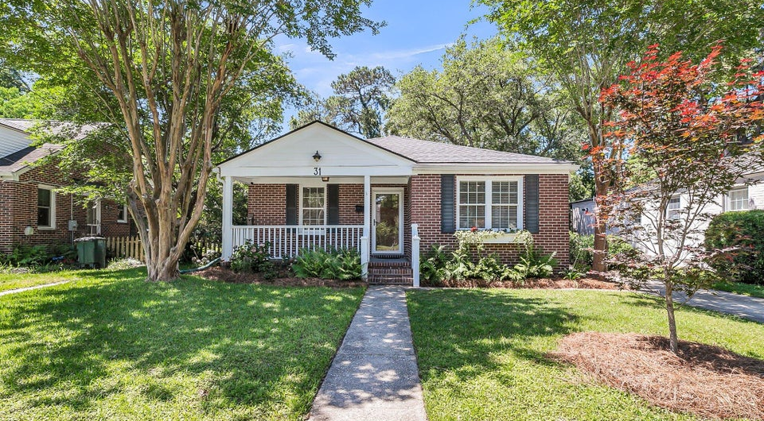
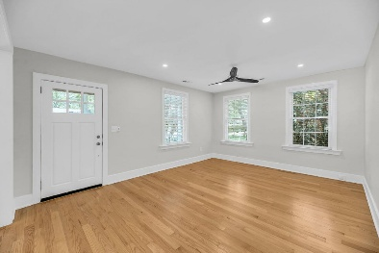
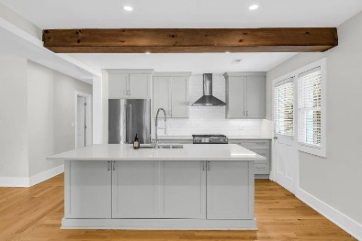
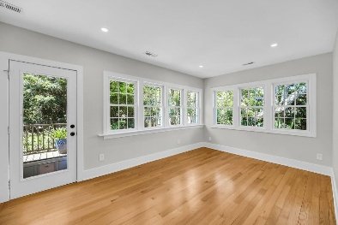
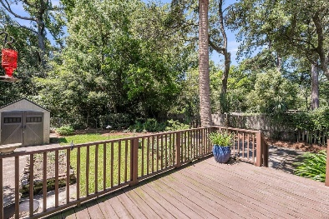


31 Lyttleton Street Byrnes Downs • Charleston, SC 29407 • MLS# 25014648 • $995,000 3 Bedrooms | 2 Full Baths | 1605 sq. ft.
Price Improvement
Experience the West Ashley lifestyle in BYRNES DOWNS, a highly sought after, desirable and Historic neighborhood nestled between vibrant Avondale, St. Andrews Center and South Windermere Center with no HOA. This freshly painted 3 bedroom 2 bath home offers a blank canvas to make your own. Step inside and discover the natural light filled open concept living, dining and kitchen as the result of a total kitchen renovation (2020) creating this everyday living and entertainer's dream, featuring high end appliances and floor to ceiling pantry with convenient roll-out drawers with an electrical socket, a chef's delight! A spacious hallway guides you to the bedrooms, including a primary bedroom with an ensuite bath and two additional bedrooms and a full bath.
At the end of the hall, bask in the abundant natural light of a true sunroom with 2 walls of windows for a tranquil retreat. The thoughtfully renovated (2024) laundry area and floor to ceiling cabinetry with roll-out drawers and stationary shelves allows for ultimate organization. Beyond interior updates include a new roof (2020), HVAC system (2021) and crawlspace repairs with moisture control (2016). The lush backyard, with a buffered area between you and the West Ashley Greenway, is a private oasis full of possibilities. Don't miss your chance to own a piece of desirable West Ashley where modern meets exceptional location.
Eve Sokol
843-991-5467
evesokol@yahoo.com
Elaine Brabham and Associates, LLC
1890 Sam Rittenberg Boulevard
Suite 217
Charleston, SC 29407

