Slide 1
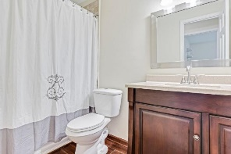
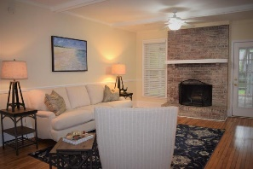
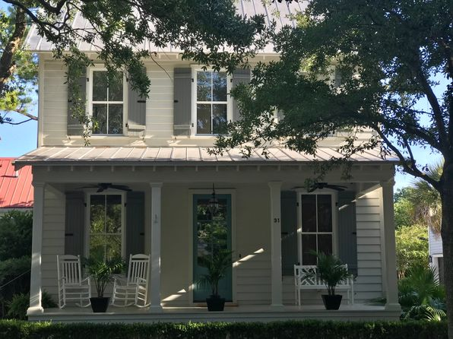
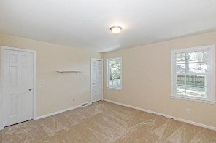
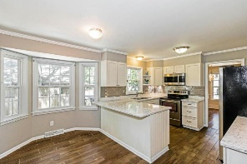
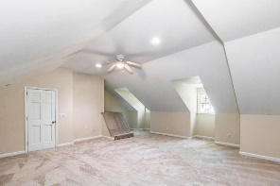
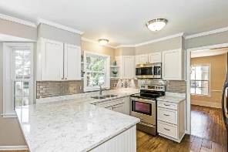
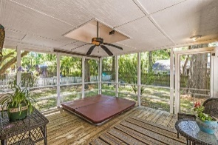
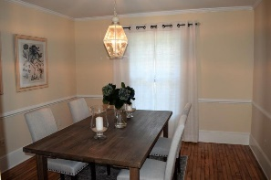
UNIQUE OPPORTUNITY!
31 Mises Street
I’On | $695,000
Here is the house you have been waiting for in I’On! You will love this charming home at 31 Mises Street $695,000. It offers a Master bedroom and bath with walk in closet on the first floor with 2 additional bedrooms and bath on the 2nd floor for kids, guests or office space. Enjoy relaxing on the porch…it is so wonderful in this serene, friendly neighborhood. The AC is a little over a year old, fresh white paint on walls, doors, ceilings, closets and trim were just completed. We just had the house power washed and painted the front door the popular I’On color. Open floor plan- Beautiful pine hardwood floors, Custom cabinets, Carrera marble countertops - Jenn Air/Bosch stainless appliances -Downstairs master suite - Marble tiled bath - Oversized frameless glass shower – Ceiling fans throughout - Front porch - Full size stackable Washer & Dryer - Wired for stereo surround sound - Crawl space for storage Custom tongue and groove shutters Alarm system can be operational.
Driveway accommodates 2 cars. With approval, a garage can be built in the back with a room above it.
If you are in the market, please make an appointment to see this Saturday from 10-12pm or Sunday 2-4pm, reviewing all contracts 6-8-20 10am. We are happy to pay agent representing Buyer 2.5% payout. You all may remember this house from Southern Charm where Kathryn use to live.
We require that you wear a mask (COVID friendly) and 2 people at a time with their agent.
Katie Dooley Curran
(314) 570-0418 | Katiedcurran@gmail.com
For Sale By Owner

