Slide 1
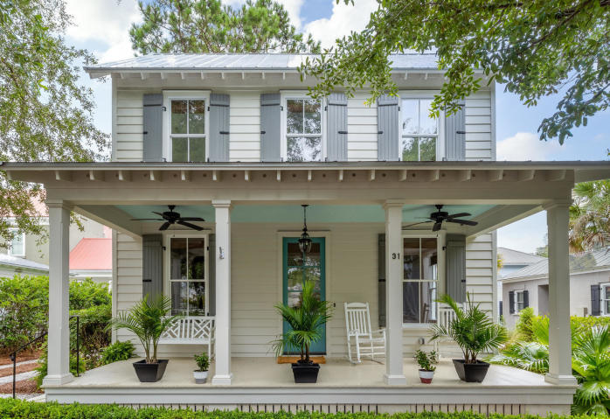
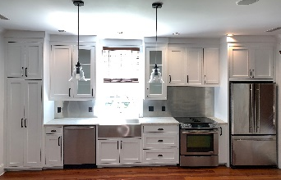
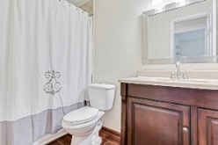
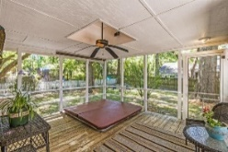
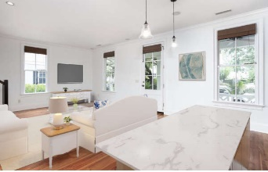
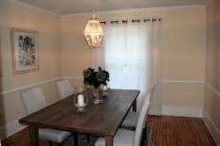
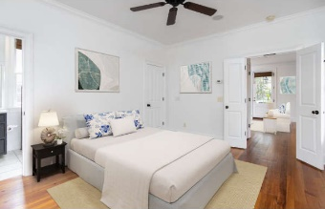
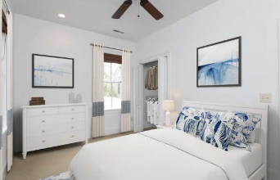
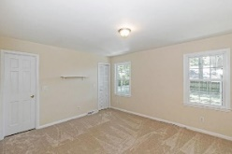
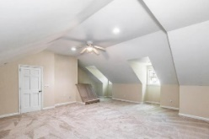
Virtually Staged and Updated Cabinets
31 Mises Street
I’On | MLS# 20015616 | $694,900
Please look at it the difference virtual staging has made. You will love the freshly painted white kitchen cabinets which are shown in the pictures. Please go on MLS for more details.
Here is the home you have been waiting for in I’on!
You will love this charming home tucked away on one of I’ons most desirable quiet streets surrounded by large beautiful homes. It offers a Master bedroom and bathroom/step in shower with walk in closet on the first floor. 2 additional bedrooms and bath on the 2nd floor for kids, guests or office space. Enjoy relaxing on the porch...it is so wonderful in this serene, friendly neighborhood. The HVAC is a little over a year old, fresh white paint on interior walls, doors, ceilings, closets and trim were just completed. House was just power washed and exterior doors were just painted I’on blue. Open floor plan- Beautiful pine hardwood floors, Custom cabinets, Carrera marble countertops - Jenn Air/Bosch stainless appliances -Downstairs master suite - Marble tiled bath - Oversized frameless glass shower – Ceiling fans throughout - Front porch - Full size stackable Washer & Dryer - Wired for stereo surround sound - Custom tongue and groove shutters - Alarm system can be operational.
Driveway accommodates 2 cars. Addition can be done in the back, or a garage can be built with a room above it with city approval.
We are happy to pay agent representing Buyer 2.5% payout. You all may remember this house from Southern Charm where Kathryn use to live.
Call Katie (Agent/owner) to show today 314-570-0418.
Katie Dooley Curran
(314) 570-0418 | Katiedcurran@gmail.com
Limited listing offered by Behren Kittrell, Charleston Flat Fee Real Estate, 843-870-3549

