Slide 1
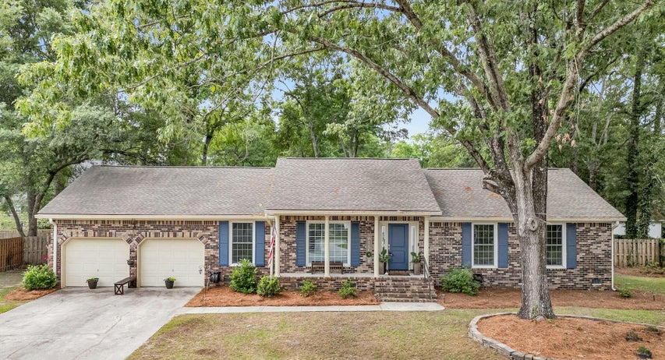
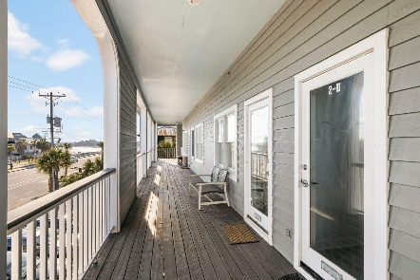
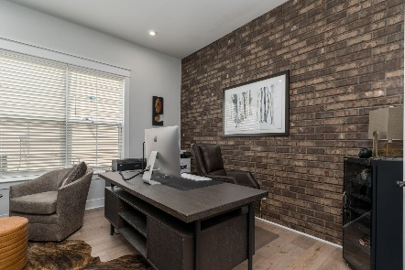
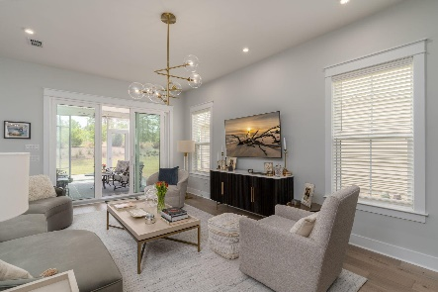

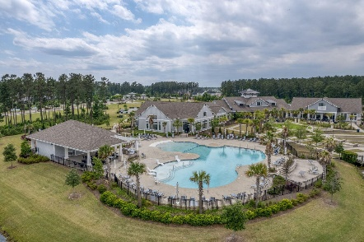
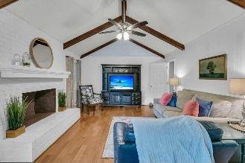
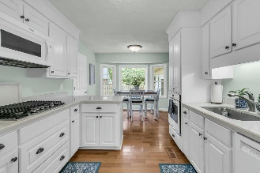
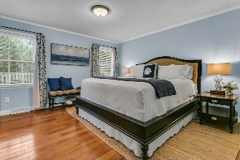
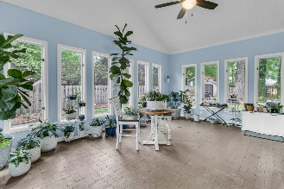
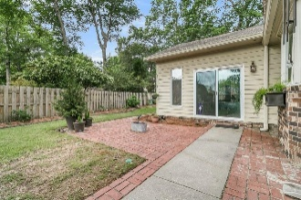
31 Monte Sano Drive Otranto | Hanahan, SC 29410 | MLS# 25011355 | $529,999
Darrell Creek Elevated Home With Elevator & Salt Pool
Beautiful Otranto Ranch
Co-sponsored by
MOTIVATED SELLER! Now offering $10,000 to buyers CC/Concessions. Moving to the Charleston area and looking for a wonderful, established neighborhood with beautiful oaks and character? Otranto in Hanahan is the place to be. This wonderfully maintained and updated brick ranch home is a perfect mix of traditional and new. As you step into the front yard and are greeted by the bold brick with cornflower blue shutters and door you know you are not in a cookie cutter neighborhood anymore. NO HOA but lovingly maintained surroundings boast pride of homeownership. Walking in the front door the rock entryway followed by wood floors throughout are reminiscent of great craftsmanship and longevity. The formal living and dining room at the front of the house offer space for entertaining and the den with wood burning fireplace are essential for the cozy winter evenings reading or watching movies with the family. The kitchen has been updated with modern appliances and granite countertops. Above the garage is a flex space used currently as a bedroom but can be a man-cave, playroom, office, etc. The laundry room is off of the kitchen and next to the garage. The hallway to the right of the front door leads you to the bedrooms. The 2 secondary bedrooms are good sized and have long, almost floor to ceiling, windows allowing for natural light flow into the rooms. The Primary bedroom is located at the end of the hallway and facing the back yard for privacy. The bathroom has been done in white shiplap and has a coastal feel to it. The upgrades throughout the home are tastefully done. The addition of the sunroom in the back is an inviting space for relaxing with a sweet tea and enjoying the garden or back yard space. The roof was replaced in 2020, Liberty safe, updated energy efficient windows and the crawl space has been encapsulated. Come see this lovely home before it's gone.
VIDEO TOUR
Offering $3000
Lender Credit
Rochelle Rennert
843-847-9694 | rochellesellscharleston@gmail.com | www.RochelleSellsCharleston.com
AgentOwned Premiere Group, Inc. | 219 N Highway 52 Ste A | Moncks Corner, SC 29461-3926

