Slide 1
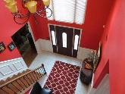
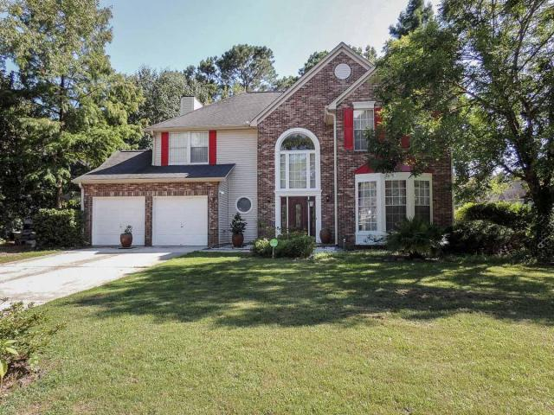
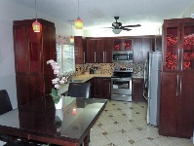
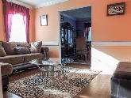
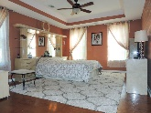
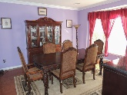
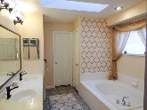
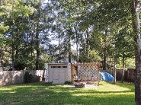

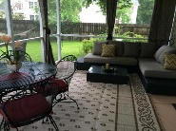
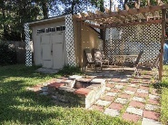
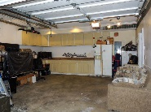
3203 Rose Walk Court
Cypress Pointe ~ Mount Pleasant ~ MLS# 16018867 ~ $394,900
Sat & Sun 1-4pm
Open House This Weekend
$5,000 toward buyer's closing cost.
$5000 agent bonus w/ BIC approval.
Priced to sell under $400K located in Dunes West outside the gates. MODEL HOUSE, 4 bedroom, 2.5 bath. WOOD floors throughout. Recently remodeled kitchen includes stainless steel appliances & quartz countertops. 1st floor offers OPEN plan of the family room, kitchen and breakfast area, formal dining, and formal living. House has 3 HVAC units: 1st, 2nd and a garage. MASSIVE master bedroom complete with a full bath, dual sinks and walk-in closet upstairs along 3 secondary bedrooms and full bath. This home has many upgrades ($90,000+ worth) and is on a premium EXPANSIVE lot, which offers SCREEN PORCH, brick fireplace, pergola, shed, and wooden fence! Dunes West pool located within 5 minutes of walking. School bus stop is in the cul de sac, where the house is located. Termite bond renewed. There is also a bonus room perfect for an exercise area or gaming room. 2 additional spacious bedrooms, full bathroom and laundry room complete the upstairs. Additional features include lighting fixtures, kitchen appliances: range, built in microwave, dishwasher. You're going to love all the different spaces this house has to offer. Especially the backyard, which offers custom made brick fireplace, wooden pergola and shed. Family friendly pool within walking distance. House has three separate HVAC units: for 1st, 2nd floors and a garage. Garage can be a perfect game room or man cave, since it has separate heater and air conditioner.
Christopher Watson
(843) 471-0956
chris@chriswatson.com Harbourtowne Real Estate | 672 Marina Drive, Ste 110 | Daniel Island, SC 29492

