Slide 1
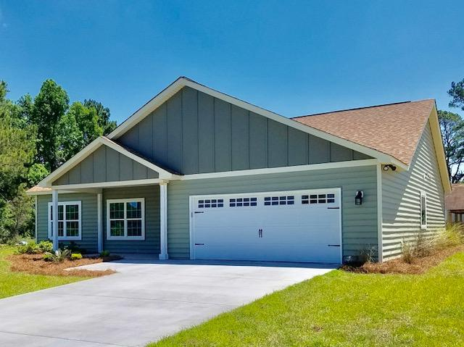
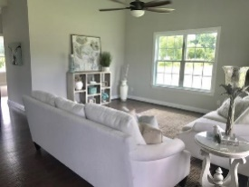
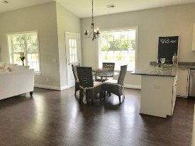
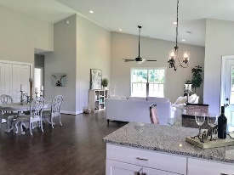
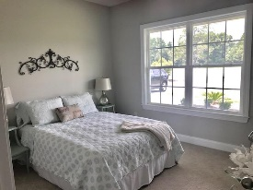
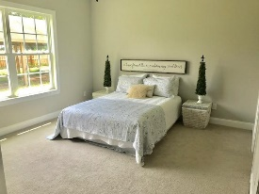
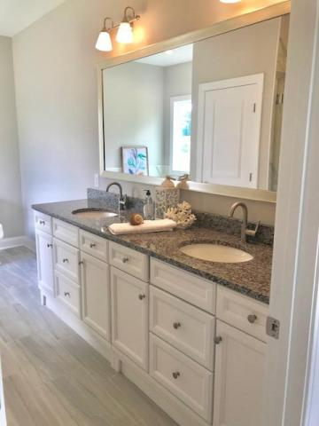
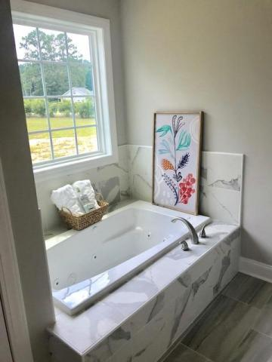


3204 Plowground Road Pt Capes Plantation | Johns Island MLS# 18018017 | $358,000
$5,000 AGENT BONUS
Gorgeous custom built home on large 3.51 acre lot. Perfect location to escape the city and a great place for horses! Short drive to Kiawah beaches, downtown Charleston and great dining nearby. You will love this open floor plan with 14 ft. vaulted ceilings in family room and kitchen and so many large windows throughout allowing sunlight to fill your house! Kitchen includes beautiful white cabinetry, stainless steel appliances under warranty and granite countertops. Upgraded laminate hardwood floors throughout living areas and upgraded trim package throughout entire house. Master bedroom includes extra large walk-in closet and upgraded gorgeous ensuite bath with granite dual sinks, custom walk-in shower with frameless glass door and separate whirlpool tub. Guest bath includes tile floor and beautiful marble top vanity. 9' ceilings and plush carpet in bedrooms. Large front porch and also a back porch. Detached 20x40 carport in back. MUST SEE!!!! Seller is offering $4000 towards buyer closing costs in addition to lender paid closing costs.
Stephanie Deaton (843) 743-4219
sdeaton@palmettost.com
www.palmettost.com

