Slide 1
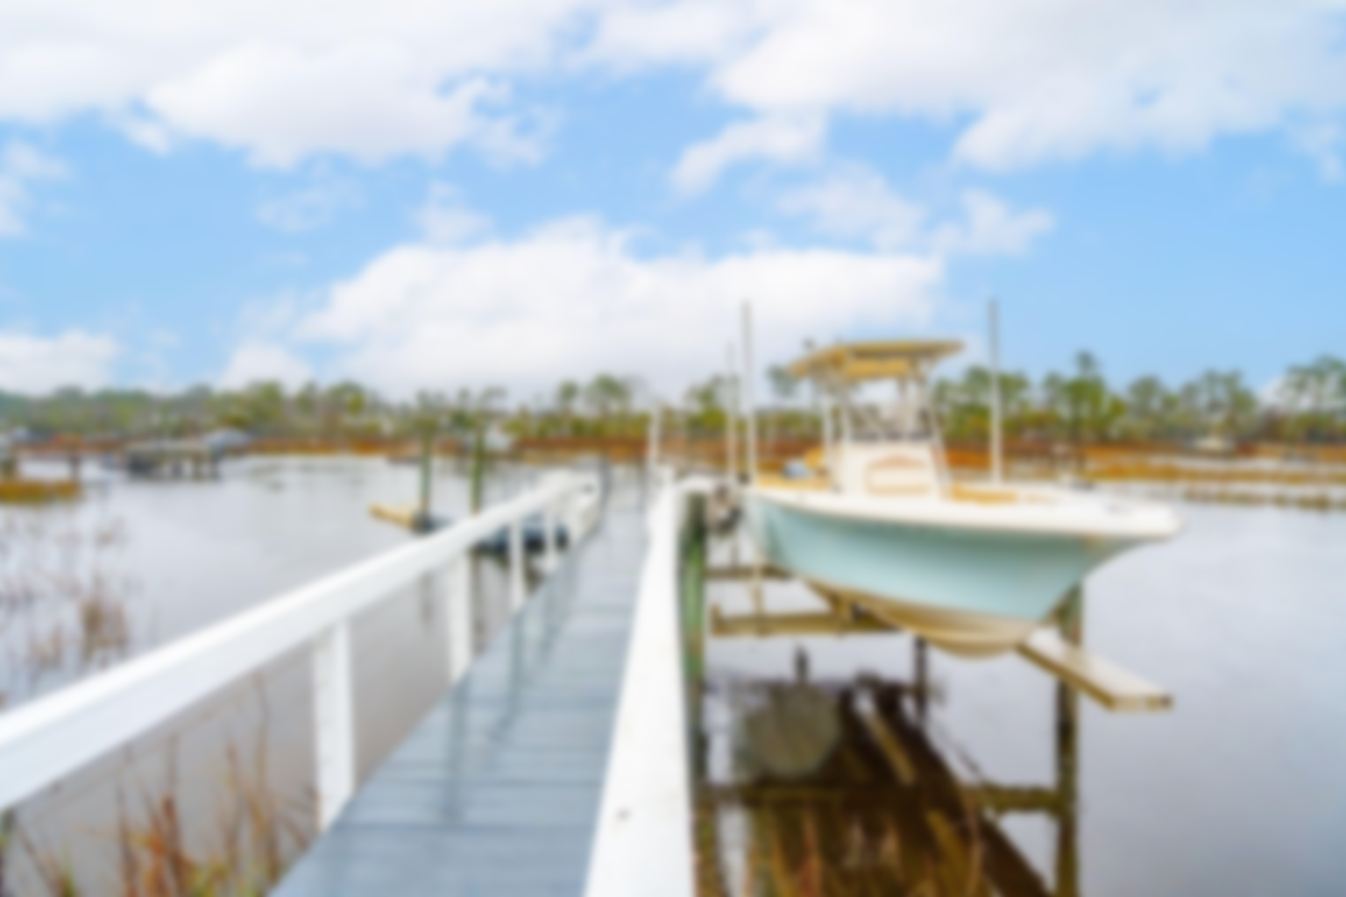
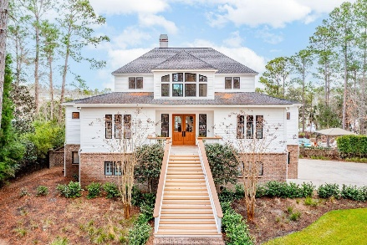
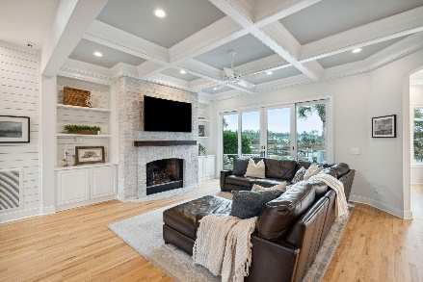
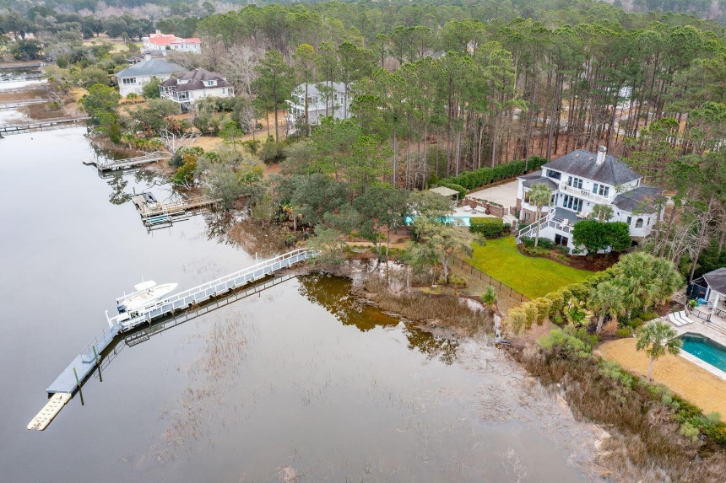
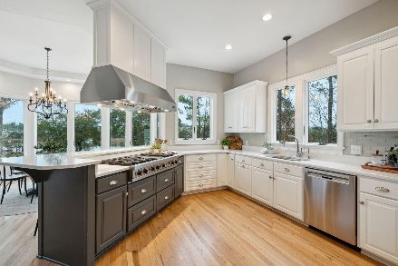
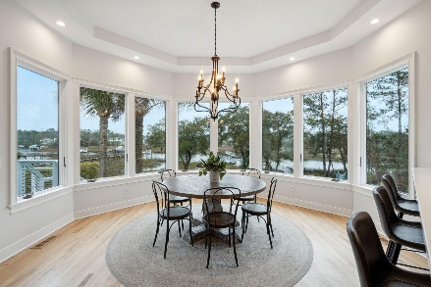
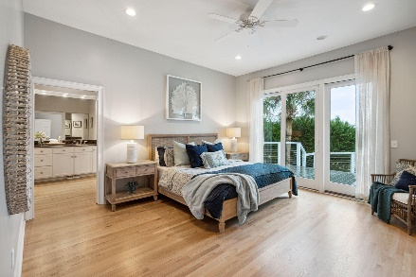
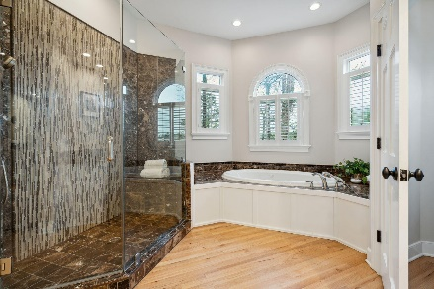
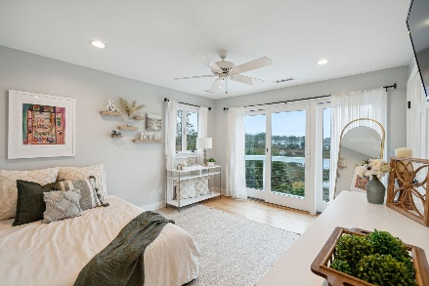
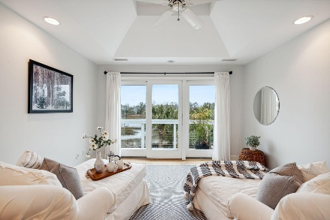
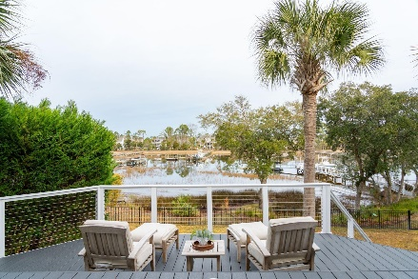
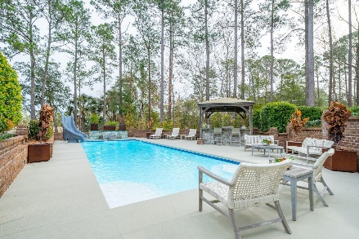
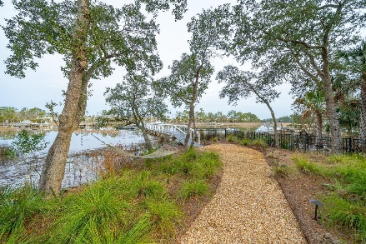
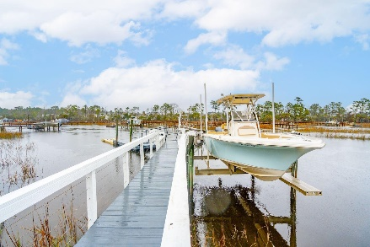


3204 Pignatelli Crescent
Dunes West
Mount Pleasant, SC 29466
MLS# 24004089 | Now $2,750,000
Private Waterfront Estate
Behind the gates of Dunes West, in prestigious Marsh Landing, this gorgeous coastal transitional style home is nestled into an estate size lot of lush landscaping and sits on the banks of Wagner Creek. The exterior of the home is impressive, from the deep water dock to the pool & outdoor kitchen, it is evident that this home was built in a timeless fashion and designed with a classically elegant flare that will transcend trends and fads.
This home boasts a gourmet kitchen that will please the most discerning of home chefs and is adorned with true professional grade appliances. A six burner Viking Cooktop with grill sits below a commercial grade exhaust hood. No one would complain about kitchen duty while cooking with such an amazing view! Stainless steel appliances, including a built-in Sub-Zero refrigerator and double Thermador Ovens are coupled with expanses of gorgeous quartz countertops and glass tile backsplash.
A large multi-level deck is accessible via the living room and kitchen and provides an excellent location to sip your morning coffee while watching Egrets and Herons fish for the morning's breakfast in the water below. When it is time to retire for the evening you'll gladly make your way to the private Owners Retreat conveniently located on the main floor. As one would expect in a home of this stature, the master retreat is tucked away and offers all of the expected luxuries and then some.
Additional conveniences include a two-stop elevator, fully finished garage with separate one car bay and a multitude of storage spaces. This home exemplifies the classic Lowcountry lifestyle ~ elegant and refined, yet comfortable and welcoming with plenty of outdoor living space. In addition to the decks and balconies, this home offers a covered patio space with stone pavers and a glimpse of the stunning water views.
Take the short stroll down to the deepwater dock complete with 6,000 lb boat lift and floating dock. The floater is a great spot for crabbing, fishing, launching a jet ski, kayaks or SUP, and for friends to tie up when visiting via boat. This dock affords you the ability to jump into your boat and be in the Wando within minutes so that fishing and other water sports are enjoyed at your leisure! This home is truly a custom masterpiece and must be seen to be fully appreciated. Located in one of Mount Pleasant's premier gated communities, Dunes West offers an award winning golf course and club house, pools, tennis club, and neighborhood walking paths. Dunes West is conveniently located close to the area beaches, shopping, dining, minutes from the new Roper St. Francis hospital and a short drive to the world class dining and shopping of historic downtown Charleston.
3D Virtual Tour! | Video Tour
Don Dawson
843-514-0452
ddawson@carolinaone.com
Carolina One Real Estate • 2713 Highway 17 North • Mount Pleasant, SC 29466
www.TeamDawsonSC.com

