Slide 1
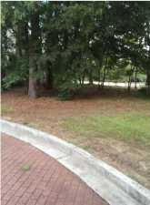


YOUR OPPORTUNITY AWAITS!
3206 Johnstowne Street
Kiawah River Estates
Johns Island, SC 29455
MLS# 15019870
$45,000
Opportunity Knocks!
This vacant lot is located inside the security gate of Kiawah River Estates and is in the Johnstowne subsection. A beautiful patio lot priced way below the current competition for a quick sale.
The annual homeowners fee covers the following amenities: pool, clubhouse, tennis courts, crabbing dock, roads, insurance.
Property owners have the opportunity to join the Kiawah Island Governors Club, Seabrook Island Club, and Oak Point Golf Club. Bicycle to the Freshfield Village for shopping and dining, or to the Bohicket Marina for shopping, dining and water activities. Of course, there is access to Beachwalker Park Beach.
A onetime fee of .25% of sales price payable by the buyer to the HOA capital reserve, upon closing.
Age, acrg, schools, sqft, HOA fees, and taxes are approx. Buyers to verify.
Bill Everett, Jr
Broker
843-693-8539
Bill@TheEverettGroup.net
RE/MAX Pro Realty, 9209 University Blvd, Charleston, SC 29406

