Slide 1
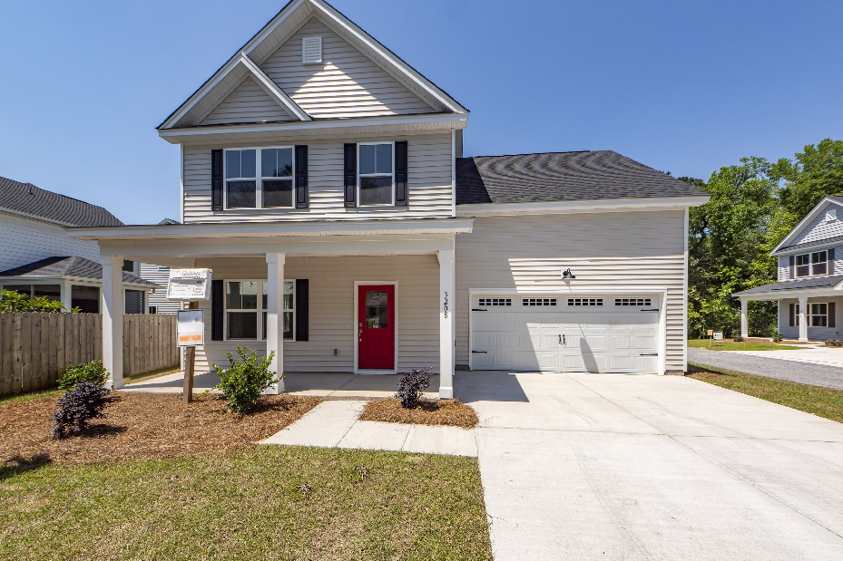
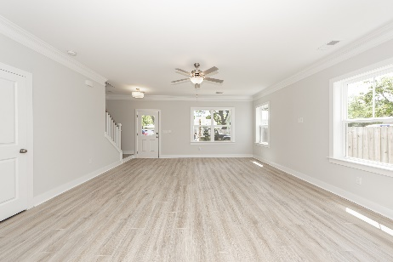
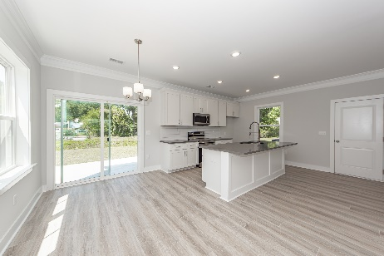
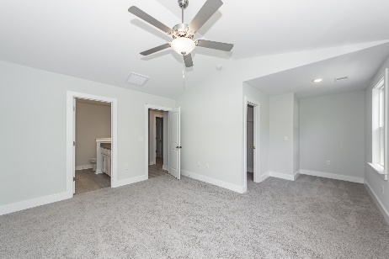
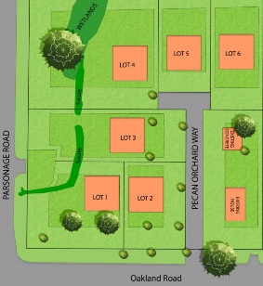



BRAND NEW HOME Situated on a quiet street in West Ashley!
3208 Pecan Orchard Way
Charleston, SC 29414
MLS# 23008388
$489,900
4 Bedrooms :: 2½ Baths :: 1,990 sf
This 4 bedroom & 2.5 bathroom home is convenient to shopping, dining, Downtown and I-526! The open concept with 9' ceilings and tall windows welcomes you right into this home. Sleek crown molding downstairs and wainscoting in the dining area give a luxurious touch! The kitchen is nicely adorned with quartz counter tops, upgraded shaker cabinets and stainless steel appliances. The stairs have beautiful Oak Treads with an LVP landing leading down the hall.
4 bedrooms allow room for family and/or guests to stay! The master bathroom has a large & elegant tiled shower and dual vanities! HUGE walk-in closets! This home is very close the public boat ramp, which is very quick access to the Ashley River!
Take a virtual tour today!
https://www.charlestonvirtualhomes.com/23008388/
Jon Moore
(843) 732-3365
jon@charlestonrealestategroup.com
www.charlestonrealestategroup.com
Charleston Real Estate Group | 443 Folly Road | Charleston, SC 29412

