Slide 1
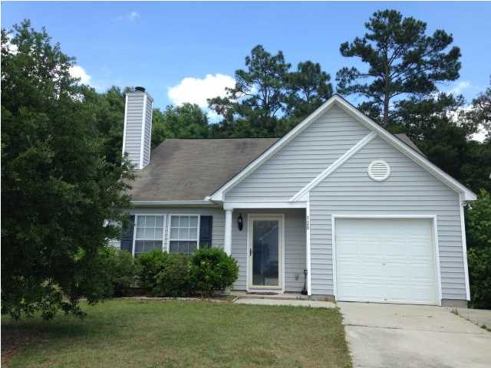
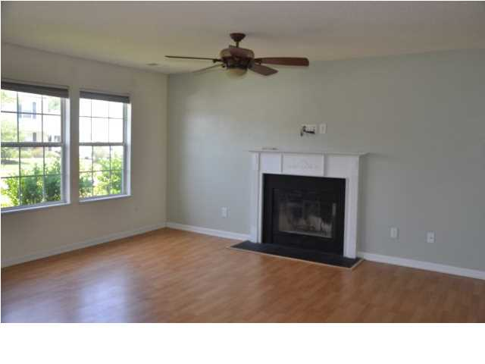
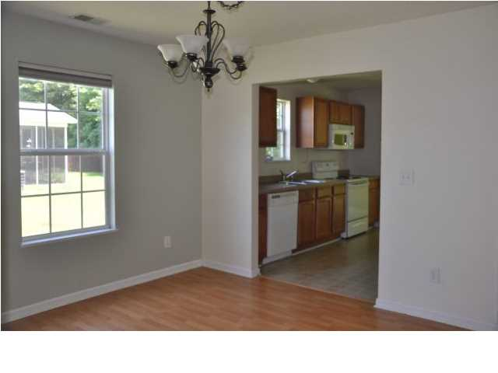
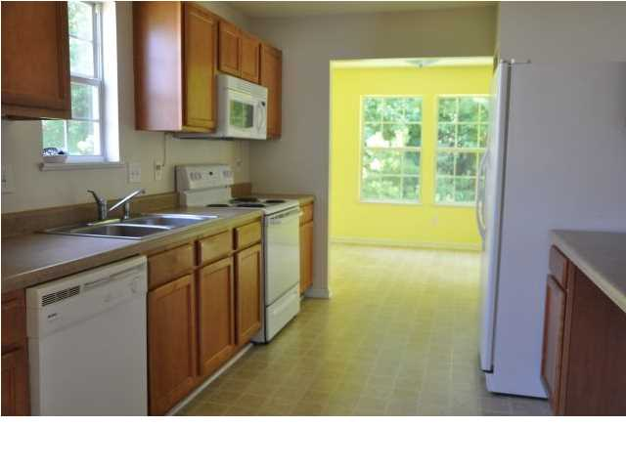
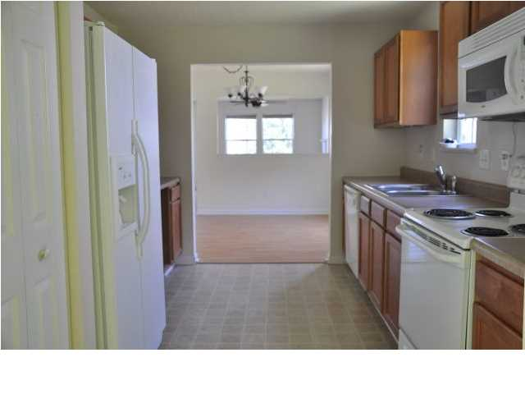
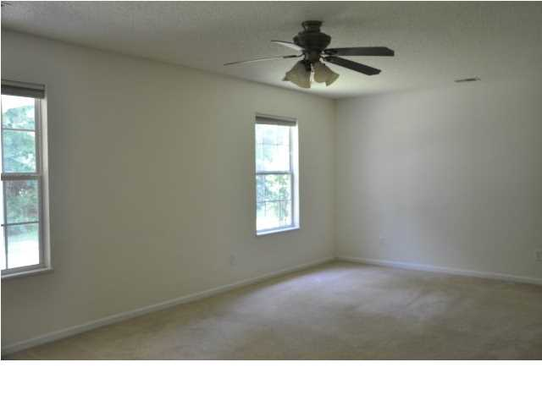
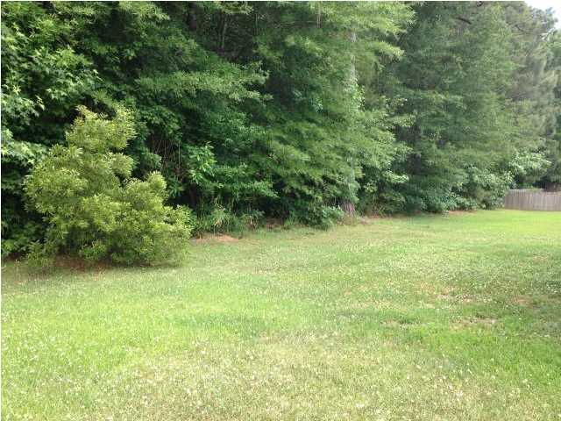
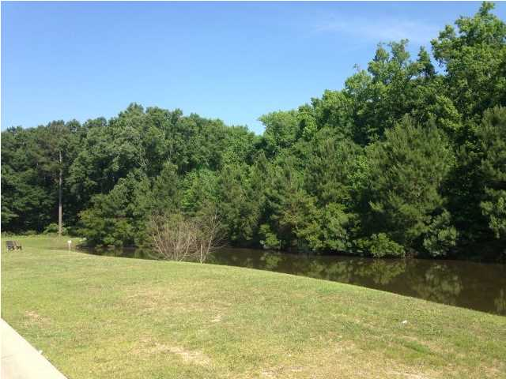
APPROVED SHORT SALE!! Below appraisal!!
320 Aberdeen Cir
Scotts Mill
Summerville
MLS# 15003165
NOW $135,000
Can close quickly! Recently appraised in October for $145,000. Adorable home located on a private lot that backs up the woods. Open flood plan with laminate hardwood in living room and dining room. Living room offers a fire place. Separate Dining room great for entertaining. Kitchen offers a home office desk area. Sunroom located off of kitchen, perfect for a sitting area. Master is located downstairs with two large secondary bedrooms located upstairs. Large master bathroom and walk in closet. Covered patio out back is a great place to relax and enjoy the private views of the wooded backyard. Must see! Home being sold AS-IS WHERE-IS.
Jennifer Laffey-Foster, MRP
Real Estate Agent
Miler Properties
Office: 843-821-1111
Cell: 843-708-1582
jlfoster86@gmail.com www.milerproperties.com

