Slide 1
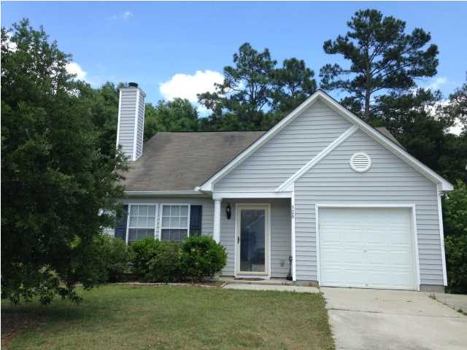
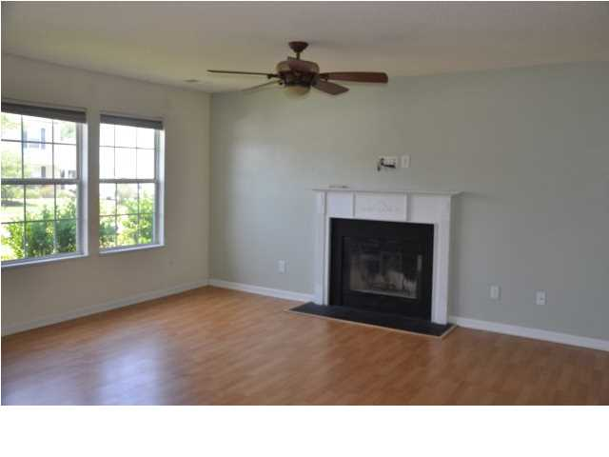
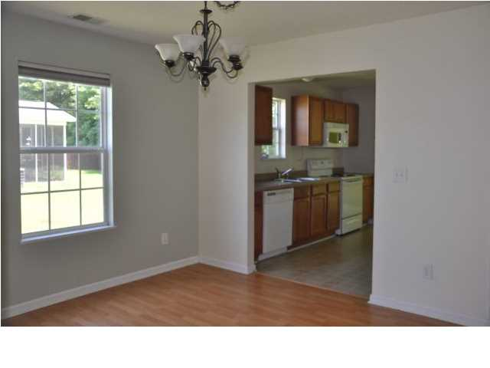
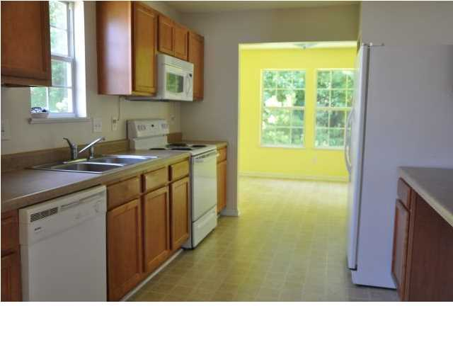
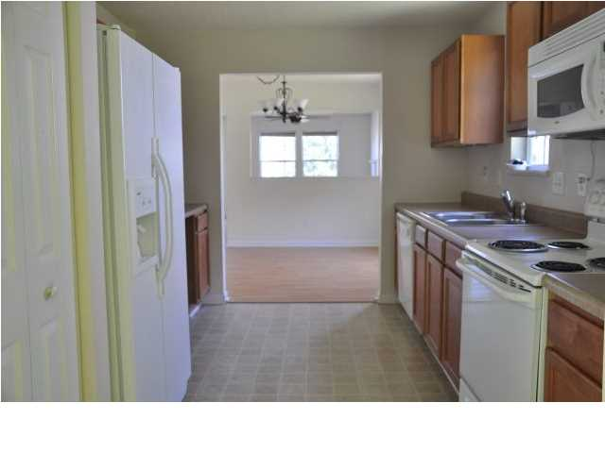
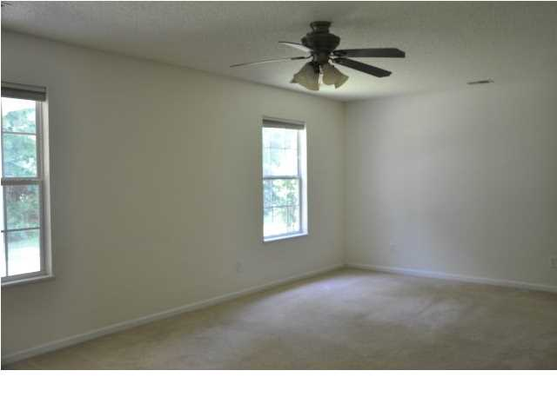
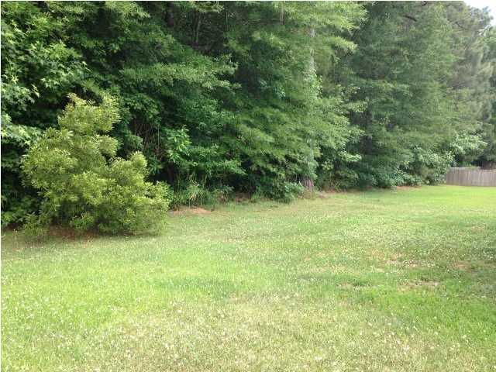
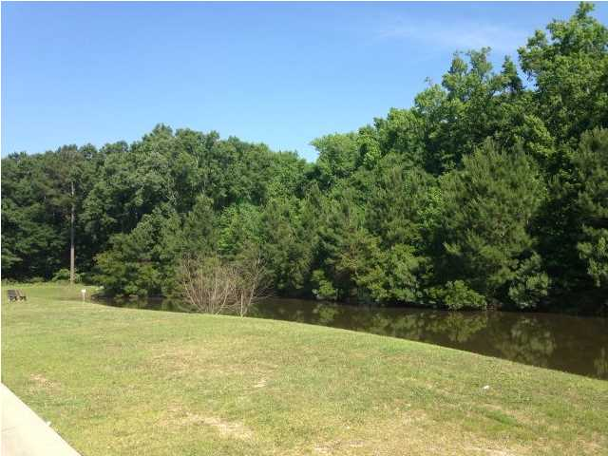
APPROVED SHORT SALE!! Just Reduced!!
320 Aberdeen Cir
Scotts Mill
Summerville
MLS# 1413033
NOW $135,000
ADORABLE!! Want a home that already has equity?? Home Appraised for $150,000 in April 2014! Awesome two story layout. Enter this home to an inviting living room with laminate flooring. Formal Dining room offers great space for entertaining and laminate flooring. Open kitchen with built in desk and includes all major appliance. Home offers a wonderful sun room for relaxation and covered patio to enjoy the very private wooded backyard. Master bedroom is located downstairs with walk in closet and ceiling fan. Master bathroom offers his and her sinks. Two large bedrooms are located upstairs. Both offer walk in closets and ceiling fans. This is a must see. Excellent price in a great neighborhood.
Jennifer Laffey-Foster, MRP
Real Estate Agent
Miler Properties
Office: 843-821-1111
Cell: 843-708-1582
jlfoster86@gmail.com www.milerproperties.com

