Slide 1
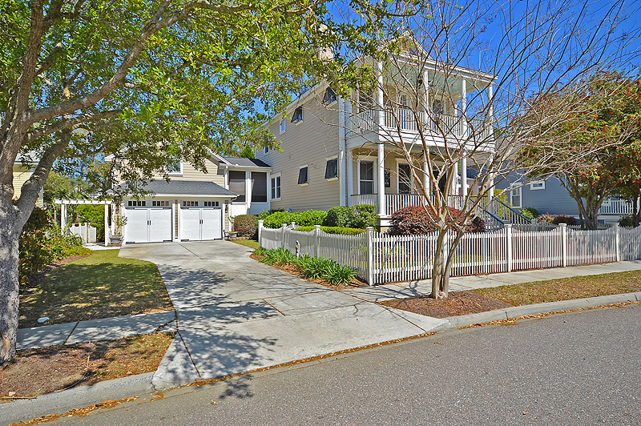
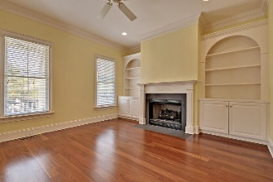
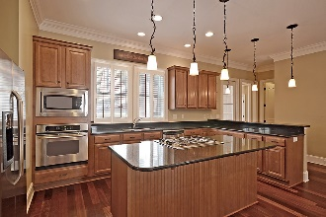
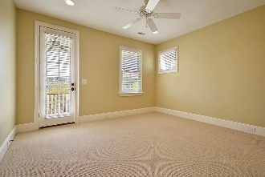
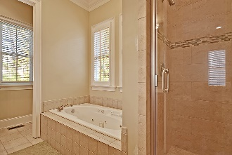
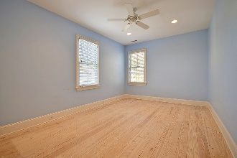

320 Bermuda Towne
Hibben @ Belle Hall | Mount Pleasant, SC 29464
MLS# 17008879 | $725,000
Price Reduction
in Park West
$775,000
Price Reduced $24,000 in Hibben
This lovely Charleston single 5BR/3.5 BA in highly sought after Hibben boasts large double front porches, two car garage and fenced in front and backyard with deck. This well designed floor plan features 9 ft ceilings, plantation shutters, hardwood floors throughout and screened in porch. Master Bedroom is downstairs with large walk in closet. Master bath has dual vanity, granite countertops, separate toilet room, large soaking tub and separate shower with seating area. The kitchen is complete with beautiful granite countertops, cherry custom cabinets, pendant lighting, island with seating space, built in microwave, under cabinet lighting and walk in pantry. The kitchen opens to a spacious eating area and family room. Three separate large bedrooms upstairs and oversized FROG w/full bath. Very well maintained home. Crawlspace is in excellent condition. New system in place will not allow water to accumulate in crawlspace. Entire crawlspace has been encapsulated has French drains along interior walls with gravel, sump pump and dehumidifier.
Stan Huff
843-670-2835
stan.huff@agentowned.com
Margaret Wannamaker
843-364-5851
wannamom66@gmail.com
www.agentownedrealty.com
AgentOwned Realty Co. Preferred Group, Inc. | 824 Johnnie Dodds Blvd | Mt Pleasant, SC 29464

