Slide 1
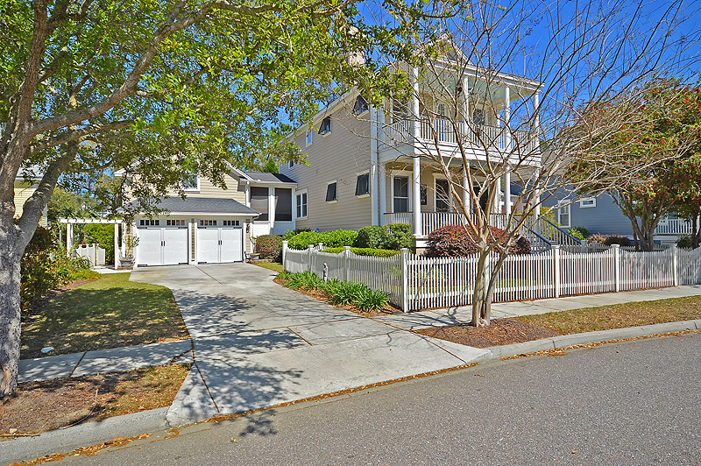
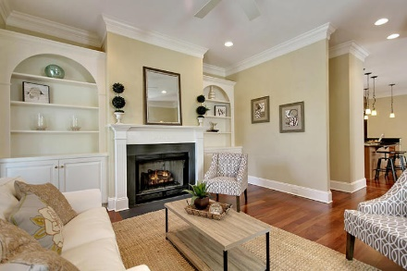
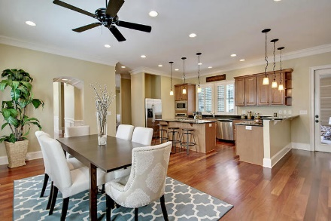
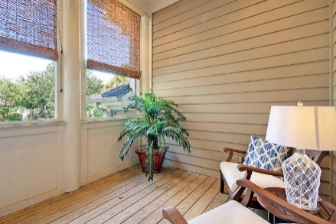
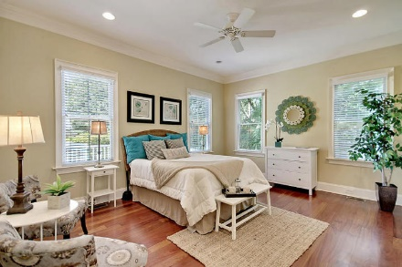

320 Bermuda Towne Hibben @ Belle Hall | Mount Pleasant, SC 29464 MLS# 17008879 | $650,000
New Low Price in Hibben at Belle Hall
Hibben at Belle Hall under $700,000
Location, Location, Location
4 BR plus FROG
3.5 Bath
2941 Sq/ft
2 car garage
Master Down
Beautiful Hardwoods throughout 1st floor
Seller Motivated
Screen Porch
Fenced in Front and Back Yard
Stan Huff
843-670-2835 stan.huff@agentowned.com
Margaret Wannamaker
843-364-5851 wannamom66@gmail.com
www.agentownedrealty.com
AgentOwned Realty Co. Preferred Group, Inc. | 824 Johnnie Dodds Blvd | Mt Pleasant, SC 29464

