Slide 1
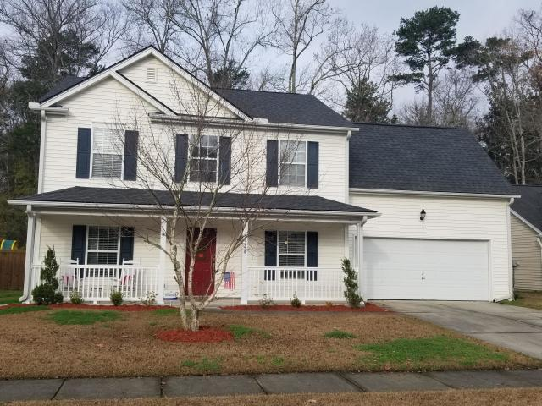
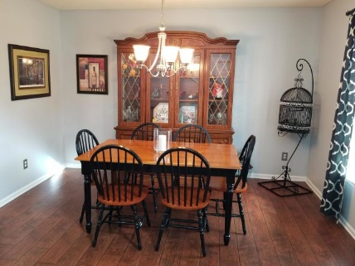
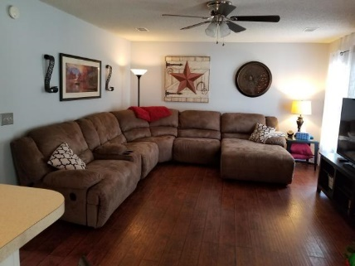
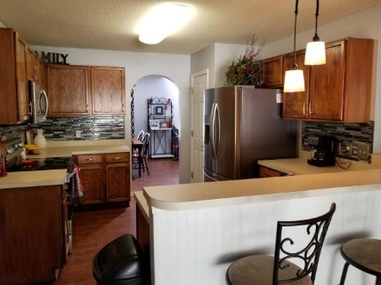
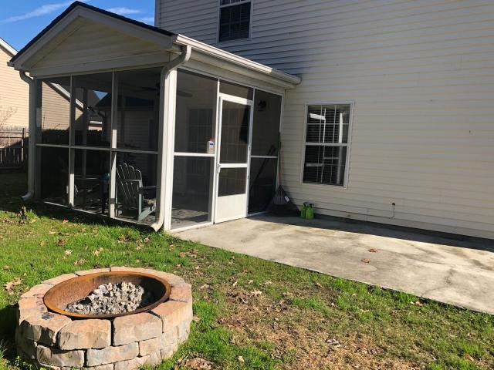
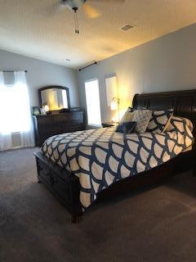
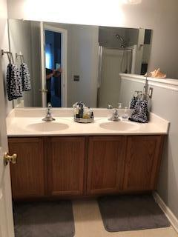
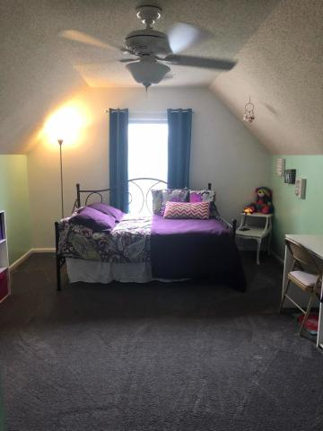
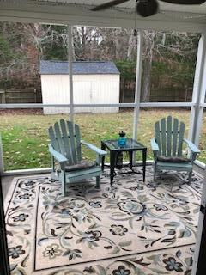
AFFORDABLE 4BR IN SUMMERVILLE
320 Eagle Ridge Road
Bridges of Summerville
Summerville, SC 29485
MLS# 19000099
$239,900
4 Bedroom | 2½ Baths
Driving up to this traditional 2-story, the first thing you notice is the gorgeous BRAND NEW ARCHITECTURAL ROOF that was installed December 2018! Lovely family-sized home offers warm wood-look laminate flooring throughout the first floor living area; formal dining room at front of home; good-sized kitchen with loads of counter space, stainless appliances & designer tile backsplash; breakfast counter at kitchen eating area in front of sliding glass doors to screened porch and private backyard; and large living room. First floor also has flex space, which could be office, playroom or possibly 5th BR. 2nd floor finds huge master suite with vault ceiling, two closets, and large master bath. Two secondary bedrooms & bonus/4th bedroom complete 2nd fl. Custom brick firepit makes cool evenings cozy. Oversized patio off screened porch has room for loads of seating and even umbrella table. Yard backs up to heavily wooded area for supreme privacy. There is also convenient storage shed.
Darlene Bollettino
Miler Properties
Office: 843-821-1111
Cell: 843-209-8955
dbollo84@yahoo.com www.milerproperties.com

