Slide 1
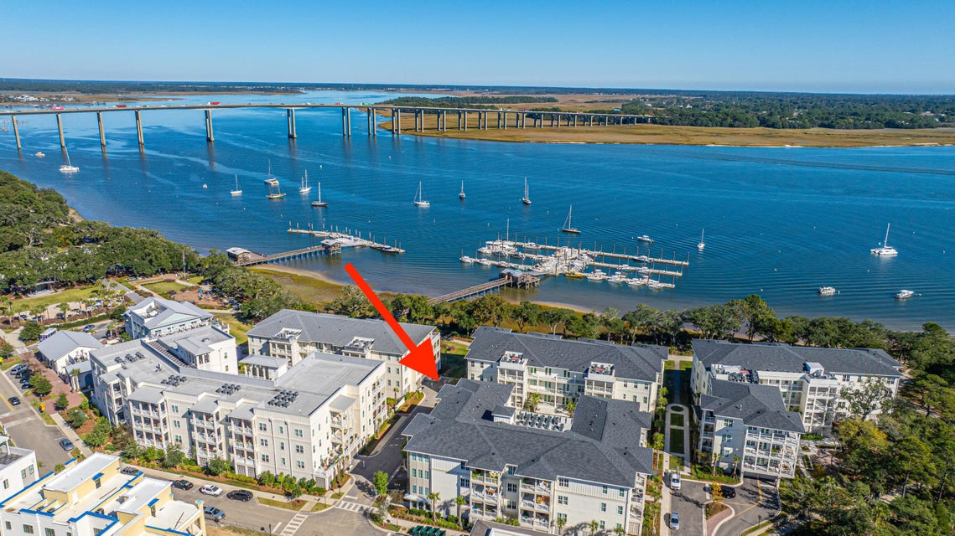
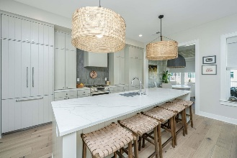
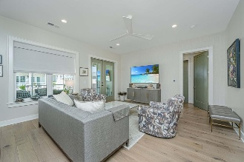
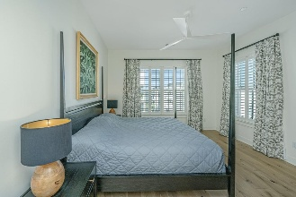
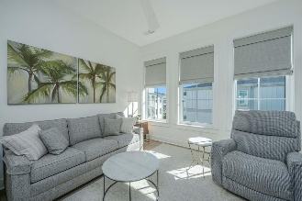
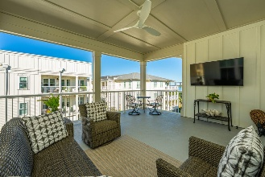

LARGE PRICE ADJUSTMENT!
AMAZING OPPORTUNITY AT THE WATERFRONT ON DANIEL ISLAND!
320 Longshore Street #1041
Daniel Island | Charleston, SC 29492 | MLS# 25029700 | $1,599,000
This 2024 top floor 2 bedroom 2 bathroom condominium is perfection! Enjoy fantastic views of the Wando River while basking in comfortable breezes from the large terrace. One of only six units throughout the community with no adjoining walls, experience unmatched quiet and privacy with an abundance of natural light from windows on all sides. Upgrades galore! Wide plank hardwood flooring throughout, high end lighting fixtures and ceiling fans, custom closets and kitchen pantry designed by Inspired Closets, built-in kitchen appliances offering a seamless cabinetry esthetic, professionally installed high end wallpaper, additional ceiling lighting in dining room, custom window treatments in every room, large 2 x 4 shower tile and specialty mirrors in both bathrooms, upgraded Farrow and Ball wall paint with all walls and trim receiving 2 additional coats of paint after purchase. Beautiful kitchen tile backsplash and custom countertop in pantry with added electrical outlet. Impeccably maintained unit with garage storage and 2 parking spaces conveniently located next to the elevator. Beautiful courtyard with multiple seating areas and state of the art grille. Well equipped fitness center and tranquil pool with gathering pavilion.
VIRTUAL TOUR
Carolina One Real Estate
195 W Coleman Blvd
Mt Pleasant, SC 29464-3495
Kathy Ware
843-830-3804
Kathy.ware@carolinaone.com
www.katherineware.com

