Slide 1
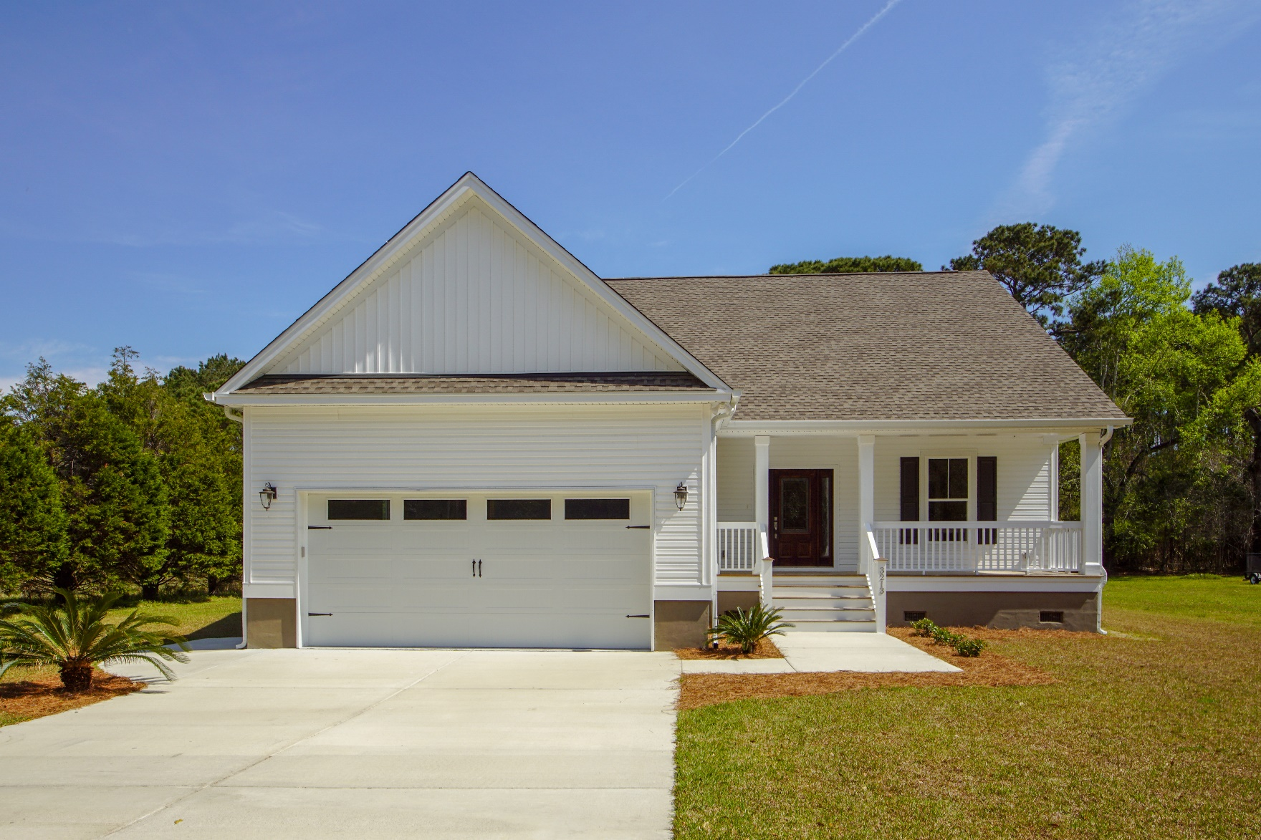
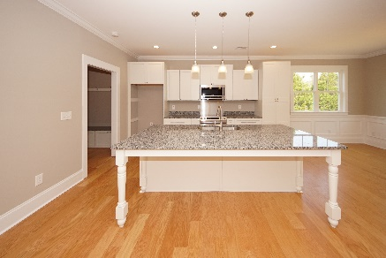
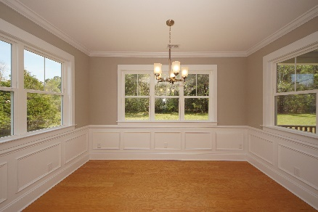
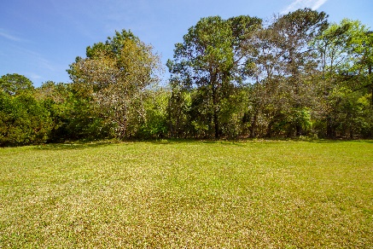


3213 Charlie Jones Boulevard Johns Island, SC 29455 MLS# 19008726 :: $398,000 3 Bed / 2½ Bath
New Finished Construction!
2.67 Acres!
Spectacular 3 bedroom 2.5 bath home with all of the upgrades on a 1 acre lot!!!
Open concept with wood floors, mudroom, stainless appliances, oversized granite island and special details in every room!
This home was built with modern style on a lot with No HOA.
Why wait for new construction when you can move in 30 days!
Connie White, Broker
843-532-3356
connie@chrepros.com · conniewhiterealestate.com
Charleston Homes · 597 Old Mt. Holly Road · Suite 301 · Goose Creek, SC 29445

