Slide 1
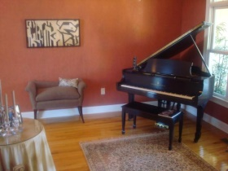
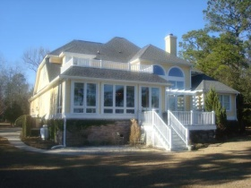
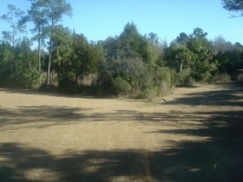
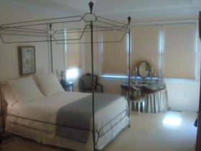
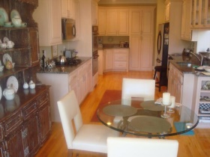
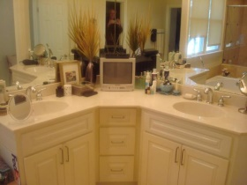
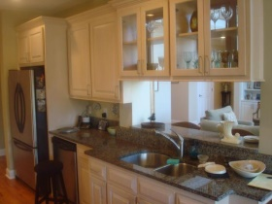
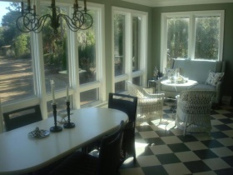
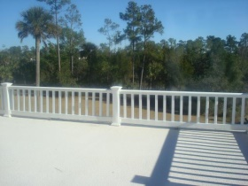
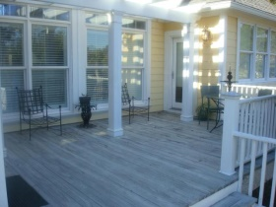
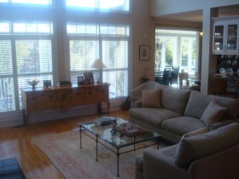
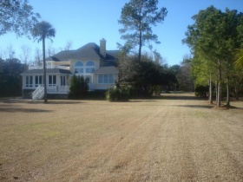
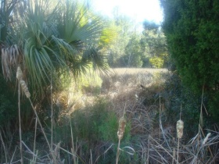
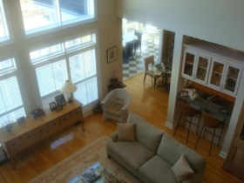
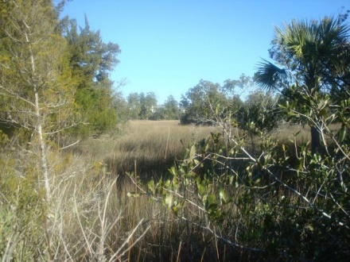
$40,000 Below Appraisal!!
3213 Cottonfield Drive
Dunes West ~ Mount Pleasant, SC 29466
MLS# 15003396 ~ $650,000 ~ 4,000+sf
This home is a real sleeper!!! The lot is very private and just about 300 feet from the tidal creek. This home has been well maintained and upgraded. When you enter the home you will notice the open floor plan with the living room, kitchen, dining area, and sunroom all overlooking the private marshfront lot. The master bedroom is downstairs and other bedrooms upstairs.
The first impression as you enter is how open and bright it is...Light colored hardwood floors are throughout the first floor except for carpet in the master bedroom. The kitchen has upgraded cabinets, stainless steel appliances, granite countertops and even a newer gas range.
Rick Willis
843-327-3017
Rick@RickWillis.com
The Group, LLC

