Slide 1
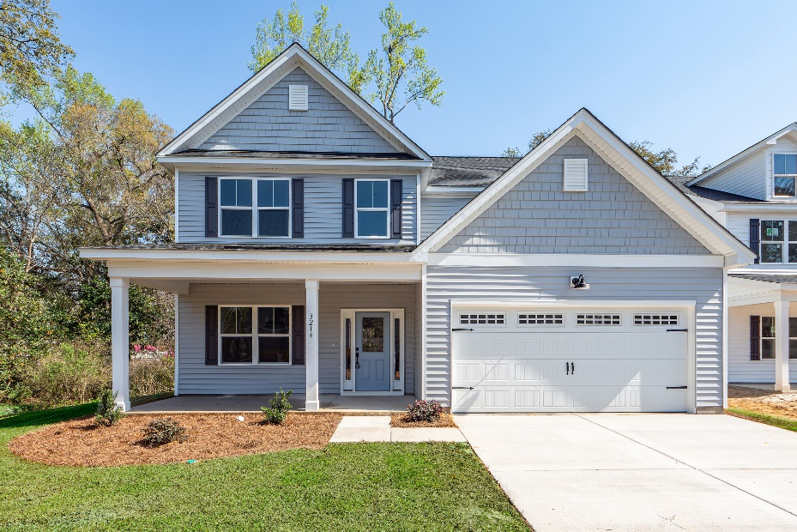
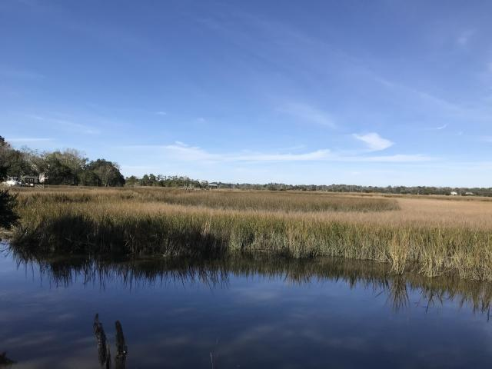
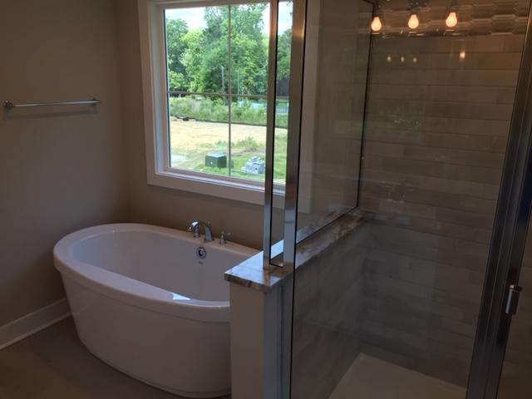
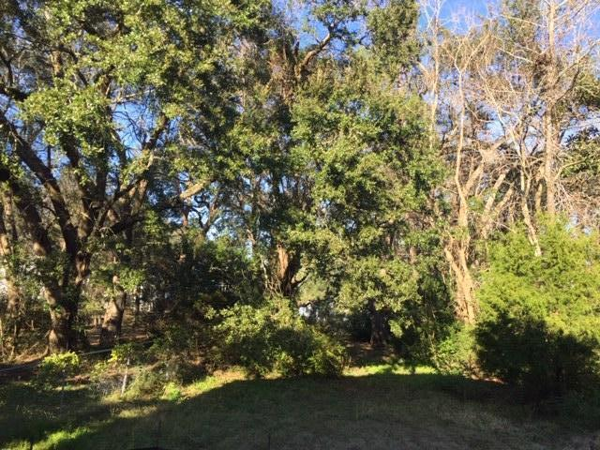
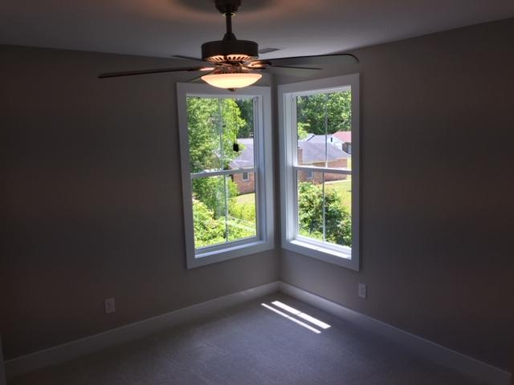
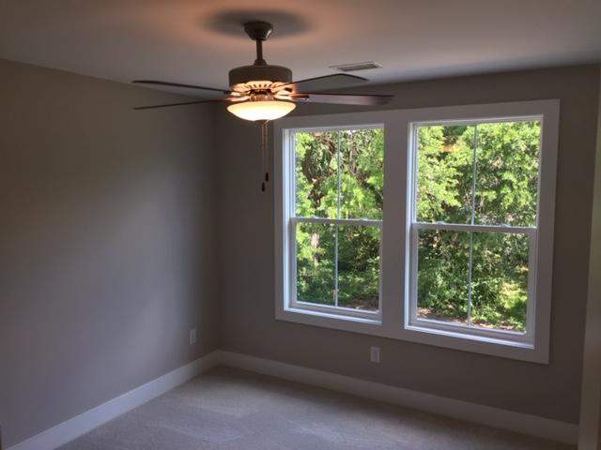
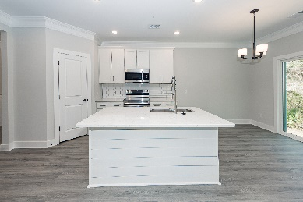
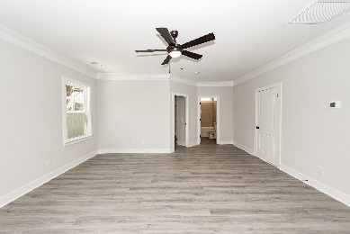
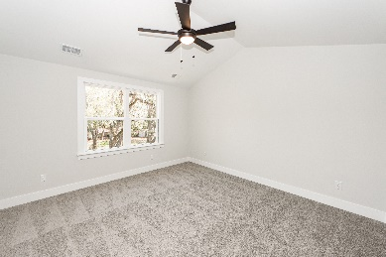
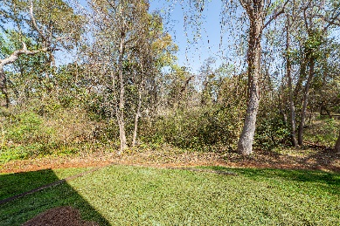
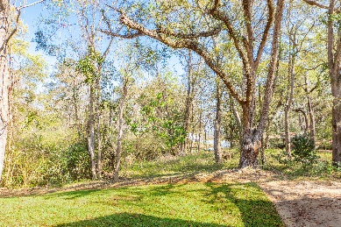




West Ashley New Construction, Large Lot
READY TO GO!
3214 Pecan Orchard Way
Charleston, SC 29414
MLS# 23004983
$499,900
5 Bedrooms :: 3 Baths :: 2,104 sf
MODERN & OPEN NEW CONSTRUCTION in desirable West Ashley! This 5 bedroom / 3 bathroom home is very close to shopping, dining, Downtown and I-526! The large open concept with 9' ceilings and tall windows invites you right into this home. Enjoy a bedroom and full bathroom downstairs with the other bedrooms upstairs. The downstairs bedroom is perfect for a guest room, or office. Beautiful crown molding downstairs and wainscoting in the dining area provide an elegant feel! The kitchen features quartz countertops, tall shaker cabinets and stainless steel appliances. The stairs have natural Oak Treads with an LVP landing leading down the hall. 5 bedrooms allow space for family and/or guests! The master bathroom has a large tiled shower, dual vanities and a walk in closet.
Enjoy the LARGE almost half acre lot with a wooded view from the back and views of the adjacent pond, with marsh and river glimpses! Maximize your yard usage for boat/toy storage with use of the huge side yard (off of Parsonage, across the wetlands inlet)! This home is VERY CLOSE to the public boat ramp, and quick access to the Ashley River!
Seller will contribute to a INTEREST RATE BUYDOWN with an acceptable offer!
Eric Draper
(843) 442-7118
eric.draper@gmail.com
Jon Moore
(843) 732-3365
jon@charlestonrealestategroup.com
www.charlestonrealestategroup.com
Charleston Real Estate Group | 443 Folly Road | Charleston, SC 29412

