Slide 1
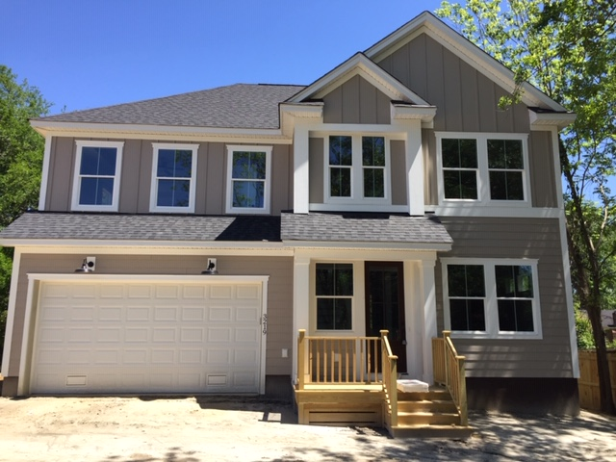
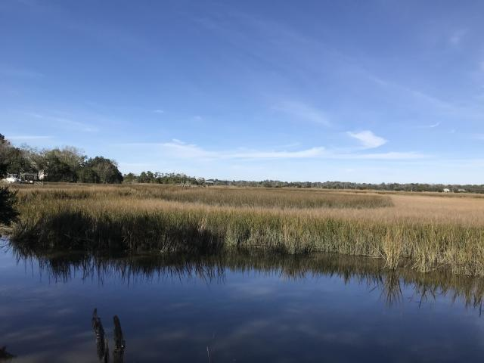
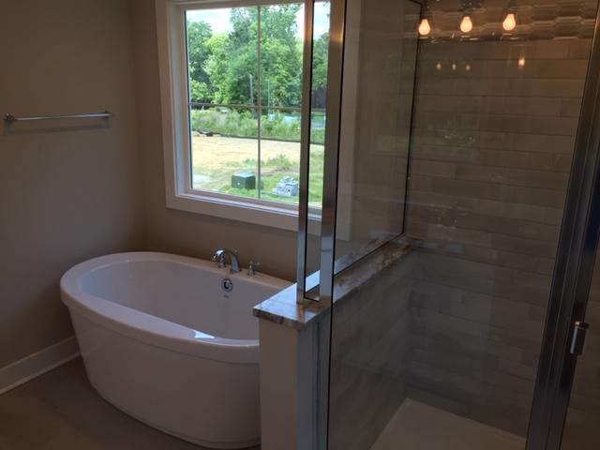
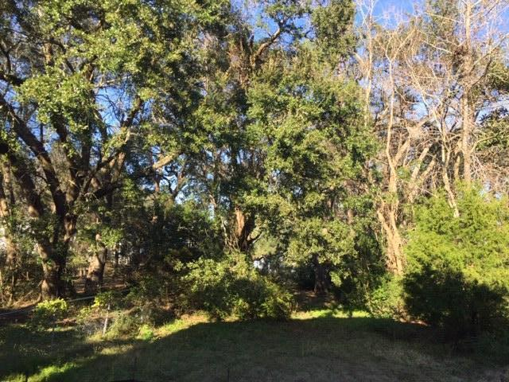
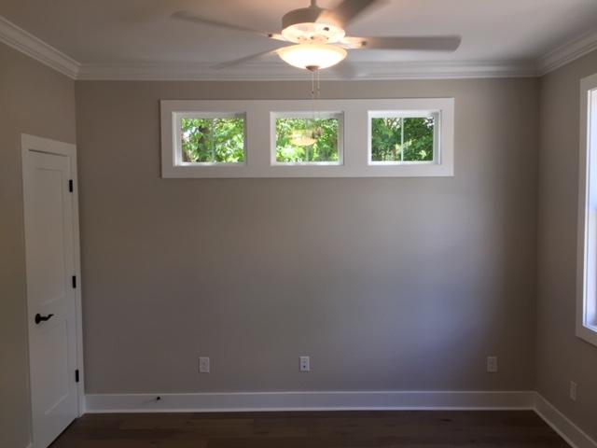
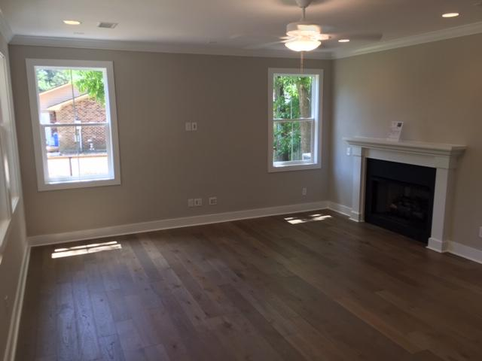
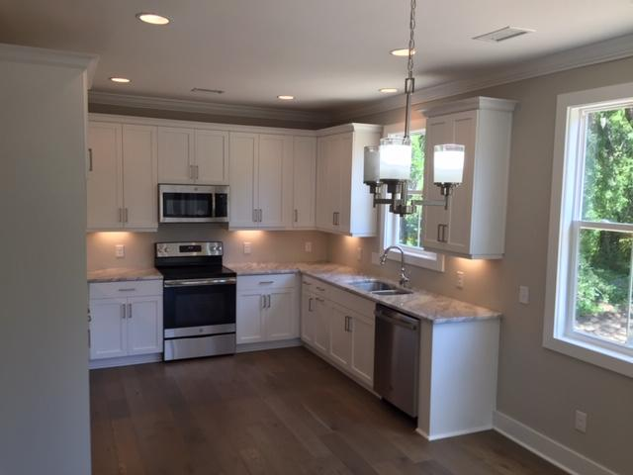
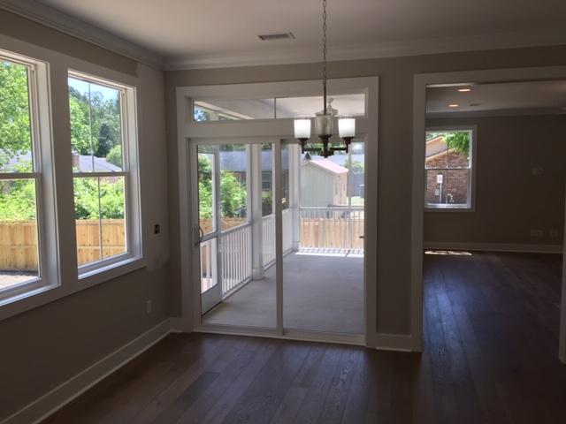
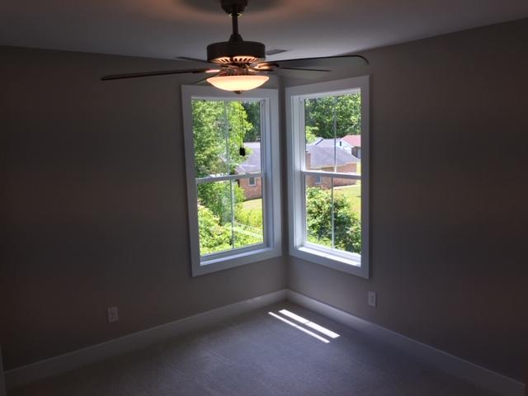
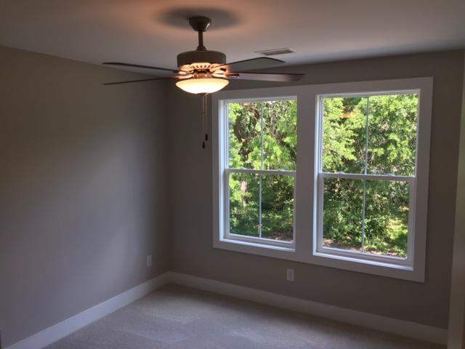
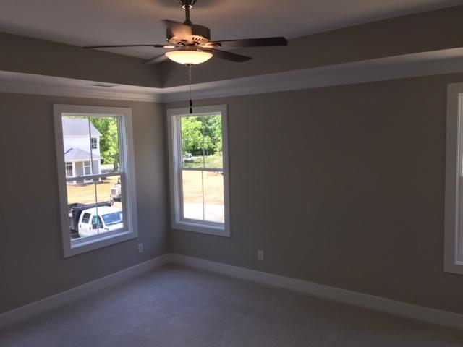
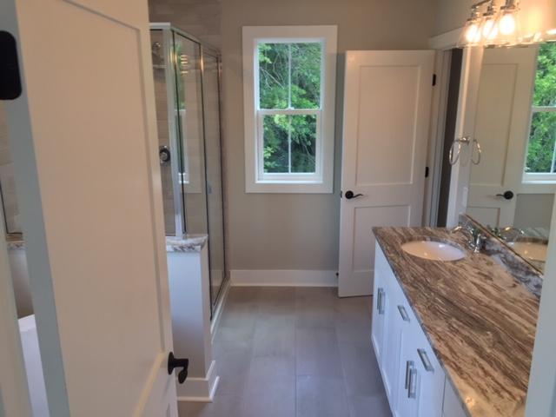
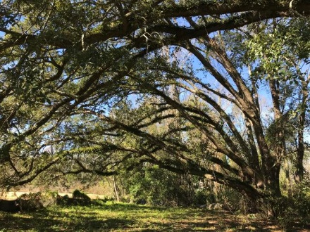
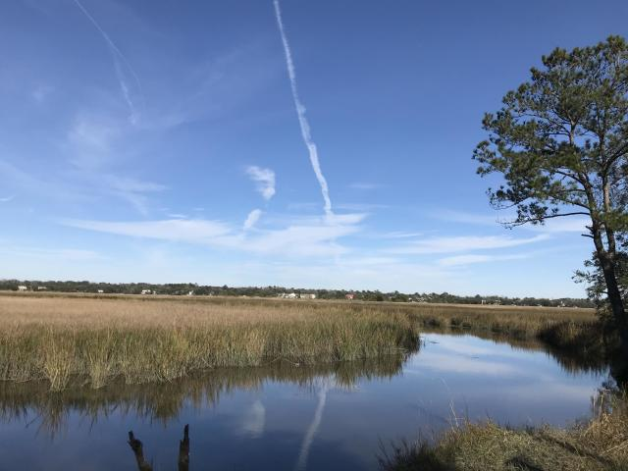




Beautiful West Ashley NEW CONSTRUCTION!
Less Than 2000 Feet From The Public Boat Ramp
3219 Pecan Orchard Way
MLS# 20005033
$395,000
4 Bedrooms :: 3 Baths :: 2,081 sf
This craftsman style home features 4 bedrooms and 3 bathrooms. Walk into large open spaces with tall 9' ceilings and ample, tall windows. Crown molding all downstairs. Hardwood Floors are throughout the home except for in the bedrooms and bathrooms. The bathrooms and laundry room are adorned with modern ceramic tiles. The kitchen features beautiful Quartz Countertops as can be found at the master bathroom dual vanity. Elegant Granite Countertops hilight the secondary bathrooms. With carpet in the bedrooms, the master bedroom features an elegant tray ceiling. The master bedroom has large walk-in closets and the master bath has a modern tiled shower and garden tub. Enjoy evenings on the screened porch overlooking the pond and Grand Live Oak Trees. There is a warming gas-log fire place that serves as an anchor centerpiece to the living room. Strong cement fiber siding with "Board & Batten" accents make the exterior classy and durable. This home is a stone's throw from the public boat ramp, which is very quick access to the Ashley River! 4 more home sites are available! Builder offers other plans to choose from, OR bring your own plans and builder will build your house for you!! New Photos coming soon!
Eric Draper
(843) 442-7118
eric.draper@gmail.com
Jon Moore
(843) 732-3365
jon@charlestonrealestategroup.com
www.charlestonrealestategroup.com
Charleston Real Estate Group | 443 Folly Road | Charleston, SC 29412

