Slide 1
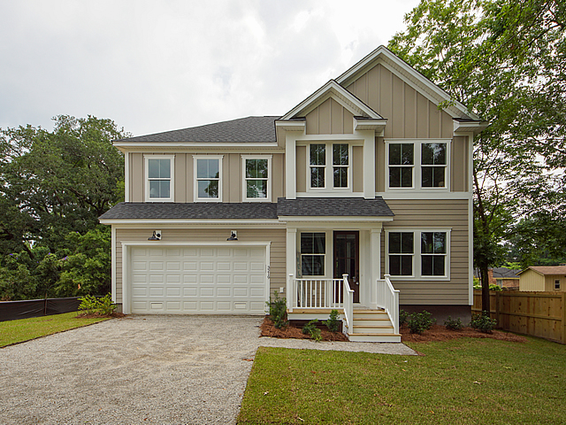
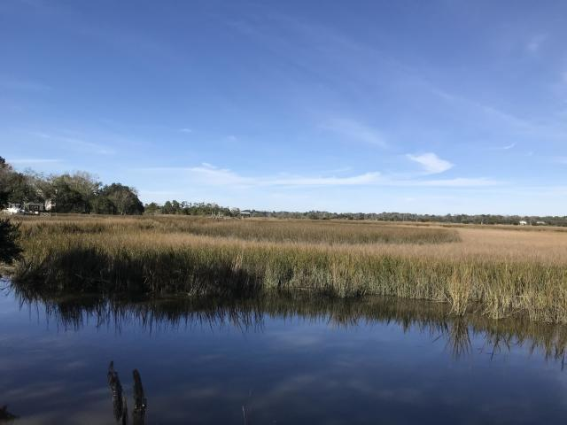
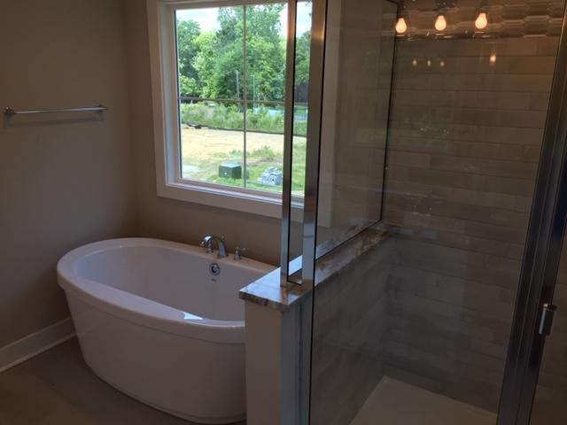
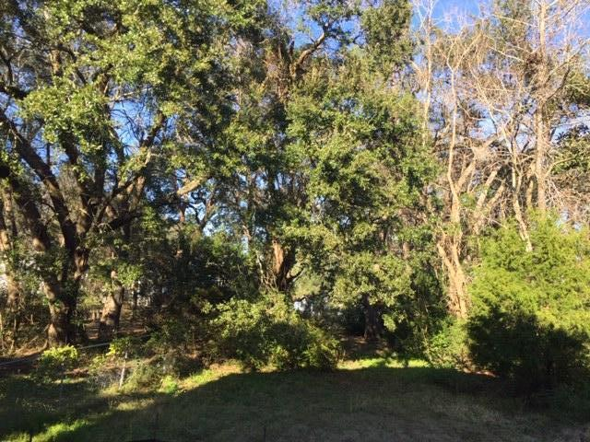
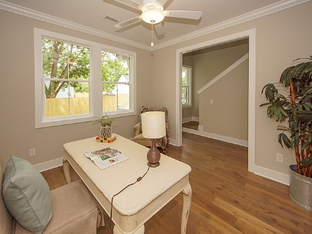
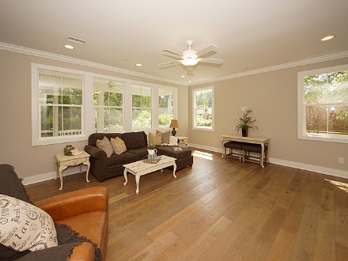
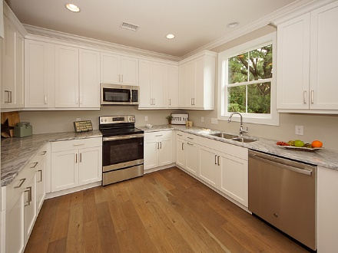
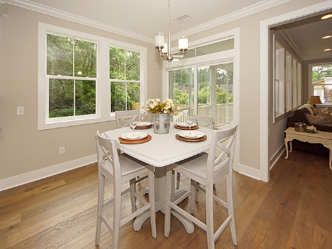
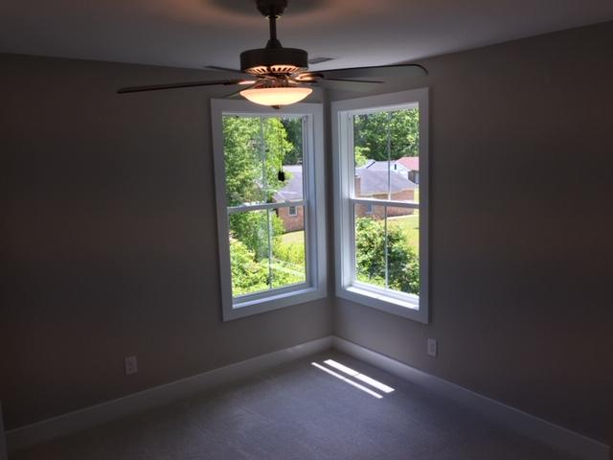
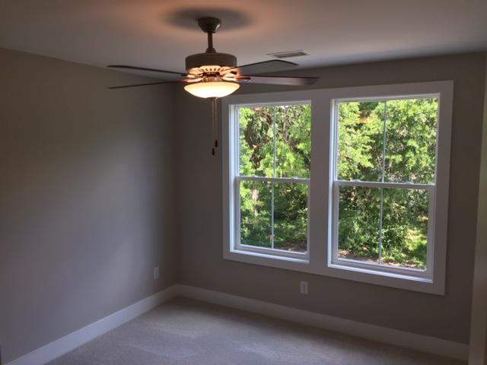
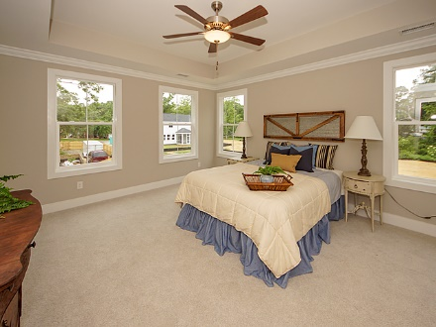
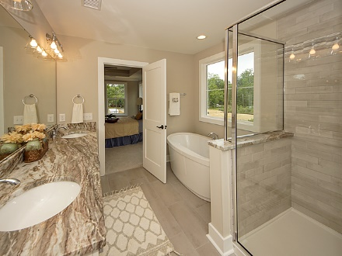
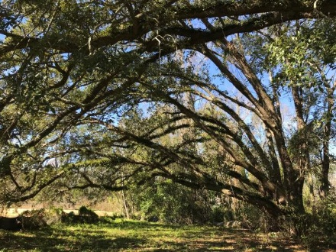
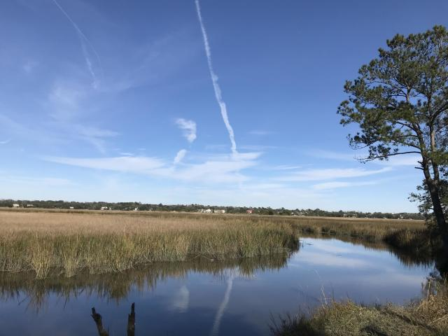




$2k Agent Bonus Offered For West Ashley New Home! GO & SHOW!!
3219 Pecan Orchard Way
MLS# 20016566
$355,000
4 Bedrooms :: 3½ Baths :: 2,081 sf
BRIGHT & OPEN NEW CONSTRUCTION in the heart of West Ashley! Featuring 4 bedrooms and 3.5 bathrooms, this home is convenient to shopping, dining, Downtown and I-526! Large open spaces with tall 9' ceilings and tall windows. Beautiful crown molding downstairs! Hardwood Floors are throughout the home except for in the bedrooms and bathrooms. The kitchen features beautiful Quartz Countertops as can be found at the master bathroom dual vanity. Elegant Granite Countertops highlight the secondary bathrooms. The master bedroom features an elegant tray ceiling & large walk-in closets. Relax in the tiled shower and garden tub in the master bath. Enjoy evenings on the screened porch overlooking the pond and Grand Live Oaks. There is a gas-log fireplace that serves as an anchor centerpiece to the living room. Strong cement fiber siding with "Board & Batten" accents make the exterior classy and durable. Tankless H20 heater! Termite bond in place! This home is a stone's throw from the public boat ramp, which is very quick access to the Ashley River! 4 more home sites are available! Builder offers other plans to choose from, OR bring your own plans and builder will build your house for you!
$2K AGENT BONUS BEING OFFERED FOR AN ACCEPTABLE OFFER RATIFIED BEFORE THE END OF JULY!
Eric Draper
(843) 442-7118
eric.draper@gmail.com
Jon Moore
(843) 732-3365
jon@charlestonrealestategroup.com
www.charlestonrealestategroup.com
Charleston Real Estate Group | 443 Folly Road | Charleston, SC 29412

