Slide 1
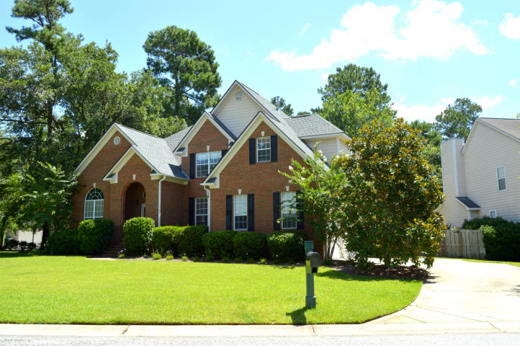
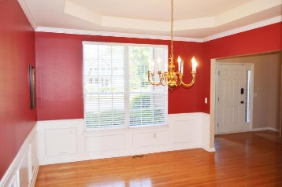
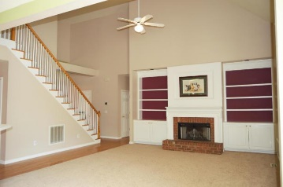
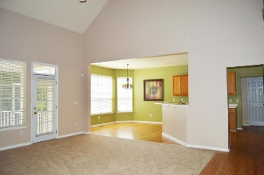
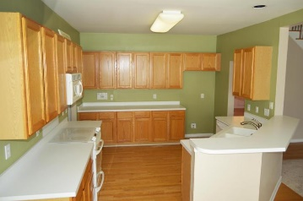
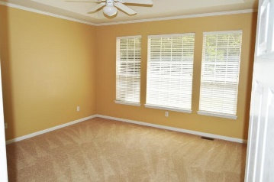
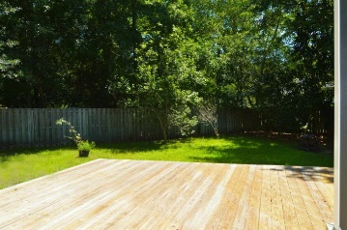
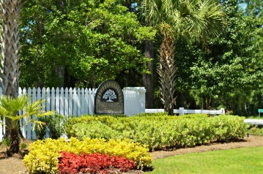
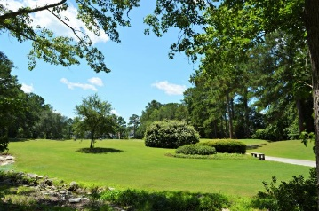


321 Club View Road
Summerville, SC 29485
MLS# 17017884 ~ $310,000
Open House Lunch ~ Friday, Oct 3 from 11 - 1
Handyman Special… Bring your hard hats!
BROKER OPEN HOUSE TUESDAY FROM 11-1
Broker Open House, 11-1 on Tuesday 10/10
Lunch and light refreshments provided. Enter your business card to win a $50 Visa gift card.
Come out and view this executive home in Legend Oaks featuring a master down, large lot and open floor plan.
Please RSVP to Hillary Jones at hillaryjones@sc.rr.com
Diana Johnson
(843) 345-6485
djohnson@carolinaone.com www.ahomeincharleston.com
Hillary Jones
(843) 709-4666
hillaryjones@sc.rr.com | www.hillaryjoneshomes.com
Carolina One Real Estate | 1530 Old Trolley Road | Summerville, SC 29485

