Slide 1
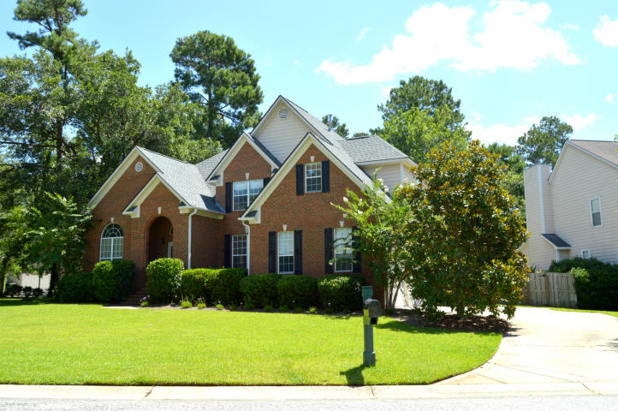
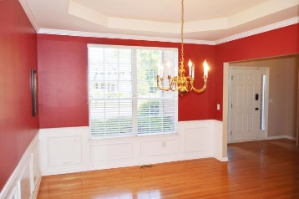
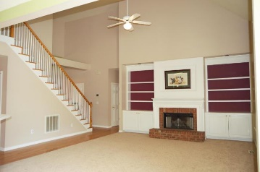
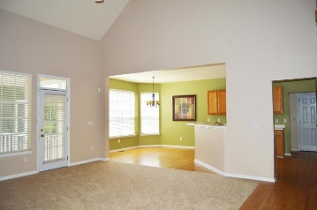
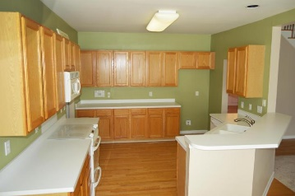
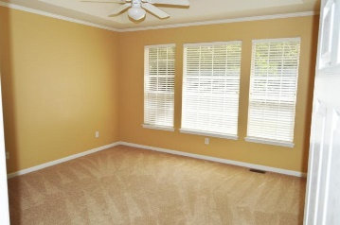
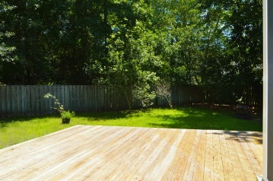
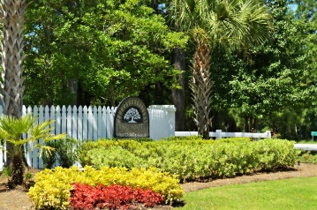
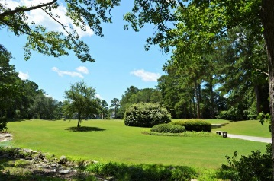


321 Club View Road
Summerville, SC 29485
MLS# 17017884 ~ $310,000
Open House Lunch ~ Friday, Oct 3 from 11 - 1
Handyman Special… Bring your hard hats!
New Price! Must See In Legend Oaks!
Traditional low country home with master down in Legend Oaks at a HUGE value! Home features hardwood floors throughout most of the downstairs and brand new carpet. Open floor plan includes a light and bright kitchen open to the eat in area. You'll be wooed by the fireplace, built in book cases and soaring ceilings in the great room. The master bedroom has tray ceilings and an ample master bath. Awesome screened in porch is perfect for relaxing and the attached deck is the ideal place for b-bq's and hanging out. 3 additional bedrooms upstairs are well appointed and perfect for guests or kids. The home is flanked by mature oak trees and a grand lawn. This is a MUST SEE at this price!
Diana Johnson
(843) 345-6485
djohnson@carolinaone.com www.ahomeincharleston.com
Hillary Jones
(843) 709-4666
hillaryjones@sc.rr.com | www.hillaryjoneshomes.com
Carolina One Real Estate | 1530 Old Trolley Road | Summerville, SC 29485

