Slide 1
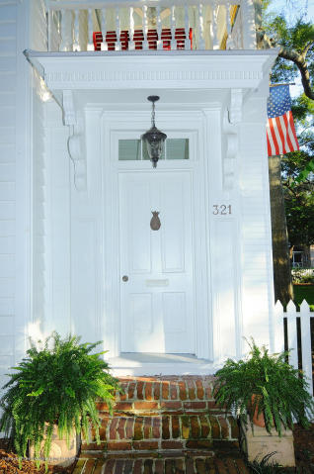
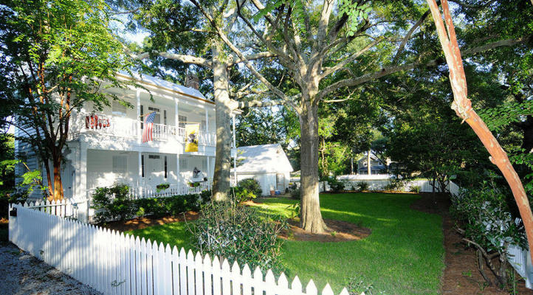
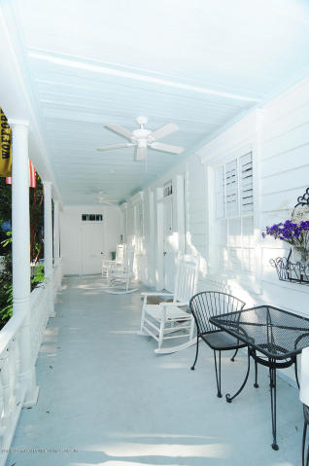
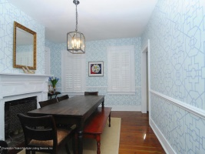
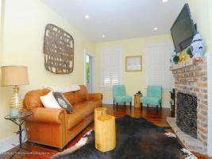
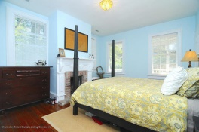
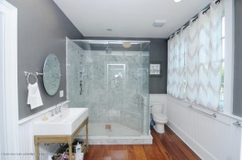
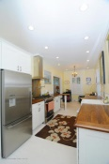
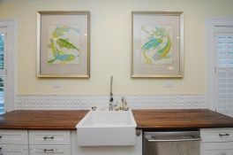
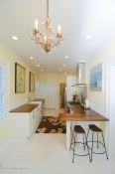
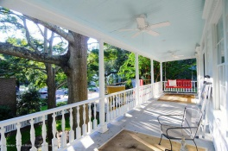
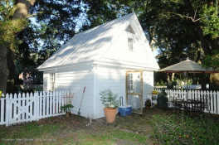
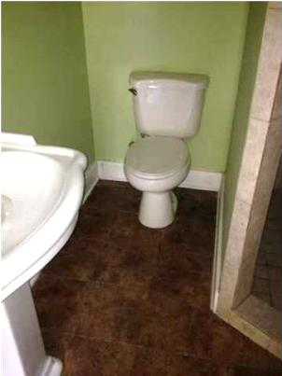
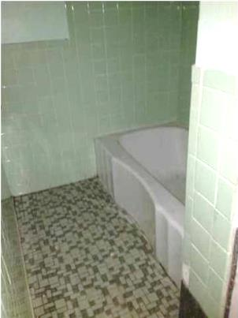
Old Village Price Reduction
321 King St ~ Mt Pleasant ~ MLS# 14027162 ~ $769,000
Gorgeous total renovation of 1892 Charleston Single home with Carriage house located on a corner lot in the heart of the Old Village. Renovations too extensive to list, but some highlights include: Refinished original heart pine floors on the 1st and 2nd floors; Pine white washed kitchen floors; Basket weave tile in guest bath with refinished clawfoot tub. Master bedroom boasts reclaimed heart pine floors, 6 foot marble shower, duel restoration hardware sinks, and large walk in closet. Additional updates include new wiring/electric paneling, Rinnai tankless hot water heater and 2 new HVAC systems and duct work. New metal roof (sealed and painted), new siding and new windows. Lot behind house can not be built on, so will always remain a green space.
Daniel B Morrison
trey@landsouthofcharleston.com
Mobile 843-697-6849
Land South of Charleston, LLC | 409 King St | Charleston, SC 29403

