Slide 1
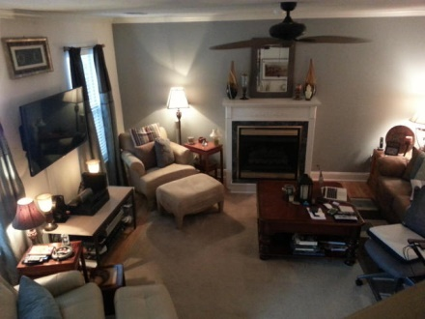
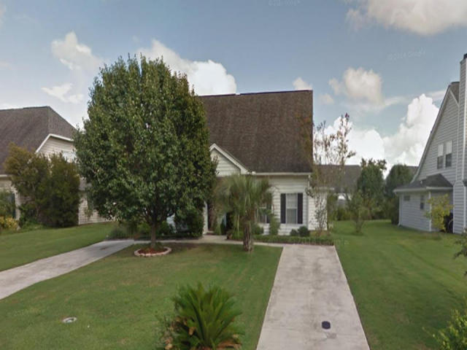
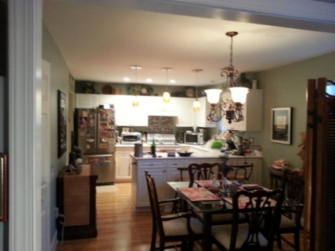
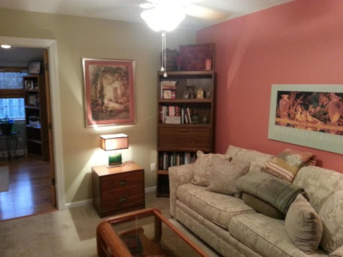
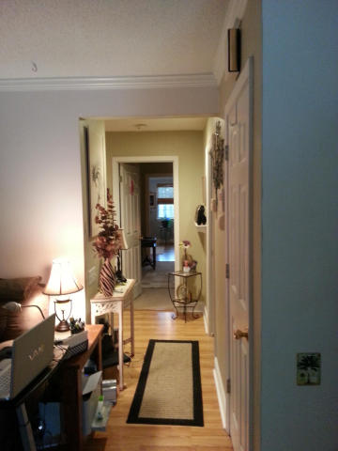
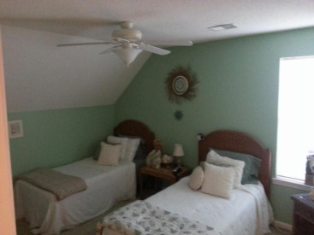
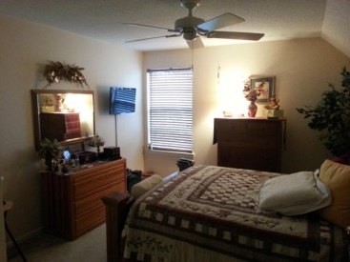
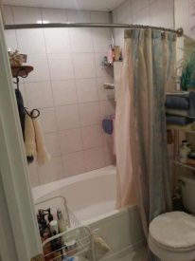
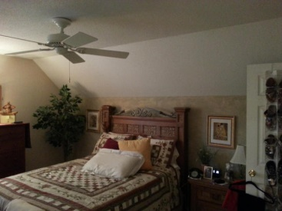
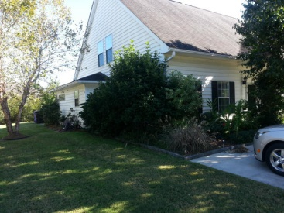
UPGRADES! LOCATION! PRICE!
3221 Queensgate Way
The Gates of Park West
Mount Pleasant, SC 29466
MLS# 14028003 - $197,900
This wonderful town home located in Park West has been meticulously cared for by the only owner. A large bonus room was added on in 2009 that can serve as a bedroom, office, or family room. Two nice sized bedrooms are located upstairs, and there is a master suite located downstairs. A nice family room with fireplace greets you upon entry. The upgraded kitchen features upgraded appliances, lights, and flooring. The beautiful floors and upgraded ceiling fans make this house feel like a home. This home is also located near top-rated schools and features the lowest HOA fees you will find in Mt. Pleasant. The fenced in patio is perfect for entertaining or relaxing. Don’t miss this opportunity!!
Mia Rooks
843-637-9728
kwrealtormia@gmail.com
Keller Williams Realty Charleston | 496 Bramson Ct Ste 200 | Mt. Pleasant, SC 29464

