Slide 1
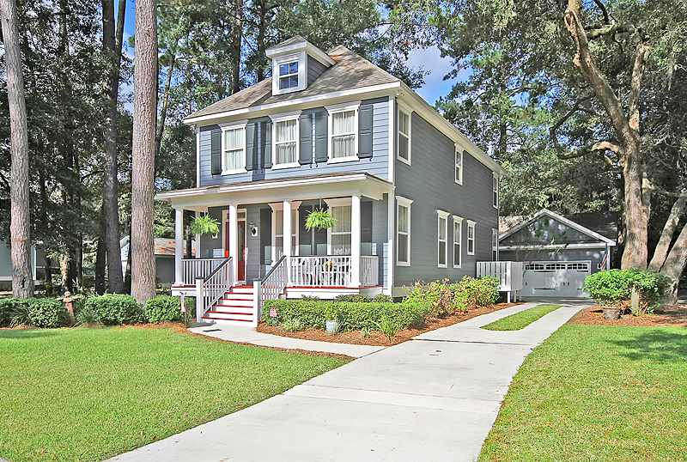
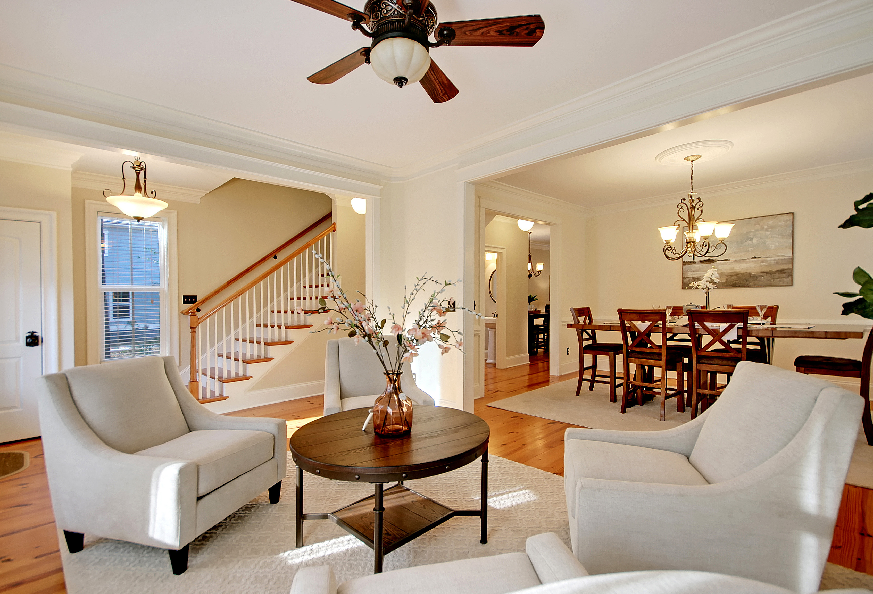
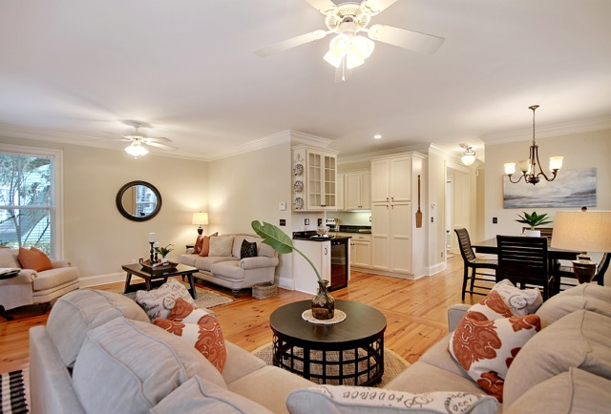
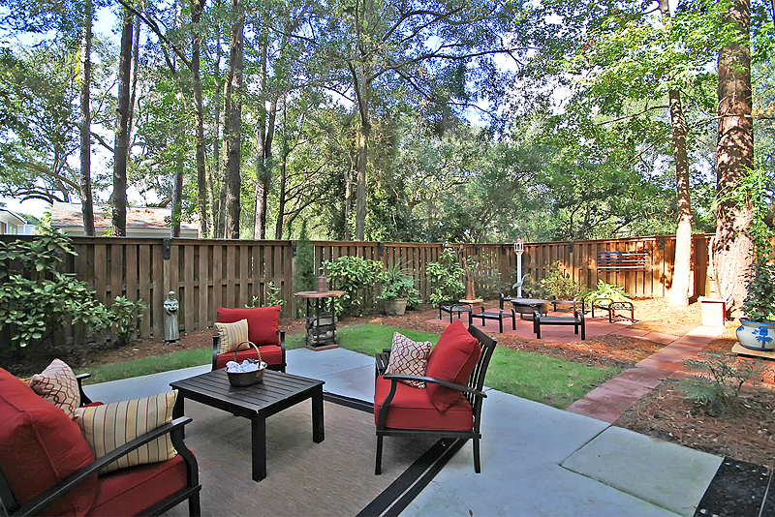
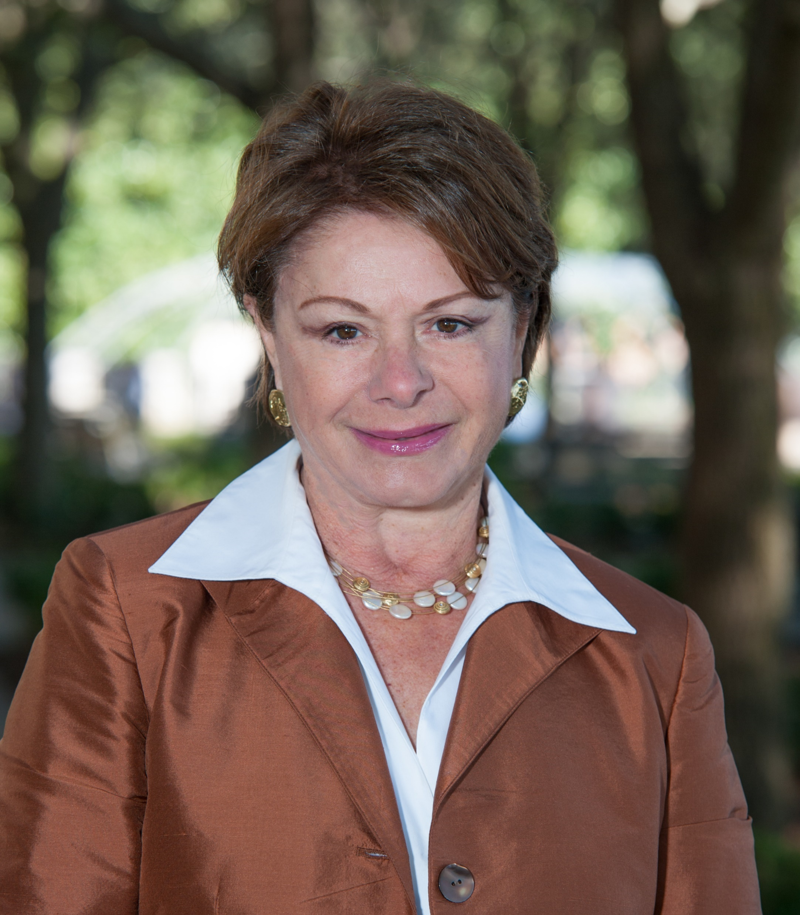

3222 Johnstowne Street Johns Island SC
Offered at $425,000 Reduced to $421,000
3 Bedrooms
2.5 Baths
2 Car Garage
Fenced Yard
2,304 sq ft home
MLS® #18024426
Open House
Sat. 1:00 pm - 3:00pm
Sun. 1:00 pm – 3:00 pm
More Detail
Beautifully maintained, spacious three bedroom, 2.5 bath home in Kiawah River Estates minutes from Beachwalker Park Beach, Kiawah Island and Seabrook Island. This classic, traditional Charleston 2-story home offers lots of living space with a formal living room, dining room and large family room with gleaming heart of pine floors. The second level has a spacious Master Bedroom with a huge closet and an en-suite bath. The remaining bedrooms are large enough to accommodate Queen sized beds. There is an additional bath and a laundry room on this level. A detached two car garage, a private fenced back yard with a charming patio, is perfect for outside entertaining and enjoyment. Kiawah River Estates is an established gated golf community built around Kiawah Islands’ Oak Point Golf Course.
Presented by: Toula DiGiovanni
843.469.7555
toulad@nvrealtygroup.com
www.toula.nvrealtygroup.com

