Slide 1
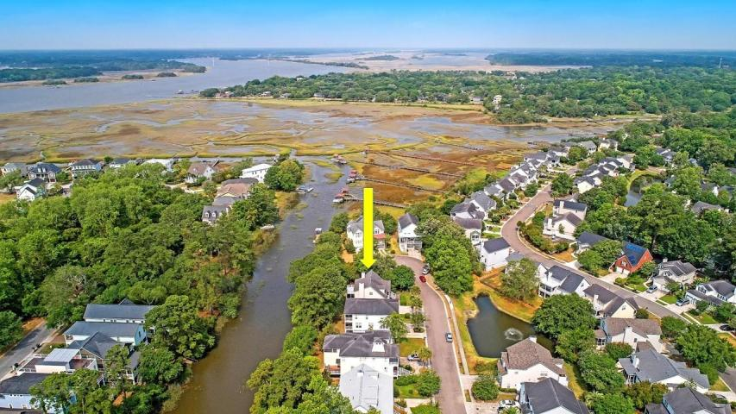
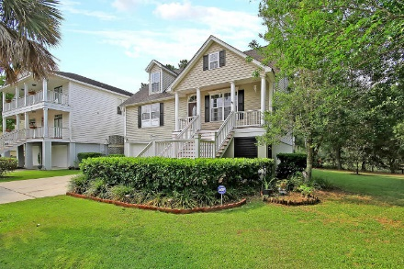
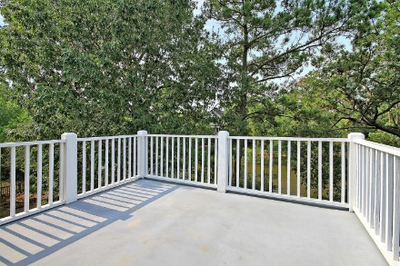
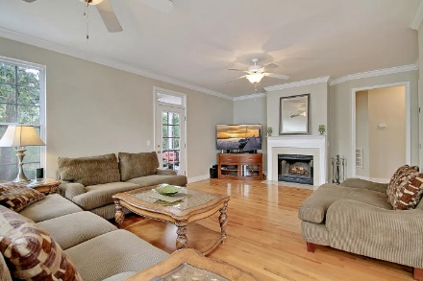
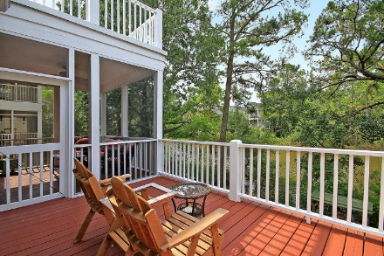
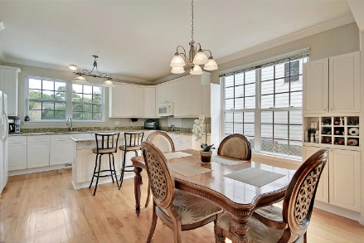
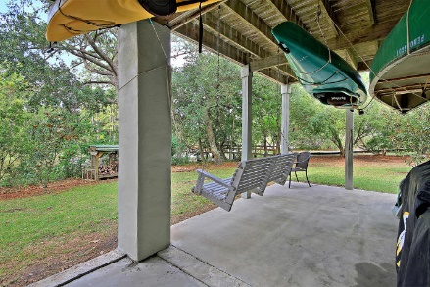
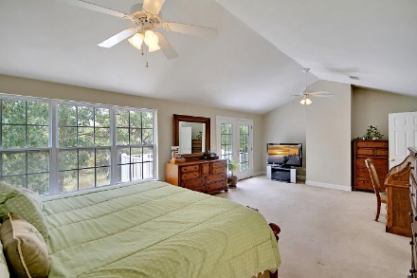
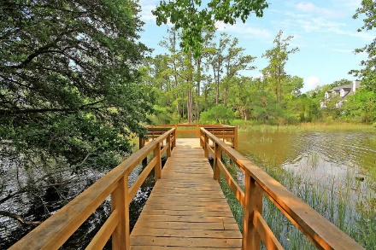
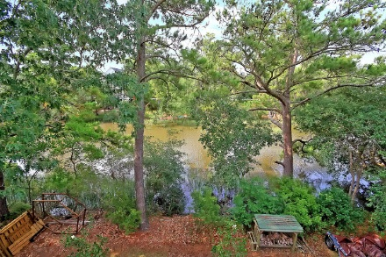
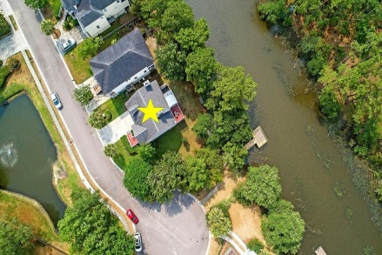

Easy Access to the Stono River
Price Reduced
For Quick Sale
Open House Saturday 12-3
322 Arlington Drive
Stone Creek ~ Charleston, SC 29414 ~ MLS# 19016871 ~ $499,900
Lowcountry living on the marsh and tidal creek with spectacular sunset views. Launch your boat, kayak, or canoe right from your backyard! Conveniently situated on a quiet culdasac next to the community fishing/crabbing dock, this beautiful, elevated home backs to a tidal creek that leads directly to the Stono River. Spacious open floor plan with views of marsh & tidal creek from about every room. Enjoy the spectacular views from the lower levels' patio with jacuzzi and swing; the main levels balcony with screened-in porch; and the private balcony overlooking the water off of the master bedroom. From the covered front porch you can enjoy the view of the pond with water fountain right across the street. With hardwood floors, a wood-burning fireplace, beautiful crown molding in the dining and family rooms and windows across the back allowing in tons of natural daylight, this home is a dream. Boasting a ton of storage along with a 3.5 car garage with a workshop area and a location that is hard to beat. Stone Creek is an intimate neighborhood conveniently located in the heart of West Ashley. This home is conveniently located to shopping, dining, 526 and downtown Charleston. Do not miss out on this amazing home!
Additional features include:
Fresh paint inside and out
Surrounded by wildlife and birds
Porch swing on the covered patio
Located at the end of the cul-de-sac
Huge Master bedroom with a cathedral ceiling and wall of windows
Large walk-in master closet with custom built-ins
Master bath features a dual vanity, garden tub and walk-in shower
All new stainless steel kitchen appliances are being installed Separate irrigation meter with sprinkler system
Incredible attic storage space
Storage shed in backyard
Dock permit in hand
Book your showing soon!
Katie Wishneff kwishneff@mattoneillteam.com 843-870-8784

