Slide 1
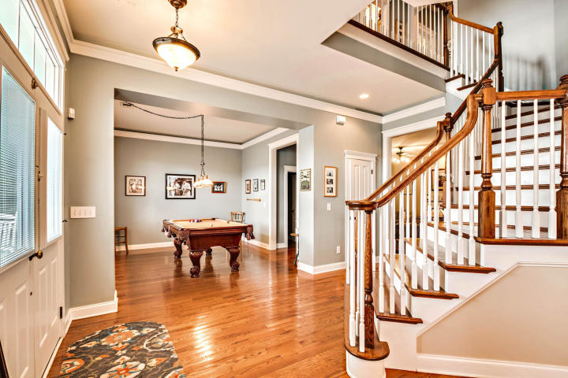
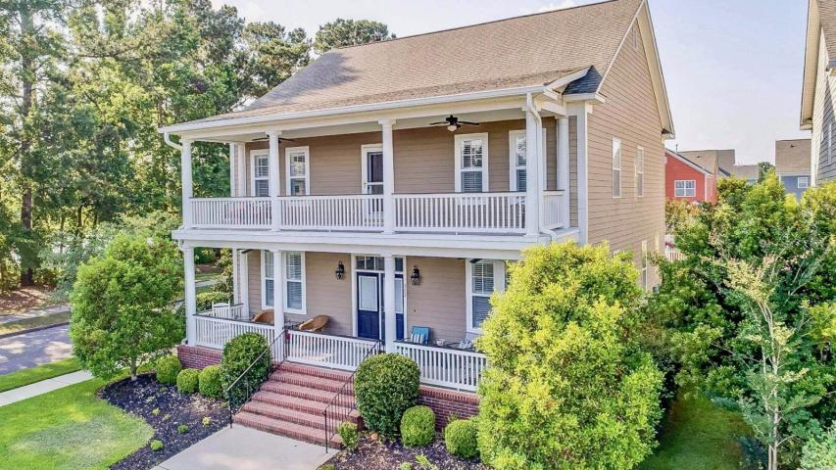
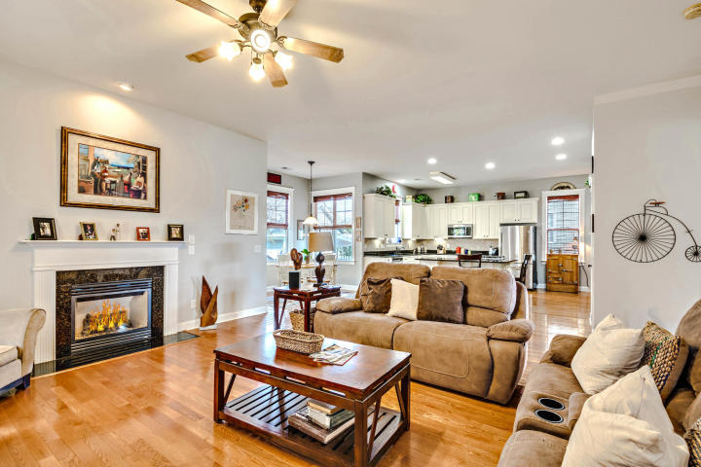
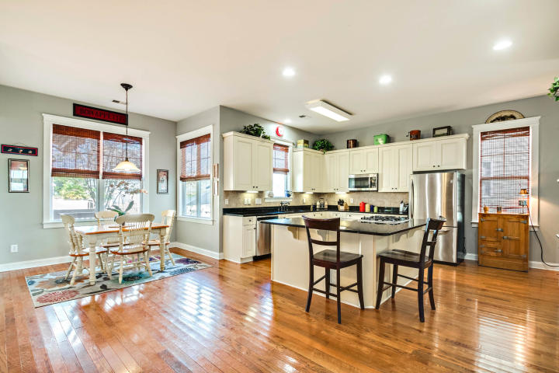
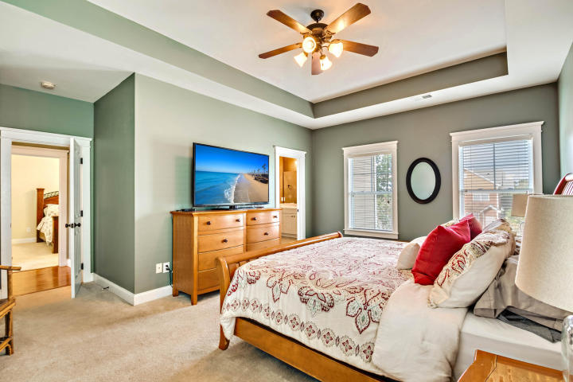
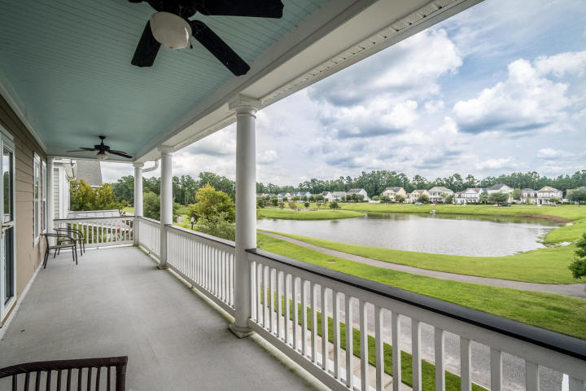
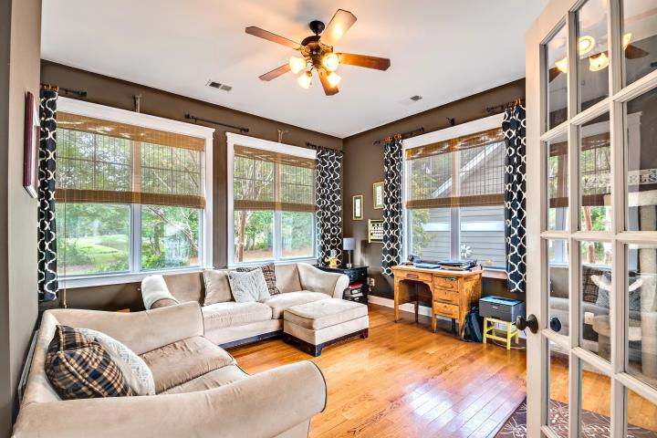
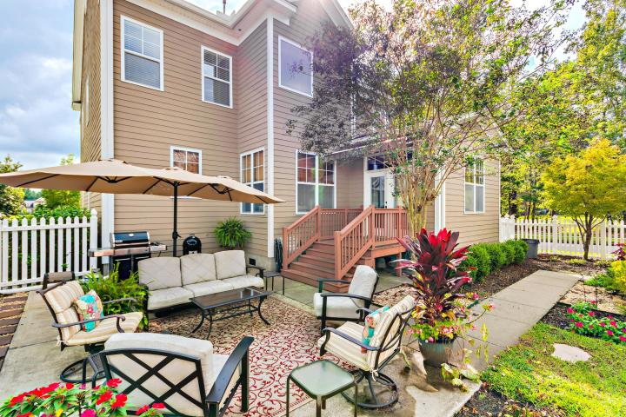
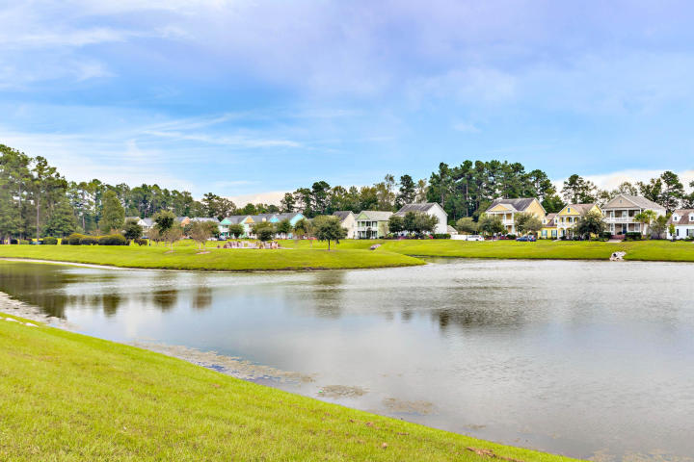


Agent Bonus Is Additional $1,000.00 Commission
Must Have Ratified Contract And Close By Sept 1, 2019
322 Germander Avenue
White Gables | Summerville, SC 29483
MLS# 19015098 | $339,900
Welcome home! This former Saussy Burbank model home is the best house on the block! With over 100k in original builder upgrades, you are bound to be impressed! This home sits on a large corner lot and it is surrounded by mature, colorful landscaping. Relax on one of the spectacular double porches and enjoy the serenity of nature and the breathtaking water views. Once you step inside the home, the grand staircase, gleaming hardwood floors, and numerous upgrades will sweep you away. From plantations shutters to beautiful crown molding in the dining and formal living room, to the upgraded chef's kitchen including double ovens, 42 inch cabinets, and SS appliances, this home is sure to impress! There is an abundance of counter space including the granite L-shaped island with gas cook top and seating for 6. The kitchen is a chef's delight and overlooks the large family room and spacious sunroom making this home perfect for entertaining family and friends. Up the home's spectacular staircase, you will find 4 bedrooms and two full baths. The master suite is well appointed with tray ceiling, dual vanities, separate shower and garden tub. Outside you will find a charming courtyard, additional patio, and lovely gardens all fenced for privacy and enjoyment of your family and pets. The owner has also installed a custom matching sliding gate on the front porch, so that you can keep your children or furry friends safe while enjoying the beautiful weather and exquisite views. The 20x24, oversized garage is perfect for parking and storage and includes custom shelving as well as an additional parking pad. Do not miss your opportunity to see this magnificent home! White Gables is a well sought after family friendly neighborhood with an array of amazing amenities including: community pool, tennis courts, basketball court, boat/RV storage area, soccer field, and miles of beautiful walking trails. It is also located in the highly desired Dorchester 2 school district. Call today to book your appointment. This home won't last long!
Jamie Pfaffenbichler
843-460-7299
jamie.pfaffenbichler@gmail.com
Boykin Real Estate | 5401 Netherby Ln, Ste 301 | N Charleston, SC 29420

