Slide 1
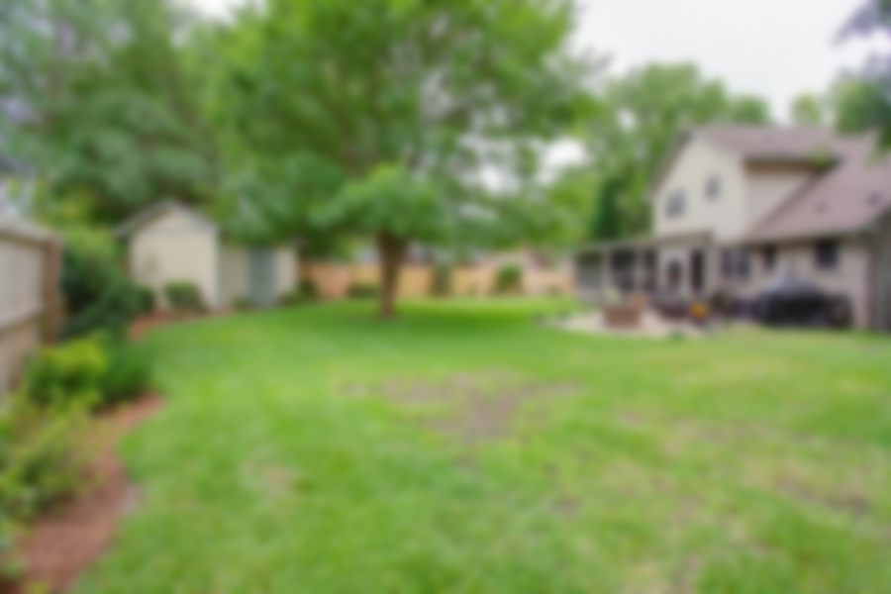
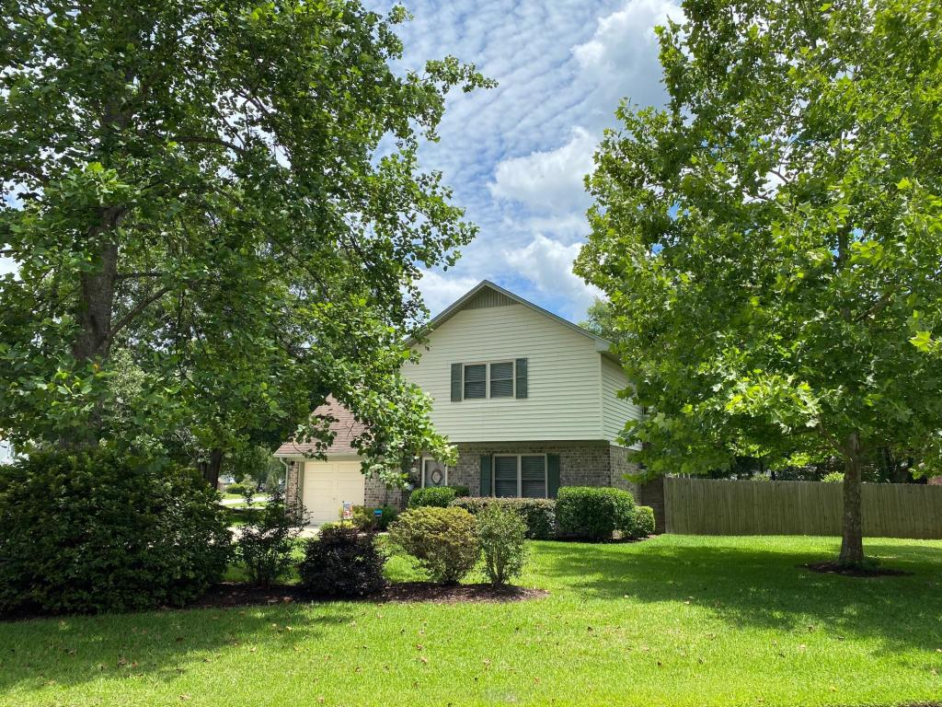
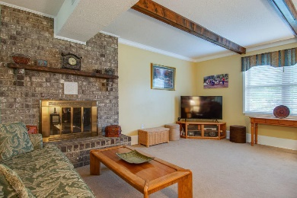
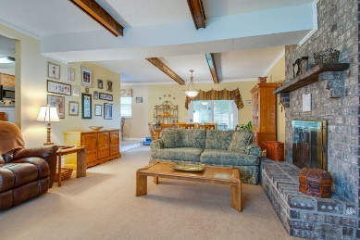
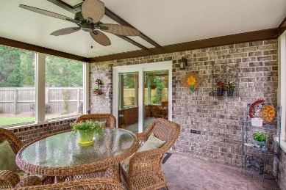
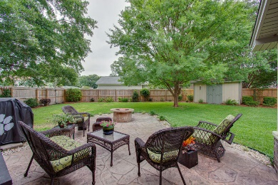



LOVELY HOME GREAT OUTDOOR SPACE TOO!
322 Huntsman Drive
Foxborough | Goose Creek, SC 29445
MLS# 20017049 | $255,000
Charming Two Story Home, on a Large corner lot, with great outdoor living space, don't miss the photos! Three Bedrooms and two and one half baths. All bedrooms are on the second floor. The living area has a nice wood burning fireplace and the eat in area overlooks the screened in porch, also perfect for dining and entertaining. The screened porch leads out onto the patio with a fire pit. There is a very nice storage/work shed out back, fully fenced in yard, also has a double gate for pulling in a boat and the yard is spacious enough to keep a boat! Close to a Variety of Shopping and Restaurants as well as schools. NO HOA, No Flood Insurance required!
Jan Miller
Cell (843) 345-9719 | Jan.Miller@nvrealtygroup.com
NV Realty Group | 91 Broad St, Ste A | Charleston, SC 29401
janmiller.nvrealtygroup.com

