Slide 1

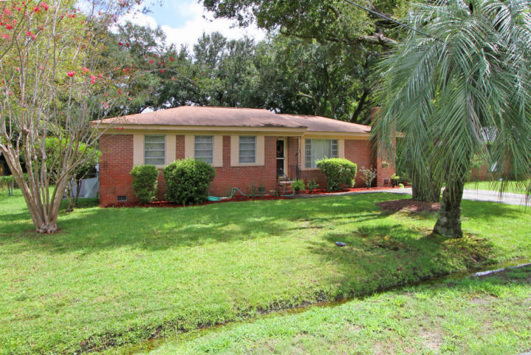
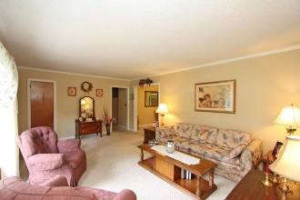
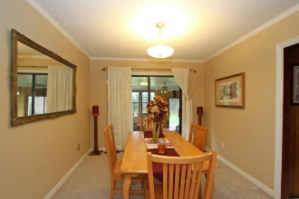
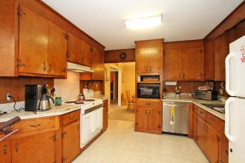
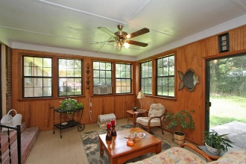
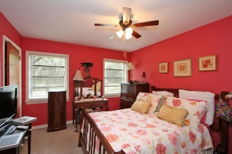
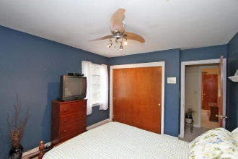
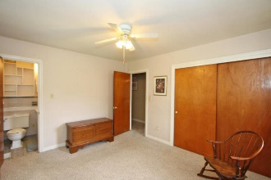
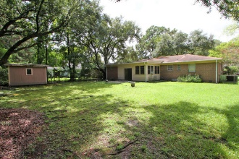


322 Jean Street Wappoo Shores Charleston, SC 29407 MLS# 15022722 $245,000
Great Older Home in Wappoo Shores!
Great fifties Wappoo Shores brick rancher with three nice room additions. Four bedrooms total, two full baths, den with built-in eating area and cabinetry, large wood-burning fireplace. Florida Room at the rear. Separate Living room and Dining Room. Hardwood floors under carpet never exposed. House is well maintained and ready for updating. A renovated version of this house without the additions just sold a block away for $319,000!
Charlie Smith
(843) 813-0352
csmith@csarealestate.com
www.csarealestate.com
CSA Real Estate Services 339 Cabell Street
Charleston, SC 29407-6928

