Slide 1

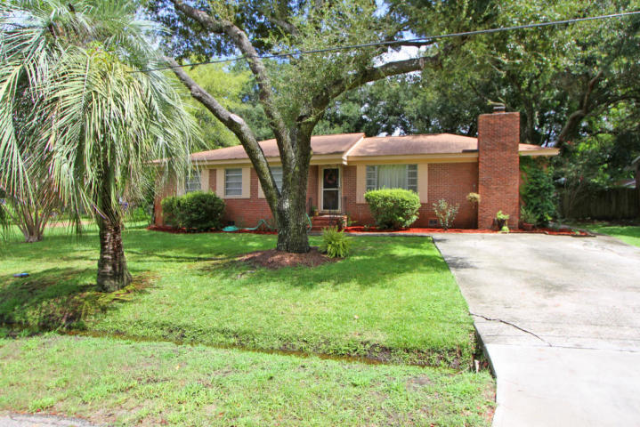
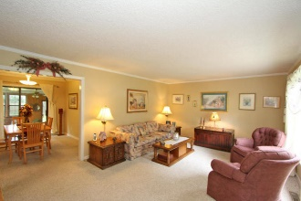
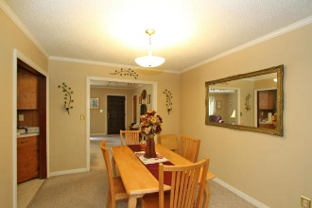
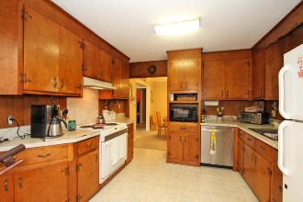
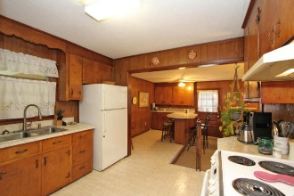
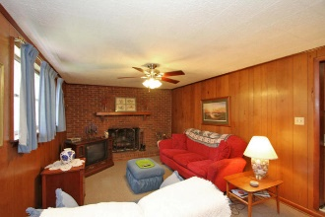
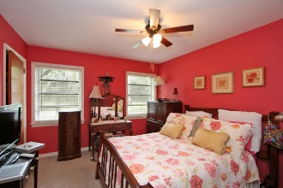
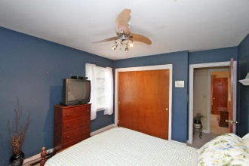
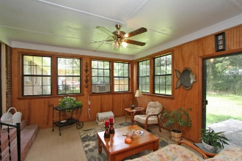
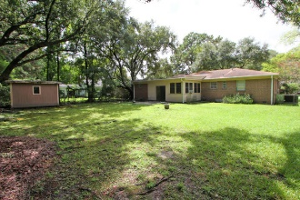


322 Jean Street
Wappoo Shores
Charleston
MLS# 15022722
$235,000
West Ashley under $240k…
Over 2,000sf of living area!
NO FLOODING IN THE RECENT STORMS!
Great fifties Wappoo Shores brick rancher for a little over $100/sf. Four bedrooms total, two full baths, den with built-in eating area and cabinetry, large wood-burning fireplace. Florida Room at the rear. Separate Living room and Dining Room. Hardwood floors under carpet never exposed. House is well maintained and ready for updating. A renovated version of this house without the additions just sold a block away for $319,000! There is an assumable flood policy for $230K in coverage for less than $500/year!
Charlie Smith
(843) 813-0352
csmith@csarealestate.com
www.csarealestate.com
CSA Real Estate Services
339 Cabell Street
Charleston, SC 29407-6928

